Slide 1
Key Issues in Reproductive Technologies Disability Rights Leadership Institute on Bioethics April 26, 2014
Silvia Yee, Disability Rights Education & Defense Fund
Marcy Darnovsky, Center for Genetics & Society

Slide 2
Common images of GATTACA
The following slide shows two advertising images of the movie GATTACA. The first shows the title of the movie and the words“There is no gene for the human spirit.” In the center of the title, two figures are running down a spiral staircase.
The other image is the DVD case for the film. The three main characters, played by Uma Therman, Ethan Hawke, and Jude Law, are portrayed on the cover. The double helix structure of DNA runs vertically between their faces.

Slide 3
Common images of GATTACA

Slide 4
Disability in GATTACA
The following slide shows two scenes from the movie GATTACA. The picture on the left depicts a man in a wheel chair gazing up through the center of a helix-shaped staircase.
The second image is in black and white of the same man in the wheelchair in the same room with the helical staircase, but here he is in conversation with another man in a reclining chair.

Slide 5
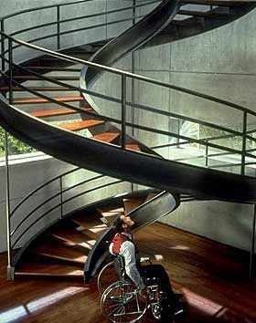
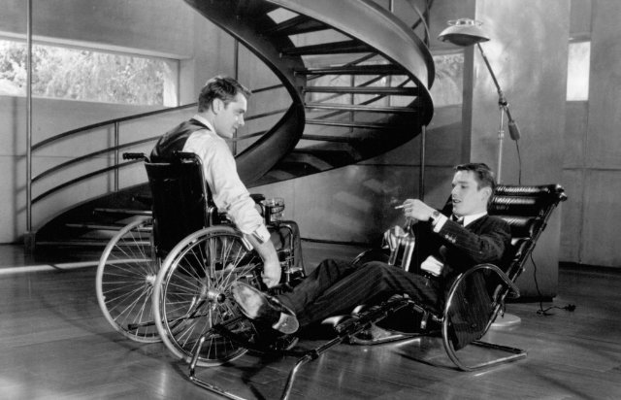
Disability in GATTACA

Slide 6
“Valids” and “in-valids”
The following slide shows another scene from GATTACA. It appears to be a certification of some sort, perhaps on a computer screen. A man’s face is at the left, with the words “IN-VALID,” written in capital letters, next to it. Below is a 14-digit number, perhaps an ID number, and a boxed warning with the words “UNAUTHORIZED SPECIMEN,” also in capital letters.

Slide 7
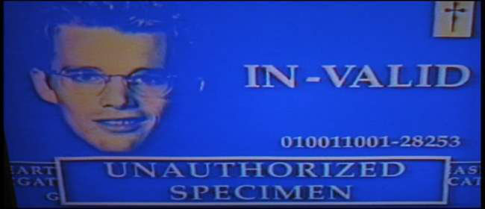
“Valids” and “in-valids”

Slide 8
Embryo screening
The next slide is a sketch of pre-implantation genetic diagnosis or PGD. The embryo, shown as an oval, was created outside the body by combining egg and sperm in a petri dish, and allowed to grow and divide for 3 days until what as a single-celled zygote became an 8-celled embryo. One of the 8 cells is physically removed through a surgical opening and genetically analyzed. It is tested for the presence or absence of certain genes, typically in order to “de-select” disfavored conditions ̶ that is, those considered disabilities.
In this example, the embryo is being tested for the mutation associated with muscular dystrophy. The affected embryo (depicted with a plus sign) is discarded; the embryo without the mutation, shown with a minus sign, is transferred into a woman’s uterus.

Slide 9
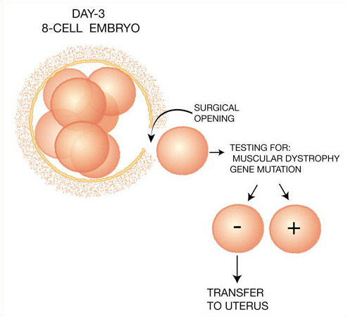
Embryo screening

Slide 10
23andMe inheritance calculator
The next slide shows drop-down menus that are part of a patent application recently awarded to the direct-to-consumer genetic testing company 23andMe. Under the heading “I prefer a child with” are menus that allow you to choose “low risk” or “high probability” of colorectal cancer, congenital heart disease, breast cancer, eye color (blue, green or brown), or ability to taste bitter.
The bottom of the display shows a table of three “preferred donors,” ranked according to each one’s risk of colorectal cancer (from .01% to .02%), congenital heart defect (.005% to .006%), and probability of green eyes (50% to 65%). The “overall score” of Donors A, B, and C are also shown, ranging from 60 to 80.

Slide 11
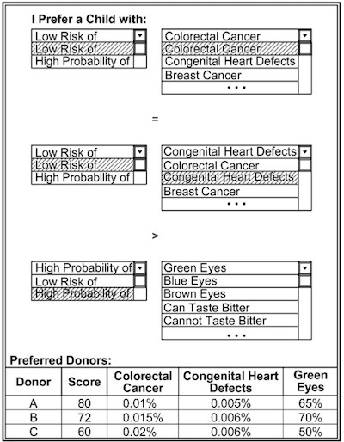
23andMe inheritance calculator

Slide 12
“You’ll pass on more than just your freckles”
The next slide shows an image from the 23andMe website: a smiling family, with the only person in focus a young boy with freckles. Below his face is the text, “Looking to start a family? You’ll pass on more than just your freckles.”
The menu options at the bottom of the screen are as follows: “Why get tested?,” “Test for 40 plus inheritable traits,” “Explore traits like eye color and freckling,” “How 23andMe works,” and “Personal genome service.”

Slide 13
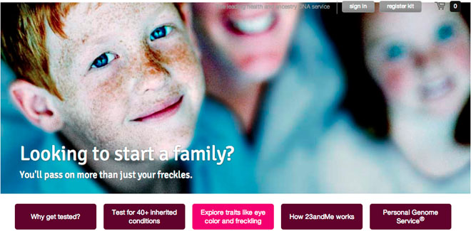
“You’ll pass on more than just your freckles”

Slide 14
GenePeeks
The next slide shows an image from the website of the company GenePeeks. Next to the company logo is an adorable baby in a diaper, who looks like he or she might be African American, and who is certainly precocious (which we can tell because he’s playing with alphabet blocks).
The phrase “Protecting our children” is in large type. The rest of the text reads, “It’s what gets us up in the morning (and keeps us up at night). A revolution in the life sciences has made it possible to keep our kids healthy with tools that were unimaginable even a few years ago.”

Slide 15
GenePeeks

Slide 16
Early fetal gene tests
The next slide shows an image of an extremely frightened baby, as depicted by wide eyes and a tucked lower lip. The unsettled child has a bar code across its forehead.

Slide 17
Early fetal gene tests

Slide 18
MaterniT21 Plus
The next slide is a web page from the company Sequenom, which calls its early fetal gene test MaterniT21 Plus.
We see a white couple in their late thirties or early forties over the doctor’s shoulder – he’s a blurred white coat in the foreground. They look concerned but reassured. Below them is a description of the product MaterniT21, described as “Clear,” “Convenient,” and “Compelling.”

Slide 20
Natera
The next slide shows another webpage, this one from an early fetal gene testing company called Natera. The most visible words are “The Next Generation of Prenatal Testing.”
The home page banner features a sun rising over a field of flowers. When you look closer, the sun is actually a clump of cells. In the sky is the company’s motto: Conceive. Deliver.

Slide 21
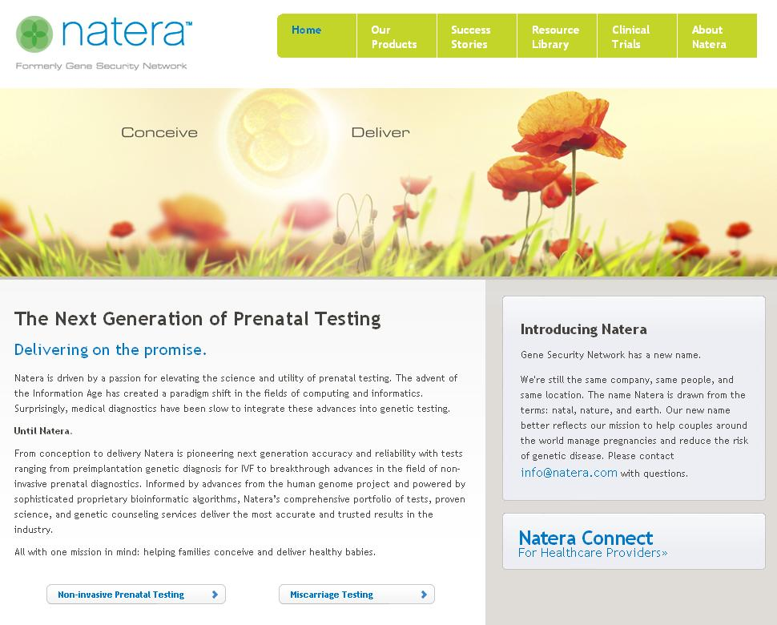

Slide 22
Disability Rights Education & Defense Fund
dredf.org

Slide 23
Center for Genetics and Society
geneticsandsociety.org
biopoliticaltimes.org

