Slide 1
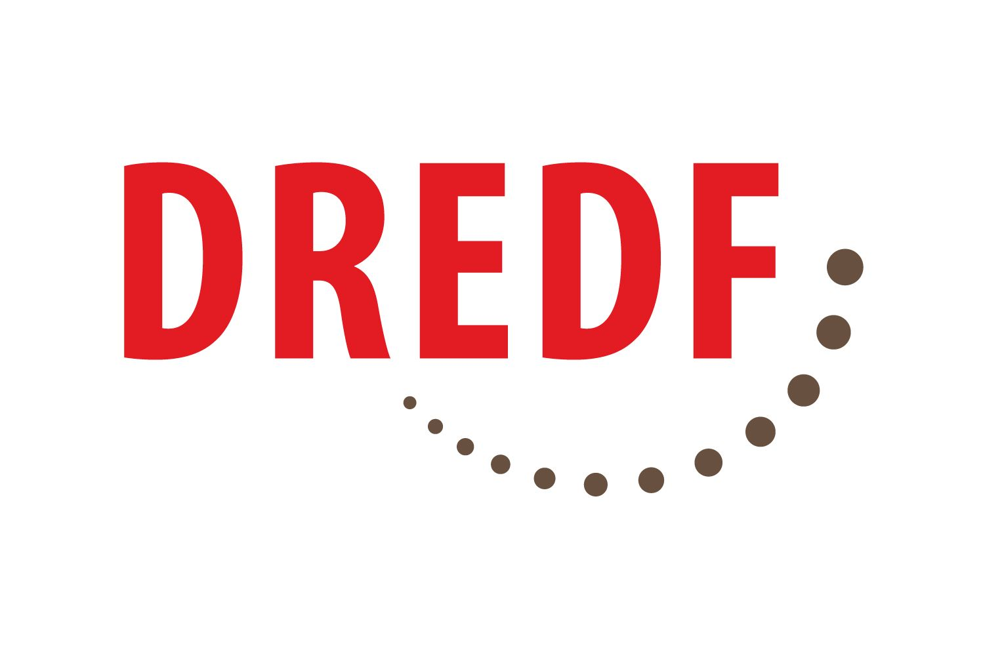
Marriage Penalties in SSA Benefits
Barriers to Marriage and Relationship Equality Faced by SSA Beneficiaries

Slide 2
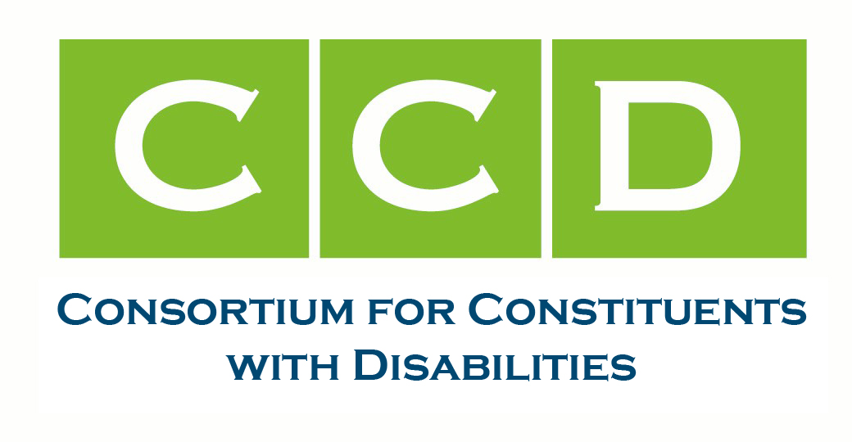
CCD Working Group on Marriage Equality
American Civil Liberties Union
The Arc
Autistic Self-Advocacy Network
Autistic Women and Nonbinary Network
Cure SMA
Disability Rights Education & Defense Fund
Justice in Aging
National Committee to Preserve Social Security and Medicare
National Disability Rights Network
National Down Syndrome Congress
National Down Syndrome Society
National PLAN Alliance
Paralyzed Veterans of America
Spina Bifida Association
United Spinal
And more …

Slide 3
Marriage & Relationship Penalties – Overview
Two SSI beneficiaries in relationship
Married : 25% cut in stipend and asset limit
Unmarried but found “holding out”: 25% cut in stipend and asset limit
Two people, one DAC beneficiary and one not (and not receiving another Title II benefit), in relationship – DAC benefits end with marriage
Two people, one SSI beneficiary and one not, in relationship
Married – “spousal deeming” of income and assets from non-SSI spouse to SSI spouse (affecting benefits)
Unmarried but found “holding out”: “spousal deeming” (affecting benefits)
Unmarried and no “holding out,” resources from non-SSI spouse can be “in-kind support and maintenance” (affecting benefits)

Slide 4
Two Married SSI Beneficiaries – 25% Cut
Under federal statute, two married SSI beneficiaries get a joint stipend and joint asset limit that is 25% lower than for two unmarried SSI beneficiaries
Stipend:
Two unmarried SSI beneficiaries: $841 + $841 or $1682 total
Two married SSI beneficiaries: $1,261 total
Asset Limit:
Two unmarried SSI beneficiaries: $2000 + $2000 or $4000 total
Two married SSI beneficiaries: $3000 total
Citations: 42 U.S.C. § 1382(a) & (b); https://www.ssa.gov/ssi/text-benefits-ussi.htm; https://www.ssa.gov/ssi/text-resources-ussi.htm

Slide 5
Two Unmarried SSI Beneficiaries “Holding Out” As Married – Same 25% Cut
SSA can decide that two SSI beneficiaries are “holding out” as married, even if the couple is not legally married
A finding of “holding out” means the couple is subject to the same 25% cut in stipend level and asset limit
Citations: 42 U.S.C. § 1382c(d)(2); 20 C.F.R. §§ 416.1806(a)(3), 416.1826(c), 416.1832(d)

Slide 6
“Holding Out” Inquiry Under POMS
Questions re “holding out” for two SSI beneficiaries living together:
What name or names are you known by?
How do you introduce the other person to friends, relatives, or others?
How is mail addressed to you and to the other person?
Are there any bills, installment contracts, tax returns, or other papers showing you as spouses?
Is the place where you live owned or rented by both of you or only one?
Not holding out if “obvious reason” to live together “other than as a couple”:
living together due to employer-employee relationship
living together “only for the purpose of sharing expenses”
Citations: POMS SI 00501.152; GN 00210.800; Form SSA-4178

Slide 7
Disabled Adult Child (DAC) Marriage Penalty
DAC beneficiaries:
disabled before age 22
child of insured parent who is deceased or currently receiving SSDI or Social Security retirement
DAC beneficiaries receive stipend, Medicare, pathway to Medicaid
DAC beneficiaries who marry lose DAC
Exceptions to rule: spouse is another DAC, a person receiving SSDI, a person entitled to “old age” SSA benefits (earliest age 62), or a person receiving another “secondary” Title II benefit; Note: SSI spouse is not within exception
Citations: 42 U.S.C. §§ 423(d)(1), (5), 1382(a), (b); https://www.hhs.gov/guidance/document/2002groups-deemed-be-receiving-ssi-medicaid-purposes

Slide 8
SSI Beneficiary Married to Non-SSI Spouse – “Spousal Deeming” of Income and Assets
SSI beneficiary married (or found “holding out”) to non-SSI spouse:
Portion of income of non-SSI spouse is allocated to SSI spouse
Countable assets of non-SSI spouse are allocated to couple
Benefits and eligibility affected
Countable assets of non-SSI spouse are allocated to the couple; if value exceeds $3,000, then SSI beneficiary no longer eligible
Example: bank account of non-SSI spouse holds $3,100
Citations: 42 U.S.C. § 1382c(f); 20 C.F.R. §§ 416.1163, 416.1165; POMS SI 01310.160, SI 00501.150

Slide 9
SSI Beneficiary Married to Non-SSI Spouse – “Spousal Deeming” (cont.)
Small income by non-SSI spouse – less than $1,000 a month (below the federal poverty level) – can cause SSI stipend to decrease
Modest income by non-SSI spouse – about $32,300 a year (less than half the US median) – brings federal portion of the SSI stipend to zero, which can make SSI beneficiary ineligible for Medicaid
Citations: 42 U.S.C. § 1382c(f); 20 C.F.R. §§ 416.1163, 416.1165; POMS SI 01310.160, SI 00501.150

Slide 10
In-Kind Support and Maintenance
If unmarried SSI beneficiary lives with non-SSI partner, contributions by non-SSI partner to household living can decrease benefits under In-Kind Support and Maintenance (ISM) rules. For example:
Household expenses paid by non-SSI partner can reduce stipend by up to one-third of FBR + $20 ($300.33 for 2022) under “Presumed Maximum Value” (PMV) rule
If SSI beneficiary lives with their partner and is not on the lease, SSA could find that SSI beneficiary does not pay their “fair share” of housing expenses and reduce stipend by one third under the Value of the One-Third Reduction (VTR) rule
Citations: 42 U.S.C. § 1382a(a)(2); 20 C.F.R. §§ 416.1130 – 416.1148; POMS SI 00835.000 et seq.; see also SI 00835.300; SI 00835.200

Slide 11
Poverty Rates of SSI and DAC Beneficiaries
More than 40% of SSI beneficiaries live below the federal poverty level
Nearly 36% of DAC beneficiaries live below the federal poverty level
SSI and DAC beneficiaries have highest poverty rates of all beneficiary groups
Citations: https://www.ssa.gov/policy/docs/rsnotes/rsn2015-02.html; https://papers.ssrn.com/sol3/papers.cfm?abstract_id=3507766

Slide 12
Medicaid = Access to Disability Supports
SSI provides Medicaid and DAC provides a pathway to Medicaid
Medicaid is the exclusive vehicle in our society for services and supports needed for people with significant disabilities, such as:
Primary and preventive health care
Medical services for illnesses and chronic conditions
Durable medical equipment including wheelchairs and lifts
Personal attendant care services and other , and other home- and community-based services
Supportive housing services and employment services
Medicaid is what enables many disabled individuals to be integrated members of their communities

Slide 13
Additional Harms Imposed by Marriage Penalties On Disabled Constituents
Limitations on forming families
Lack of social recognition of important relationships
Inability to engage in religious practices/conflict with religious beliefs
Disconnection from community

Slide 14
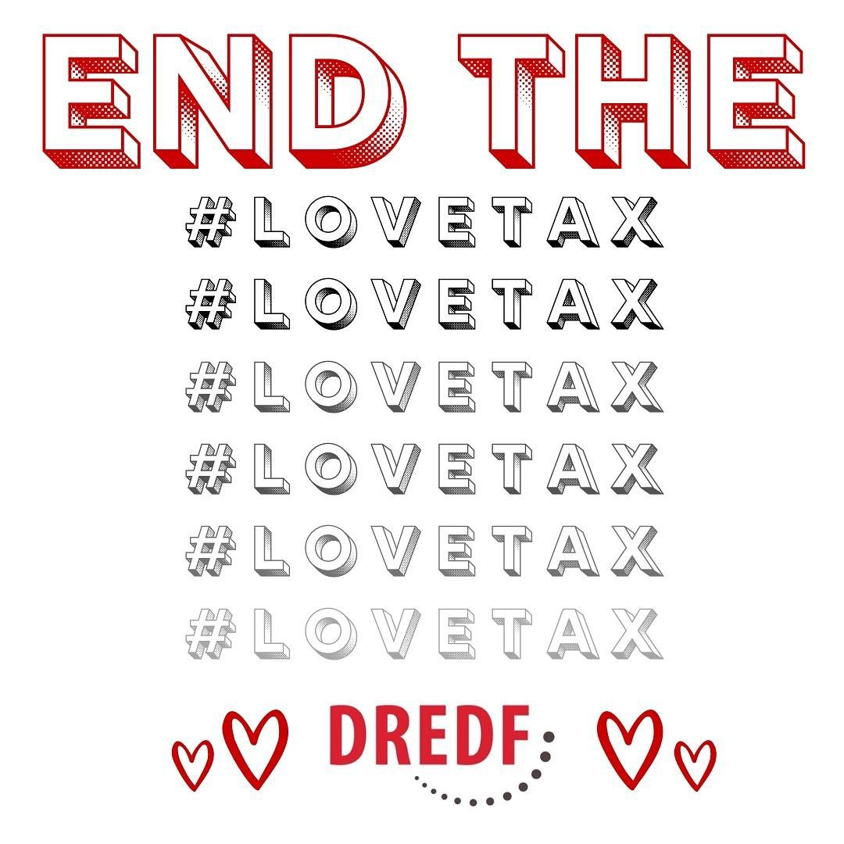

Slide 15
Eliminating or Reducing Marriage Penalties –Bills Introduced in Congress
SSI Restoration Act, https://www.congress.gov/bill/117th-congress/senate-bill/2065
Would eliminate 25% penalty
Marriage Equality for Disabled Adults Act, https://www.congress.gov/bill/117th-congress/house-bill/6405
Would eliminate DAC penalty
Additional bills:
MAPSA, https://www.congress.gov/bill/117th-congress/house-bill/761/text
SSI Savings Penalty Elimination Act,
https://www.law.cornell.edu/uscode/text/42/1396r-5

Slide 16
Reducing Marriage Penalties – Agency Actions
Mitigate 25% cut
Clarify “holding out” standard – apply only to affirmative representations by both individuals of marriage under state law; disclaim “functional” analysis & articulate safe harbor
Mitigate Spousal Deeming
Allow spousal living allowance (deduction from non-SSI spouse’s income)
Revise and clarify “holding out” standard as stated
Administrative process for RFRA claims
Better public education and guidance on complex rules
Esp. DAC penalty and “holding out” rules
Comprehensive report on penalties and reforms
Citations: https://www.ssa.gov/policy/docs/issuepapers/ip2003-01.html; Beaty v. Berryhill, No. 2:18-cv-00519 AC, 2019 U.S. Dist. LEXIS 81373 (E.D. Cal. May 13, 2019)

Slide 18
Questions and Answers

