Slide 1
Fighting for Safe Access in a Masks-Optional Healthcare Environment
A Workshop on Making Reasonable Accommodation Requests Under the ADA
June 27, 2023

Slide 2
Who We Are
Emma Martin (she, her) Community Engagement Program Manager Center for Independent Living (CIL)
Beth Kenny (they, them) Member Senior Disability Action (SDA)
Claudia Center (she, her) Legal Director Disability Rights Education and Defense Fund (DREDF)

Slide 3
Topics to be Covered
COVID Mitigation Measures in Healthcare – Claudia
Impact of Current Healthcare Environment on Patients – Beth
The ADA and Disability Rights – Claudia
How to Make a Reasonable Accommodation Request – Claudia
Next Steps if Your Request is Denied – Beth
Questions and Answers

Slide 4
COVID Mitigation in Healthcare – History and Present

Slide 5
COVID Mitigation in Healthcare – History and Present
Federal Public Health Emergency
January 31, 2020, begins
May 11, 2023, ends
May 11, 2023, CDC stops calculating COVID-19 community levels
California’s COVID-19 State of Emergency
March 20, 2020, begins
February 18, 2023, ends
April 3, 2023, mask mandate for high-risk settings (such as healthcare) ends
ID: A black stethoscope laying across a keyboard

Slide 6
COVID Mitigation in Healthcare – Current California Rules
California Department of Public Health, March 3, 2023, guidance document on masks:
Mask mandates end April 3, 2023
Masks “recommended” or “strongly recommended” in high-risk settings like healthcare based on community COVID levels – but CDC no longer tracking community levels

Slide 7
COVID Mitigation in Healthcare – Current California Rules (cont.)
CalOSHA
June 2023 California Workplace Guide covering healthcare: Surgical masks (with ties) or procedure masks (with ear loops) should be used for “source control” (aka symptomatic people)
Healthcare facilities must follow CDC “Respiratory Hygiene” rules:
Offer masks to persons who are coughing
Advise healthcare personnel to wear surgical or procedure mask when examining patient with symptoms of a respiratory infection

Slide 8
COVID Mitigation in Healthcare – Local Practices May Vary – Examples
San Francisco County: People who work in healthcare settings are still required to wear a mask when around patients
San Francisco General: masking required for all patients, staff and visitors in all areas where patients are present
Santa Clara County: masking still required during “designated winter respiratory virus period”

Slide 9
COVID Mitigation in Healthcare – Local Practices May Vary – Examples (cont.)
Alameda County, Contra Costa County: masking still required at Skilled Nursing Facilities (SNFs)
Los Angeles County: masking still required in all patient care areas
Cedar-Sinai: masking required in all patient care areas and anywhere a patient can be anticipated—including lobbies, elevators and waiting rooms

Slide 10
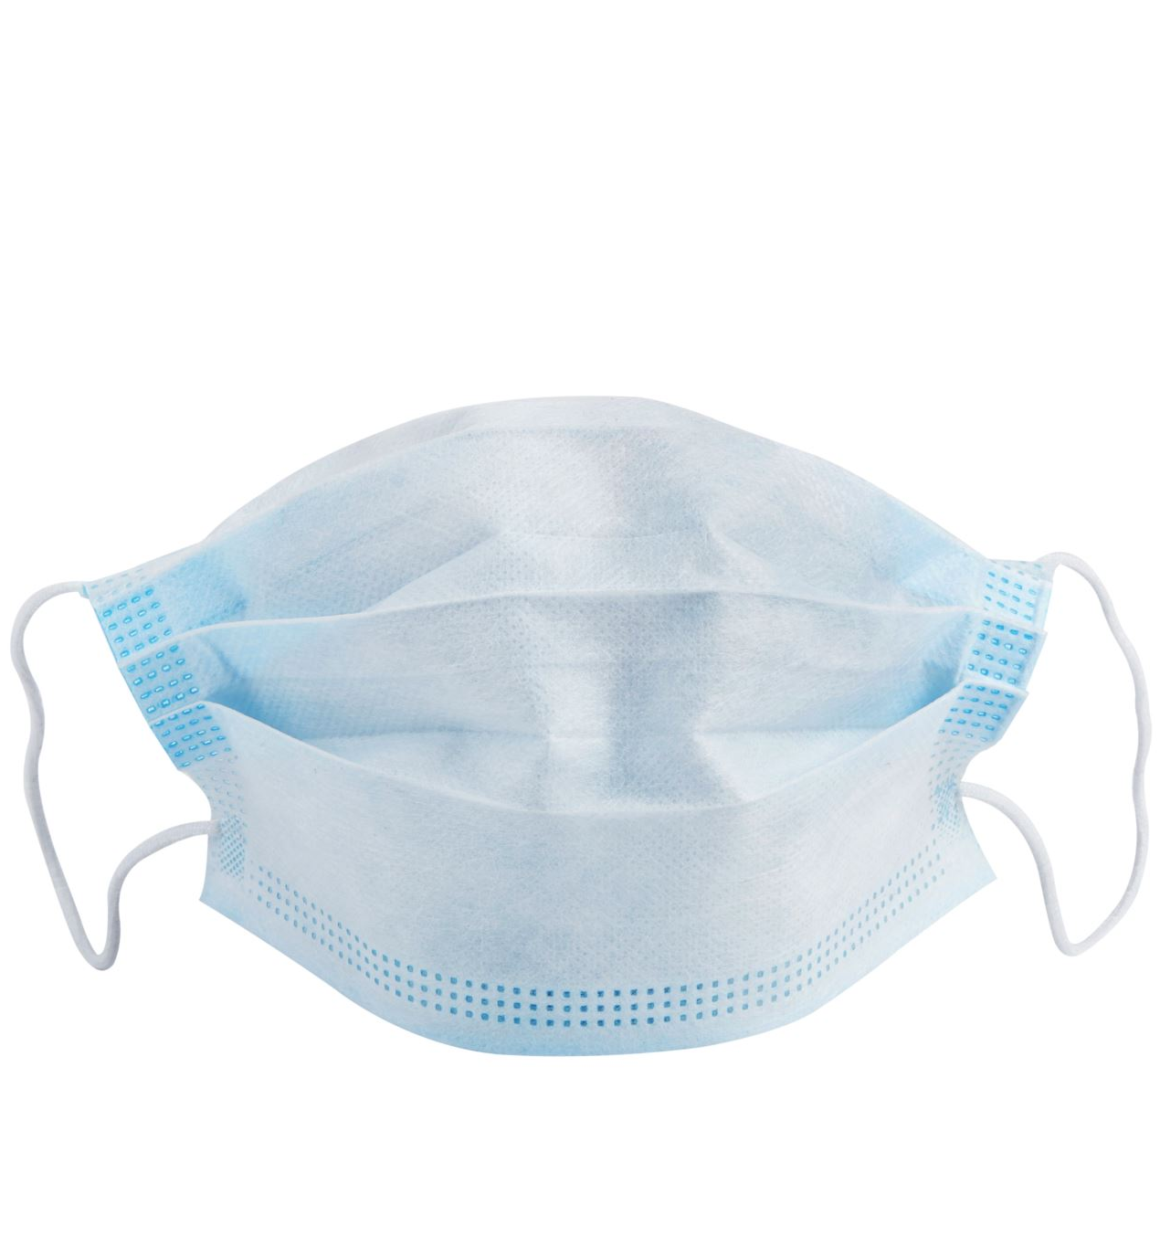
Remember these Takeaways – We’ll Come Back to Them
Most state mask mandates are over BUT existing guidelines show:
Masking is feasible
Masking is recommended for many settings
Masking is still required in certain circumstances (see, e.g., CalOSHA “source control”)
ID: a light blue disposable surgical mask

Slide 11
Impact of Current Healthcare Environment on Patients

Slide 12
Impact on Patients Who are Vulnerable to Severe Effects from COVID
Vaccinations do not prevent COVID infection, do not prevent all severe outcomes from COVID infection
One-way masking does not prevent all COVID infection
Some patients report contracting COVID even while wearing N-95 masks – this comports with studies using modeling
Masks are typically not professionally fit-tested
Some people cannot wear masks or wear them reliably
Some health care requires that masks be removed

Slide 13
Impact on Patients Who are Vulnerable to Severe Effects from COVID (cont.)
“No face mask provides 100% protection”
Peter Chin-Hong, MD UC San Francisco, infectious disease expert specializing in patients with suppressed immune systems
Lack of risk management causes patients to be anxious and fearful during appointments, disrupting communication and assessments

Slide 14
Impact on Patients Who are Vulnerable to Severe Effects from COVID (cont.)
Risk of delaying / avoiding care vs. risk of accessing care without mask mandates and COVID-19 protocols in place
Fenit Nirappil, “Masks come off in the last refuge for mandates: The doctor’s office,” Wash. Post (May 1, 2023) (accounts of patients)
ID: Article in the Washington Post titled “Masks come off in the last refuge for mandates: the doctor’s office”, with a photo of a white person with brown hair sitting in bed under a yellow blanket, next to a dog

Slide 15
Impact on Patients Who are Vulnerable to Severe Effects from COVID (cont.)
Jonah Beleckis, “Vulnerable to COVID-19, patient calls retreat of hospital mask mandates a ‘betrayal,’” Wisc. Public Radio (June 14, 2023) (accounts of patients)
ID: Article and radio piece on website for Wisconsin Public Radio titled “Vulnerable to COVID-19, patient calls retreat of hospital mask mandates a ‘betrayal,’” with photo of two white people standing outside, one with white cane and “I am a pre-existing condition” t-shirt

Slide 16
Introduction to the ADA and Other Disability Rights Laws

Slide 17
Disability Rights Laws in Healthcare
State or local government healthcare providers:
Title II of the Americans with Disabilities Act (ADA), 42 U.S.C. § 12131, et seq.
Section 504 of the Rehabilitation Act, 29 U.S.C. § 794
Section 1557 of the Affordable Care Act (ACA), 42 U.S.C. § 18116
Section 11135 of the California Government Code
ID: White marble front steps and columns of a building

Slide 18
Disability Rights Laws in Healthcare (cont.)
Private healthcare providers
Title III of the ADA, 42 U.S.C. § 12181, et seq.
Section 504 of the Rehabilitation Act, 29 U.S.C. § 794
Section 1557 of the ACA
California’s Unruh Civil Rights Act, Cal. Civ. Code § 51, et seq.
ID: White marble front steps and columns of a building

Slide 19
Disability Rights Laws in Healthcare (cont.)
What do the laws require?
Equal access to programs and services for people with disabilities, including
Reasonable accommodations where “necessary” to nondiscrimination,
unless the covered entity can demonstrate “fundamental alteration”
No retaliation or interference

Slide 20
What is a “Disability”? ADA Amendments Act of 2008
Mental or physical impairment that substantially limits one or more major life activities
Or a record of such impairment, being regarded as having impairment
“Substantially limits” construction –
Should not be “demanding standard,” see Findings and Purposes
No mitigating measures
Consider condition that is episodic or in remission in “active” phase
“Major life activities” –
Expanded list of functional major life activities
Expanded concept and list of “major bodily functions”

Slide 21
What is a “Disability”? Major Life Activities (cont.)
Citations: 42 U.S.C. § 12102; 28 C.F.R. § 35.108; 28 C.F.R. § 36.105
caring for oneself
performing manual tasks
seeing
hearing
eating
sleeping
walking
standing
sitting
reaching
lifting
bending
speaking
breathing
learning
reading
concentrating
thinking
writing
communicating
interacting with others
working

Slide 22
What is a “Disability”? Major Life Activities (cont.)
Citations: 42 U.S.C. § 12102; 28 C.F.R. § 35.108; 28 C.F.R. § 36.105
Major Life Activities = operation of major bodily function:
immune system
special sense organs and skin
normal cell growth
digestive
genitourinary
bowel
bladder
neurological
brain
respiratory
circulatory
cardiovascular
endocrine
hemic
lymphatic
musculoskeletal
reproductive

Slide 23
What is a “Disability”? Predictive Assessments
Citation: 28 C.F.R. § 35.108; 28 C.F.R. § 36.105
Conditions that are virtually always disabilities: deafness, blindness, intellectual disability, partially or completely missing limbs or mobility impairments requiring the use of a wheelchair, autism, cancer, cerebral palsy, diabetes, epilepsy, HIV, multiple sclerosis, muscular dystrophy, major depressive disorder, bipolar disorder, post-traumatic stress disorder, obsessive compulsive disorder, schizophrenia

Slide 24
Disabilities include …
Psychiatric Disabilities:
PTSD
Bipolar disorder
Schizophrenia
Depression
Anxiety
OCD
Traumatic Brain Injury
Intellectual & Developmental Disabilities
Autism, Neurodiversity
Mobility Disabilities
Sensory Disabilities:
Deafness
Blindness
Learning Disabilities
Dyslexia
ADHD
Dementia, Alzheimer’s
Chronic Illnesses like:
Asthma
COPD
Diabetes
High blood pressure
Kidney disease
History of cancer
Long COVID

Slide 25
Why Masking of All Present During Appointment is “Reasonable”
What is “reasonable”? Courts consider:
Feasible
Ordinary
Not ordinary but justified given circumstances
Masking of all:
Still required in some jurisdictions
Still required statewide in some circumstances
Feasible as demonstrated by past and present experience
Modification justified by risk of severe health outcomes

Slide 26
Possible Reasonable Accommodations for Mitigating Infection Risk in Healthcare
Video telemedicine
Masking of staff during time at site
Masking of all people in environment during time at site
Increased ventilation at site
Separate space for waiting on site
Waiting in car or outside until appointment begins
Referral to site with COVID protocols
Outside appointment
At-home appointment

Slide 27
How to Make a Reasonable Accommodation Request

Slide 28
How to Make a Reasonable Accommodation Request
Mode: In Writing
Fine to use telephone, but confirm in writing by email or through healthcare portal
Recipients of Email:
Cast wide net to increase chances of getting to the right person
Include people like patient coordinator, ADA coordinator, appointment coordinator
Portal Request:
Be specific: you are requesting a reasonable accommodation for a disability, ask for instructions
ID: Glasses laying on top of paper on a desk with a mug and computer in the background

Slide 29
How to Make a Reasonable Accommodation Request (cont.)
Elements of request for Reasonable Accommodation:
Disability
Introduce self and state condition(s) that create vulnerability
Briefly explain why condition is disability under the ADA
Need Reasonable Accommodation
State that you need reasonable accommodations to mitigate risk of transmission of COVID or another disease
State particular accommodations you are seeking
Willing to Communicate
Make clear that you are willing to discuss your request, provide information, consider alternatives

Slide 30
How to Make a Reasonable Accommodation Request (cont.)
Additional helpful elements:
Personal experiences as disabled person
Describe prior experience in which you experienced severe effects from COVID-19 or another illness and suffered harm (e.g., missed substantial school or work)
Describe prior experience in which you were forced to be in a risky setting for a necessary appointment and experienced disruptive fear and anxiety
Describe a prior experience in which you were accommodated for an appointment, and everyone found the accommodations to be feasible and appropriate
ID: Open doors leading down a white and glass hallway

Slide 31
Sample Text: Reasonable Accommodation Request Pre-Scheduled Appointment
Sample Introduction of Self and Disability:
Dear (Names),
I am a patient at (Name of Provider). I have several conditions including diabetes that put me at risk for severe outcomes from COVID-19, https://www.cdc.gov/coronavirus/2019-ncov/hcp/clinical-care/underlyingconditions.html. As you likely know, diabetes is a “disability” under the Americans with Disabilities Act because it substantially limits several major life activities, including the endocrine function.

Slide 32
Sample Text: Reasonable Accommodation Request Pre-Scheduled Appointment (cont.)
Sample Statement of Need for Accommodation:
I wear a mask to healthcare appointments, but no mask is 100% effective in preventing transmission of COVID-19 or other dangerous infectious diseases. Because of my disabilities, acquiring COVID-19 would threaten my health and well-being and potentially cause great harm.
I need and am requesting reasonable accommodations to have an equal opportunity to access healthcare as a disabled person. I am requesting accommodations that will mitigate the risk of my acquiring COVID or another disease while at my upcoming appointment on (Date of Appointment).

Slide 33
Sample Text: Reasonable Accommodation Request Pre-Scheduled Appointment (cont.)
Sample Statement of Requested Accommodations:
Here are the accommodations that I think would work for me to be able to safely access my in-person healthcare appointment:
That I be permitted to wait in a separate space by myself instead of in a waiting room with unmasked people
That providers and staff wear high-quality N-95 masks while near me or interacting with me
Please let me know if (Provider) can implement these accommodations.

Slide 34
Sample Text: Reasonable Accommodation Request Pre-Scheduled Appointment (cont.)
Sample Statement of Willingness to Communicate:
I think that the accommodations that I have identified are the simplest and most feasible ways for (Provider) to accommodate my disability. However, I am open to having a discussion about the best way for (Provider) to meet my needs during my upcoming appointment.
You may reach me at (Phone Number) or this email to discuss my request.
Thank you for your prompt attention to this time-sensitive matter,
(Your Name)

Slide 35
Next Steps if Your Request is Denied

Slide 36
Next Steps if Your Request is Denied
Elevate and escalate within the healthcare organization
Contact high-level administrators, follow up with phone calls
Contact the general counsel for the healthcare provider
Use the State Bar of California “Advanced Search” function to find the names of counsel, type the first word of the name of the provider in the Firm Name field and hit Search
Ask to file a formal grievance and then do so

Slide 37
Next Steps if Your Request is Denied (cont.)
Refer healthcare organization to the Pacific ADA Center.
Pacific ADA Center Statement – June 27th, 2023
“Healthcare facilities, like hospitals and doctors' offices, must follow ADA requirements. Some patients who visit healthcare facilities have disabilities that make them more likely to get diseases that are easily spread (such as COVID-19 or a lung virus like RSV). These patients also may be more likely to get very sick from these illnesses or take longer to get better.”

Slide 38
Next Steps if Your Request is Denied (cont.)
Refer healthcare organization to the Pacific ADA Center.
Pacific ADA Center Statement – June 27th, 2023
“Healthcare facilities must provide reasonable accommodations to protect patients with these types of disabilities. Accommodations can include:
telehealth (where it can be effective),
a separate space to wait for appointments,
masking by all staff located near the patient,
better ventilation at the site by opening windows and running air filters, and
other modifications.
If you have questions about your rights as a person with a disability or about your responsibilities as a healthcare provider, you can contact the Pacific ADA Center.”
Phone: 1-800-949-4232
Email: adatech@adapacific.org

Slide 39
Next Steps if Your Request is Denied (cont.)
File a formal complaint with an administrative agency
U.S. Department of Health and Human Services, Office for Civil Rights
California Civil Rights Department
California Department of Managed Health Care
California Department of Insurance
NOTE: These procedures can be slow or ineffective.

Slide 40
What’s Next: Peer Support Office Hours
Join Senior and Disability Action and CIL for Peer Support Office hours
Peers will be available to discuss potential reasonable accommodations, workshop sample language, and support with other parts of the reasonable accommodation process.
Join us on Thursday, July 6th, from 12:00 p.m. – 1:00 p.m. on Zoom.
Register Here: https://bit.ly/ADAPeerSupport

Slide 41
What’s Next: Survey on Experience with Accommodations in Healthcare
We want to hear from you regarding your experience requesting reasonable accommodations in healthcare!
The short survey will better help our organizations and our communities understand what type of accommodations are being submitted, what type of accommodations are being met, and where/by which healthcare providers.
Take the survey here: https://bit.ly/ADAHealthcareSurvey
The survey will also be sent out after the workshop

Slide 42
Questions and Answers

