Slide 1


Setting Boundaries:
Avoiding the Unauthorized Practice of Law
June 13, 2024
Disability Rights Education and Defense Fund

Slide 2
Presenters
Malhar Shah (he/him), Special Education Staff Attorney, DREDF
Cheryl Theis (she/her), Senior Education Advocate, Parent Training and Information Center, DREDF

Slide 3

Topics to Be Covered
Definition of “unauthorized practice of law”
Role of non-attorney advocates in educating and supporting indigent and underrepresented Californians
Practical strategies for using non-attorney advocates to provide education and support while following the rules on the unauthorized practice of law
Notes:
Malhar cover the first bullet point as introduction
Cheryl covers the second and third bullet points really quickly

Slide 4
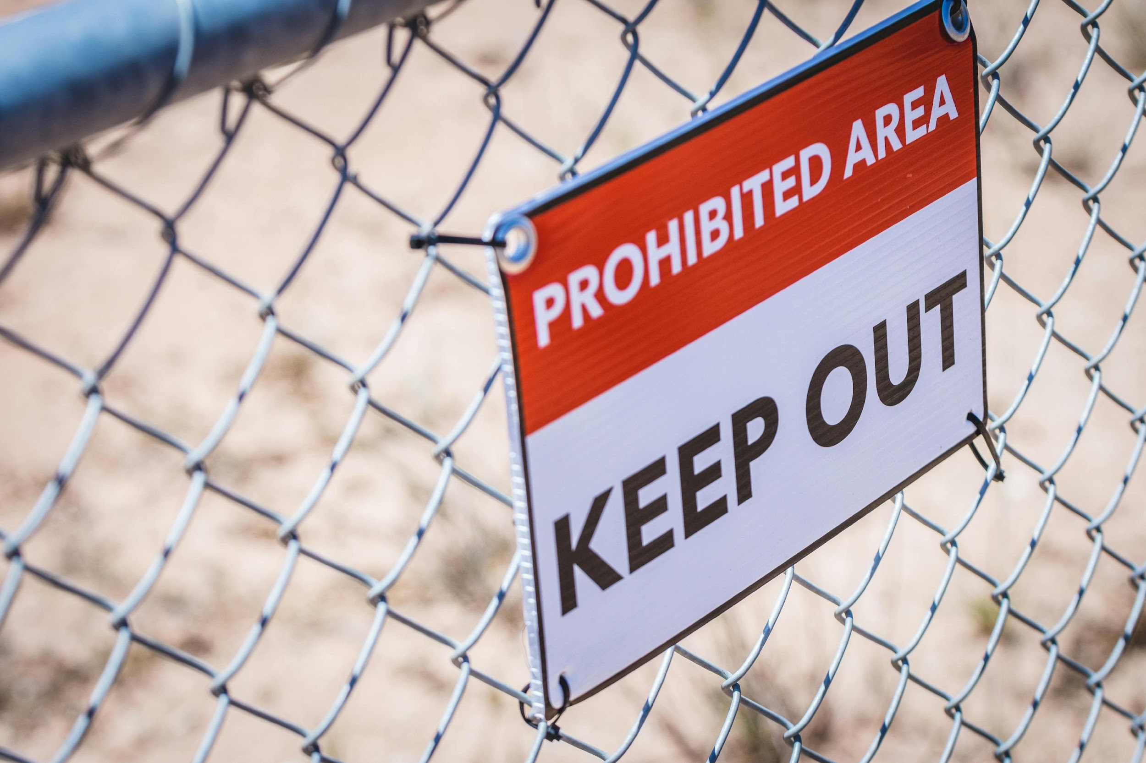
Unauthorized Practice of Law
Cal. Bus. & Prof. Code § 6125: “No person shall practice law in California unless the person is an active licensee of the State Bar.”
Notes:
Malhar – This is a definition, we’ll cover examples, roles of attorneys and non-attorneys, and repurcussions of practicing law.
We’ll be talking specifically about how this applies in the context of PTI and parent advocates, but the analogy applies to similar meetings with clients where you are trying to support clients and help them develop advocacy skills without crossing over to the practice of law.

Slide 5
Unauthorized Practice of Law
Cal. Bus. & Prof. Code § 6126: “misdemeanor punishable by up to one year in a county jail or by a fine of up to one thousand dollars ($1,000), or by both”
State Bar of California, Unauthorized Practice of Law Complaint: “The State Bar works with other law enforcement agencies to investigate when someone violates the law.”
Notes:
Malhar

Slide 6
State Bar of California,
California Rules of Professional Conduct
Rule 1-300: Member of State Bar “shall not aid any person or entity in the unauthorized practice of law”
Rule 5.3: Responsibilities Regarding Nonlawyer Assistants
  Lawyers who supervise must make reasonable efforts to ensure that conduct of nonlawyer staff “is compatible with the professional obligations of the lawyer”.
  Lawyer can be responsible for conduct of nonlawyer staff if it would violate the Rules if it had been done by a lawyer.
Notes:
Malhar will talk about is making sure that any nonattorneys working with attorneys are given specific direction about what they can and cannot say or do both in the presence and not in the presence of attorneys.
During meetings when attorney is present, the non-attorney can be seen as an extension of the attorney and engage a little bit more forcefully. But that when the attorney isn’t present, the non-attorney needs to be very careful.

Slide 7
Rules of Professional Conduct (Continued)
Together, Rules 1-300 & 5.3 mean that organizations with lawyers and nonlawyers must take reasonable steps to follow these two principles:
  When nonlawyers are not helping lawyers practice law – organizations must make sure that the nonlawyers do not engage in unauthorized practice of law.
  When nonlawyers are helping lawyers practice law – organizations must make sure that the nonlawyers receive clear instructions so that their actions comply with the rules that apply to lawyers.
Notes:
There is a lot of pressure from the people we are serving to push the envelope.
Malhar: Ensuring that the non-attorneys recognize and communicate to the clients that even though the attorney isn’t present, the communications are still integral to the attorney-client relationship, if there is indeed one. So they need to communicate that the privilege applies.
Cheryl: Misunderstanding and pushing of the envelope when non-attorneys conduct presentations. Cheryl can give an example of a parent asking “so you’re recommending . . .”
Malhar: Intakes as an example, meetings with opposing parties and their counsel.
Cheryl: Walk-ins in which clients received a letter that they want non-attorneys to respond to.

Slide 8

So what is it? What is the
“unauthorized practice of law”?
Logically, the unauthorized practice of law means practicing law without having an active California license.
But what is “practicing law”? No definition in California Code or Rules of Professional Conduct but some guidance in caselaw, see e.g. Baron v. Los Angeles (1970) 2 Cal.3d 535, 542:
  “doing and performing services in a court of justice”
  “legal advice and counsel”
  “preparation of legal instruments and contracts by which legal rights are secured”

Slide 9
What is practicing law?
  Giving legal advice and counsel
    Includes: advice based on the application of legal principles to facts
  Preparing legal instruments like contracts
    Exception: “Merely clerical” services do not count – “merely clerical” services include making forms available, filling out forms at the specific direction of the client, and delivering forms as directed by the client.
    See People v. Landlords Prof'l Servs. (1989) 215 Cal.App.3d 1599, 1608 [describing permitted activities before finding defendant did engage in UPL].
Notes:
We’ll talk in a little bit about what it means to apply legal principles to the specific facts because that can get murky. But before we do, we want to talk about what is clearly not in that category.
Cheryl will give an example of filling out forms. A family who wants to get their three-year-old evaluated but needs to get registered in the school district and filling out the form. But wouldn’t say, “but you should put in this . . .”. Instead using continuous check-ins. Would also suggest that at the end of that kind of activity, that a non-advocate follows up about the form they filled out. With the information you provided to me, if I got anything wrong.
Make sure you constantly prompt your staff to inform them that there is this bright line with contracts and filling out forms.
Cheryl can give example of a situation where you were actually not sure if they were providing legal representation. And if you are that person providing that service, being clear what service you are actually providing.

Slide 10
What is practicing law? (Continued)
  Representing someone in court or at a hearing
    Exceptions (non-exhaustive)
      Hearings or depositions conducted by certified law students consistent with Cal. Rules of Court Rule 9.42; see also Rules of State Bar of Cal. Rules 3.3-3.10
      Certain state administrative proceedings by code or agency rule such as Unemployment Insurance Hearings, see FAQ: Do I need a lawyer? (“You have the right to be represented by any person at your own expense. The person need not be a lawyer.”); Cal. Unempl. Ins. Code §§ 1951, 1957
Notes:
The idea is that the way that the CA Supreme Court seems to look at what is the practice of law is to look at the activity, if it is giving legal advice, creating documents that is not transcribing, or representing at court, those are indicia of practicing law.
But when you look at the State Bar opinion, there are all these administrative agencies that are set up to allow non-lawyers to help people in their hearings and there is a laundry list of them given in the State Bar opinion, and this is one example and did unemployment as an example. There was some kind of mental health, 72 hour things.
But the general rule is that you cannot represent someone at a contested hearing.

Slide 11
What is practicing law? (3/3)
  Representing someone in court or at a hearing (continued)
    Exceptions (non-exhaustive) (continued)
      Special education due process hearings if nonlawyer has “special knowledge or training relating to the problems of individuals with exceptional needs,” Cal. Educ. Code § 56505(e)(1)
      But see Cal. Atty. Gen. Op. No. 14-101 (Sept. 28, 2017) (“By no means do we suggest that consultants and other lay advocates are barred from due process hearings. … We conclude only that … a nonlawyer may not engage in the practice of law in special education due process hearings.”)
Notes:
Malhar: situation where you should be most cautious—we at DREDF don’t even send PTI to due process hearings. Because it is an adversarial and court-like context, there is a lot more room for their presence being considered a practice of law. Err on the side of caution. Don’t know how people are reconciling this—it is tricky and there is as conflict on these.
Cheryl: I have participated in pre-due-process hearings and there was an OAH mediator. I can talk about what I did there. I went to Larisa Cummings about what I can and cannot do. My role there was that when the parent as trying to lose it and turning off and being inflexible, stated that we needed some time to step aside. Telling the parent, what are you trying to say, it is becoming adversarial. What is your long-term objective. Without giving the content.
Cheryl: ADR becoming really popular in the State. I got really good advice from Deb Jacobson where she said, in response to a facilitated IEP process, to jusrt be careful because you know they are talking to their attorneys. In some sense, when you are participating in the processes, the parent is showing their hand. I’ll say it as “Can you please present that in a way the parent understands . . .?” It’s about checking yourself and know it is about helping the parents understand their concerns.

Slide 12
Role of Non-Attorney Advocates
During the study year, “55 percent of Californians at all income levels experienced at least one civil legal problem in their household, yet nearly 70 percent of them received no legal assistance.…
Even when experiencing problems that have a significant impact on them, most do not receive legal help: 27 percent of low-income Californians received some legal help, while 34 percent of middle-income individuals did.”
  2019 California Justice Gap Study
Notes:
Cheryl will cover: SPED is such a specialized area of knowledge that it is hard to find people who are understanding of the area, but that does not mean it is our role to fill in the gap to act as lawyers. There is such a need that developing a referral list is really important. Always tell parents we cannot control whether attorneys will take their case or have a position on the strength of their case.

Slide 13

Role of Non-Attorney Advocates (Continued)
Approximately 85 percent of all Californians received no legal help, or inadequate legal help, for the civil legal problems they experienced.
  2019 California Justice Gap Study
Notes:
Cheryl will cover

Slide 14
Role of Non-Attorney Advocates (Continued)
Less than 10 percent of low-income Americans currently get legal help — from a lawyer or anyone — to resolve critical civil justice problems. …
Evidence from the United States and other countries suggests that justice workers are as or more effective than lawyers in helping people to resolve their civil justice issues — and that they have the potential to scale to meet the need and empower communities.
  Frontline Justice Website
Notes:
Cheryl will cover

Slide 15

Example: Parent Advocates
Employed by Parent Training and Information (PTI) Centers
  PTIs serve families of infants, toddlers, children, and youth with disabilities, birth to twenty-six
  At least one PTI in every US state and territory
  PTIs do not represent families but provide resources and support, including modeling effective participation
  Often peers – themselves parents or family members of children with disabilities
  Provide youth, parents, other education rights holders, and community supports with free information, trainings, support, and referrals about the education rights of disabled children and youth, and how to advocate and problem solve effectively
Notes:
Cheryl will cover

Slide 16
Parent Advocates with PTIs (Continued)
Parent advocates work with parents, guardians, youth, and community supports to:
  Understand rights under state and federal laws
  Review and understand options
  Use rights and participate effectively
  Prepare for participation in IEP and other school meetings
  Communicate concerns or disagreement
  Center child, family, and cultural priorities
  Problem solve at the local level
  Refer families to community resources
Purpose: empower parents and youth to participate and advocate for meaningful education in the least restrictive setting based on individual needs of the student, family, and cultural values/priorities
Read more about Parent Centers Serving Families of Children with Disabilities.
Notes:
Cheryl will cover

Slide 17


DREDF’s PTI Center
Parent Center for 30 counties in Northern California
Four advocates, two bilingual Spanish speaking
Serves 80+ families and community providers per month, 900+ contacts per year
Provides 60+ trainings per year in person or online on key topics in Spanish and English
Works with more than 15 state and local partners to improve special education
Conducts 20+ specialized presentations yearly for hospitals, universities, child welfare, county mental health, social workers, and education training programs
Notes:
Cheryl will cover

Slide 18
Challenges for Parent Advocates
In Setting Boundaries
Families face cultural, language, and other barriers to effective participation – it may seem easier and more efficient to “take over”.
Parent Advocates see power differential and want to defend families and students.
Many Parent Advocates are themselves parents or people with disabilities and want to use their experience and insight.
Families are desperate for help and will ask the advocate what they recommend.
Notes:
Cheryl will cover

Slide 19

Challenges for Parent Advocates
In Setting Boundaries (Continued)
Families may choose a course of action (for example, not speaking up, signing a document they don't understand or agree with, or letting an important issue go) that may create risk
Tip: Parent Advocate works to empower and support the parent/youth, not to advocate for them!
Notes:
Cheryl will cover

Slide 20
Practical Steps to Avoid
Unauthorized Practice of Law
Make sure the client knows that the advocate is not a lawyer and is not providing legal advice or any other legal services:
  During meetings (out loud) and in emails
  Reiterate each contact
Make sure the advocate does not “act for” or represent the client
Make sure that the advocate does not give legal advice – can share legal rules but should not apply them to particular facts
When in doubt, do not guess.
  Refer to an attorney
Notes:
Cheryl: Instead of saying I am here on behalf of the family, say I am here at the invitation of the family to help them participate more effectively.
Malhar: If you don’t know the law in this situation, either because you just don’t know or, more importantly, because the law’s application is ambiguous or open to interpretation, then don’t say anything.
Cheryl: Example: I asked for an IEE and it’s been 25 days and it’s the summer, what’s the timeline and unreasonable delay? If you say things to them, like maybe 30 days, then they will write a letter to the District saying you gave an interpretation like 30 days.
Cheryl: Contrasted it with something you’d say in an IEP meeting that is as clear statement of the law. For example, a parent requests an assessment and saying to parent you know you have a right to get that plan within 10 days.
Malhar and Cheryl compare and contrast how to get a student a new BIP and FBA. Malhar would say something like, the kid has had behaviors over and over again for the last month that have affected his education and that of others. Cheryl would introduce the ways in which she’d get a BIP and FBA. Everyone is an agreement that the student’s behaviors are getting worse and maybe we can discuss the options the parent has . . . . Your job is to keep everyone flexible and student centered.
Cheryl: Example of two parents who are not on the same page where one parent asks what they should do in the family court context. Danger zone.

Slide 21
Use Disclaimers
Use oral and written disclaimers:
  My role here is as the parent’s advocate. I am here at the invitation of the family to help them participate effectively in the process today. I am not here as an attorney.
  Ensure every email to a parent includes a written disclaimer.
  Ensure every email to a school district includes a written disclaimer.
  Provide families with a written service agreement stating the role of Parent Advocate and disclaiming any legal advice or service.
Notes:
Cheryl

Slide 22
No Legal Advice
Legal Advice and Services
Not Legal Advice or Legal Services
My advice is that you should file a request for an independent educational evaluation
I think that under the law, your child’s behavior was a manifestation of their disability
Drafting a complaint for a parent
Speaking for the parent at the IEP meeting
Sharing rules of law (without applying them to facts)
Identifying available options
Supporting client in identifying their own values and preferences
Speaking from experience
Role playing an IEP meeting
Transcribing a parent’s complaint
Notes:
Malhar can take these. I can ask Cheryl to give additional options.

Slide 23

Sticky Situation?
Call the State Bar Ethics Hotline
1-800-238-4427 (in California) or 415-538-2150
Notes:
Malhar

Slide 24
Wrap Up
Your role is to support, not to advocate.
Your presence itself changes the temperature of the room.
Teach a parent to fish.
Help parents develop lasting collaboration and relationships.
Notes:
Malhar

Slide 25
Questions and Answers

