Slide 1
Access to Abortion and Reproductive Health Care for People with Disabilities in a Post-Dobbs World
Presented by:
Jillian MacLeod
Reproductive Justice Legal Fellow, Disability Rights Education and Defense Fund (DREDF)
Amanda Spriggs-Reid
Equal Justice Works Fellow, Women Enabled International (WEI)
Notes:
Name/pronouns/position/org/visual description
Before we start we wanted to do a quick poll to understand backgrounds of everyone attending. We designed this training to be helpful people from a broad range of professional or personal backgrounds by sharing information about the rights of people with disabilities who are seeking reproductive and sexual health care so you can either advocate for yourself if you are a person with a disability, or you can educate and advocate your clients if you work with disabled people!

Slide 2
Outline
Disability 101
Why is Access to Sexual and Reproductive Health Care Important for Disabled People?
Historical Context
Current Context
Legal Responsibilities of Providers
LSC restrictions on participation in abortion litigation and proceedings
Reasonable accommodations and supported decision making
Effective communication
Accessible facilities and medical equipment
2024 updated regulations
Resources

Slide 3
Disability 101

Slide 4
People with Disabilities – Who Do We Mean?
ADA and Section 504 Definition: a person who has a physical or mental impairment that substantially limits one or more major life activities, a person who has a history or record of such an impairment, or a person who is perceived by others as having such an impairment.
CRPD Definition: “Persons with disabilities include those who have long-term physical, mental, intellectual or sensory impairments, which in interaction with various barriers may hinder their full and effective participation in society on an equal basis with others.”
Disability Identity: “sense of self that includes one’s disability and feelings of connection to, or solidarity with, the disability community”
Notes:
Large and incredibly diverse population that can be hard to define

Slide 5
Terminology
Person First Language
Identity First Language
Emphasizes the person and shows that person is not defined by their disability
Traditional rule
Remains common, especially people with chronic illnesses and mental health or I/DD
Examples:
Person with a disability
Person with Down Syndrome
Person with epilepsy
Emphasizes that disability and identity are intertwined
Preferred in certain communities among blind, Deaf, and Autistic people
Examples:
Disabled person
Autistic person
Deaf person
Blind person
Notes:
If you are unsure, can always ask!

Slide 6
Terminology: Disability is Not a Bad Word!
Don’t say it | Why? What to use instead?
Handicapped | Outdated; use disabled, person with a disability
Wheelchair bound, confined to a wheelchair | Negative, inaccurate (wheelchair is mobility device and tool for freedom); use wheelchair user, person who uses a wheelchair
Differently abled, handi-capable, special | Euphemisms, condescending; use disabled, person with a disability, name of disability (person with CP, person with an intellectual disability)

Slide 7
Terminology: Disability is Not a Bad Word! (Continued)
Don’t say it | Why? What to use instead?
Suffering from MS; HIV victim, afflicted with epilepsy | Negative, disempowering, othering; use neutral terms like person with MS, person living with HIV
Disability slurs like R-word, M-word, idiot, imbecile, moron, cripple, feeble-minded, lunatic | Offensive, rooted in eugenics and institutionalization, use current language like intellectual disability, little person, person with dwarfism
“Mind of a child” | Describe concretely impacts of intellectual or developmental disability on individual’s functioning
Take care with disability nouns: avoid “the mentally ill,” “the disabled,” but know some subgroups use nouns.
Notes:
Maybe a quick note on not needing to be perfect but trying to be thoughtful and respectful

Slide 8
Models of Disability
Medical Model
Charity Model
People with disabilities deserve our support and care as an act of charity.
Exception: people with stigmatized disabilities, who are viewed as causing their disabilities
People with disabilities are seen as objects of charity.
Disability is a medical problem that should be treated as other medical problems and cured if possible. The “problem” of disability is located squarely within the individual.
Responsibility is placed on the individual to “overcome” their disability.

Slide 9
Models of Disability (Continued)
Social Model
The social model separates impairment, a person’s bodily or functional limitation that results directly from a medical condition, from disability, which is a socially constructed disadvantage.
This disadvantage arises from a multitude of factors including environmental, attitudinal, structural, and economic barriers.
Foundational Tenets of the Social Model
Impairment has no negative connotation and is seen as a natural part of human diversity.
Impairment must not be used as an excuse to deny or restrict people’s rights.
It is everybody’s responsibility to remove socially constructed barriers.
People with disabilities need rights and justice, not charity

Slide 10
Ableism
Definition: discrimination, prejudice, or social prejudice against people with disabilities. It manifests in various forms, from individual attitudes to systemic practices that disadvantage or discriminate against people with disabilities.
Examples
Attitudinal Ableism:
Negative attitudes, stereotypes, and assumptions about the capabilities and worth of people with disabilities
Example: Believing that a person with a disability cannot be a good parent
Institutional Ableism:
Policies, practices, and societal structures that disadvantage people with disabilities.
Example: Lack of medical school training on treating patients with disabilities

Slide 11
Accessibility vs. Reasonable Accommodations
Accessibility
“The degree to which a product, device, service, or environment is available to as many people as possible”
True accessibility occurs when a space is always, 100% of the time, welcoming to people with disabilities
Reasonable Accommodations
Adaptations made to environments, programs, policies and/or technology upon the request of an individual with a disability without imposing a disproportionate or undue burden
Accessibility is related to groups, whereas reasonable accommodations are related to individuals.
Notes:
Maybe contrast how this relates to rights versus justice?

Slide 12
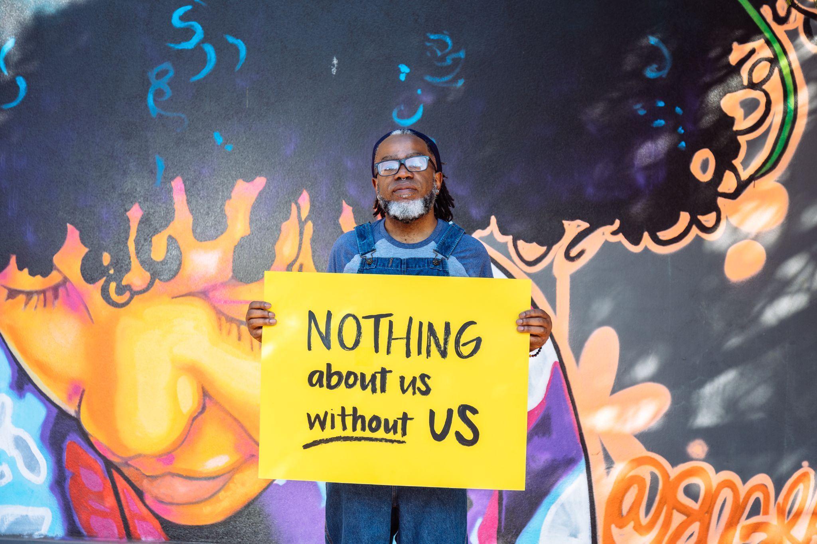
Principles of Disability Justice (Sins Invalid)
Intersectionality
Leadership of Those Most Impacted
Anti-Capitalist Politic
Cross-Movement Solidarity
Recognizing Wholeness (each person is full of history and life experience)
Sustainability
Commitment to cross-disability solidarity
Interdependence
Collective access (shared responsibility for access, flexibility and creativity)
Collective liberation (no body or mind is left behind)
Image from Disabled and Here licensed under CC
Notes:
INTERSECTIONALITY “We do not live single issue lives” –Audre Lorde. Ableism, coupled with white supremacy, supported by capitalism, underscored by heteropatriarchy, has rendered the vast majority of the world “invalid.”
LEADERSHIP OF THOSE MOST IMPACTED “We are led by those who most know these systems.” –Aurora Levins Morales
ANTI-CAPITALIST POLITIC In an economy that sees land and humans as components of profit, we are anti-capitalist by the nature of having non-conforming body/minds.
COMMITMENT TO CROSS-MOVEMENT ORGANIZING Shifting how social justice movements understand disability and contextualize ableism, disability justice lends itself to politics of alliance.
RECOGNIZING WHOLENESS People have inherent worth outside of commodity relations and capitalist notions of productivity. Each person is full of history and life experience.
SUSTAINABILITY We pace ourselves, individually and collectively, to be sustained long term. Our embodied experiences guide us toward ongoing justice and liberation.
COMMITMENT TO CROSS-DISABILITY SOLIDARITY We honor the insights and participation of all of our community members, knowing that isolation undermines collective liberation.
INTERDEPENDENCE We meet each others’ needs as we build toward liberation, knowing that state solutions inevitably extend into further control over lives.
COLLECTIVE ACCESS As brown, black and queer-bodied disabled people we bring flexibility and creative nuance that go beyond able-bodied/minded normativity, to be in community with each other.
COLLECTIVE LIBERATION No body or mind can be left behind – only moving together can we accomplish the revolution we require.

Slide 13
Principles of Reproductive Justice (SisterSong)
Reproductive justice is defined as the human right to:
Maintain personal bodily autonomy
Have children
Not have children
Parent our children in safe and sustainable communities
DJ and RJ share the themes of intersectionality, centering the most marginalized, solidarity across movements, issues, and identities, focus on access, and commitment to dismantling systems of oppression.

Slide 14
Why is Access to Sexual and Reproductive Health Care Important for Disabled People?
Notes:
Of course, for the same reasons that non-disabled people need access to abortion--to protect their lives, health, and autonomy.
This might seem obvious to you all, but pervasive ableism and paternalism towards disabled people in our society influence many people’s views that people with disabilities are not inherently sexual beings with the same preferences, hopes and dreams around building or not building families as nondisabled people

Slide 15
What is Sexual and Reproductive Healthcare?
Sexual and reproductive health (SRH) is a state of complete physical, mental and social well-being in all matters relating to the reproductive system. It implies that people are able to have a satisfying and safe sex life, the capability to reproduce and the freedom to decide if, when, and how often to do so.
Maintaining Sexual and Reproductive Health requires:
Access to accurate information about sexual and reproductive health
Safe, effective, affordable and acceptable contraception choices
Information about sexually transmitted infection prevention
Access to abortion
Once pregnant, access to skilled health care providers and services that support safety, well-being, and good outcomes

Slide 16
What is an Abortion?
Medication abortion (also known as the abortion pill) consists of using two different medicines called mifepristone and misoprostol to end a pregnancy until 10 weeks of pregnancy. 63% of all abortions in the US are medication abortions.
In-clinic abortion (also called a procedural abortion) is a medical procedure that can be done one of three ways: aspiration abortion, dilation and evacuation (D&E) and dilation and curettage (D&C).

Slide 17
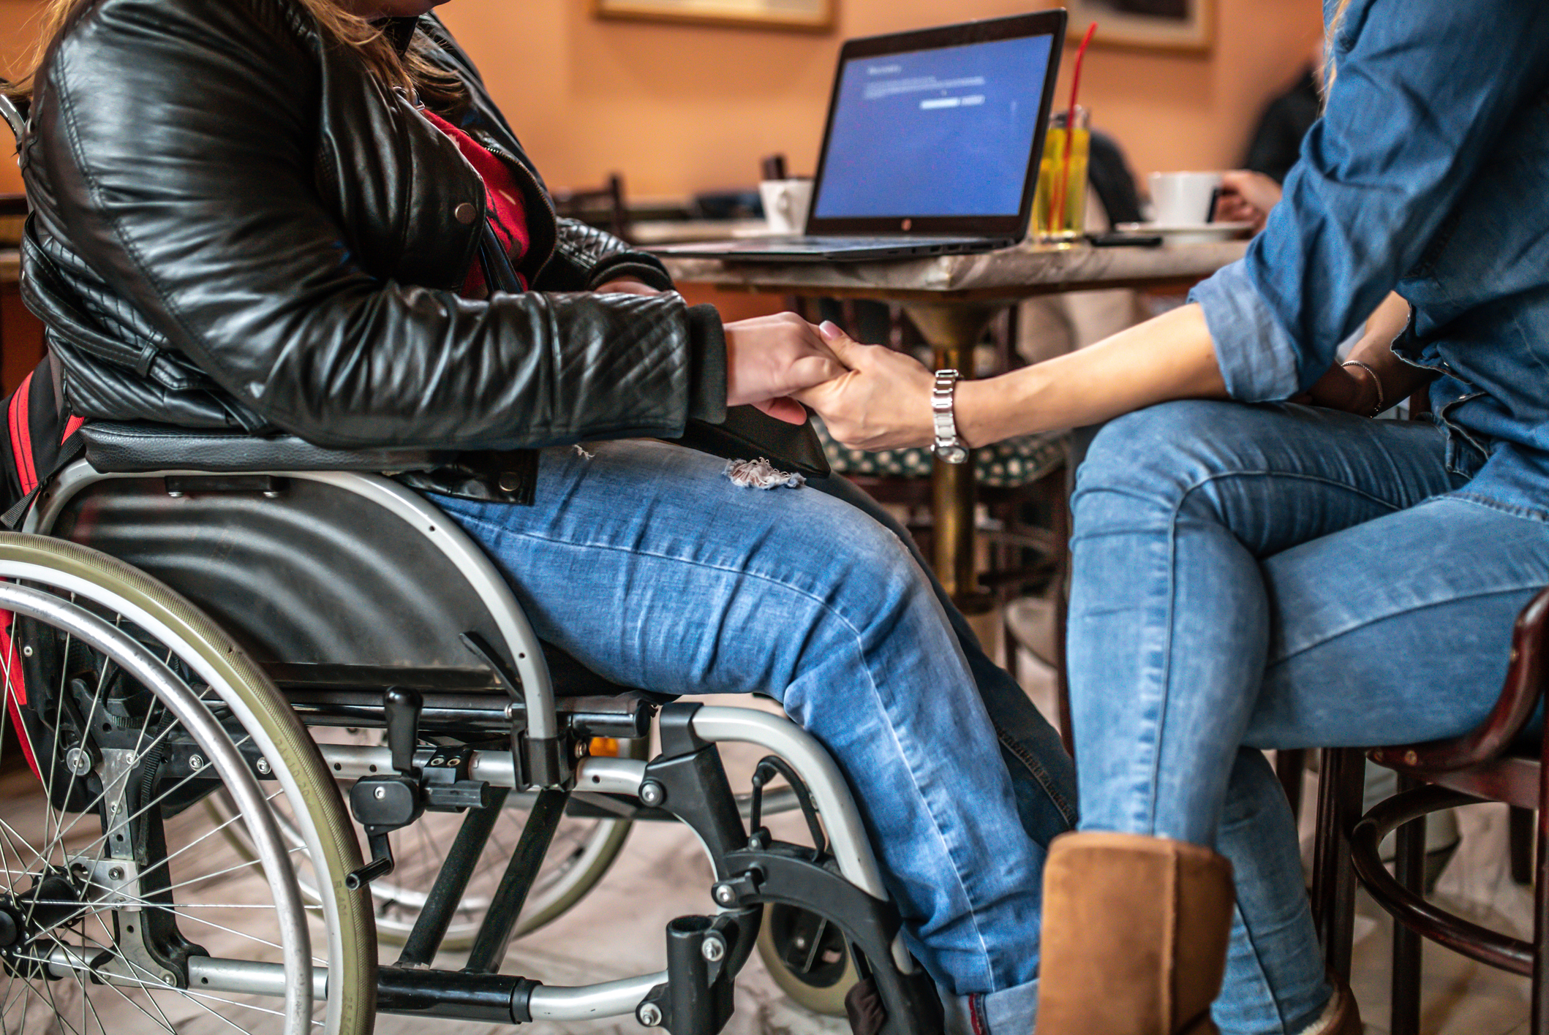
Importance of SRH Care Access for Disabled People
People with disabilities have similar rates of sexual activity and pregnancy as non-disabled people
Disabled people have similar fertility desires as non-disabled people
Disabled people are less likely to receive comprehensive sexual education than non-disabled people
Women with disabilities are significantly more likely to experience reproductive coercion or sexual violence than non-disabled people
Notes:
Studies show ....

Slide 18
Importance of SRH Care Access for Disabled People
Disabled people are less likely to receive cervical cancer screening, prenatal care, and family planning services than non-disabled people
Pregnant people with disabilities are at higher risk for nearly all adverse outcomes during pregnancy, including:
6x the risk for thromboembolism;
Nearly 4x the risk for cardiovascular events;
3x the risk for infection; and
2x the risk for severe preeclampsia.
People with disabilities are 11x more likely to die during childbirth than non-disabled people.
Notes:
Of course, people with disabilities can have fully safe and happy preganacies, and this slide is not meant to imply that pregnancy is less desirable or possible for PWD. Instead, all of these factors make up the context in which people with disabilities may be making decisions about whether they can continue or want to continue a pregnancy and its important to be aware of that context.
In light of these health risks, it is especially important that people with disabilities have access to a full range of reproductive health care options including abortion.

Slide 19
Historical Context
Notes:
Its important for us to discuss the historical context of access to sexual and reproductive healthcare for people with disabiltiies in the united states, because this history informs the ways that people with disabilities interact with the healthcare system today.

Slide 20
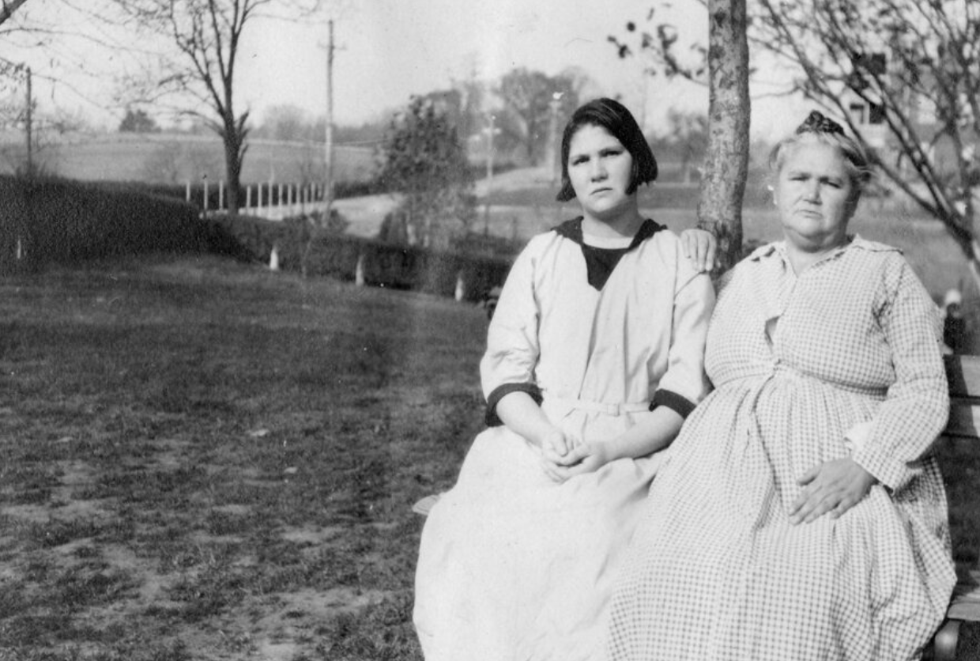
Historical Context
Buck v. Bell (1927): the Supreme Court held that the “feeble minded” could be sterilized against their will for the “protection and health of the state.” Justice Holmes wrote “[t]hree generations of imbeciles are enough.” (Buck has never been explicitly repealed).
After Buck, 70,000 Americans were forcibly sterilized.
Women of color were more likely to be involuntarily sterilized than white women.
31 states and Washington DC still have laws on the books that allow forced sterilizations.
Arthur Estabrook Papers, M.E. Grenander Special Collections & Archives, University at Albany, SUNY.
Notes:
Forced sterilization still happening today in locked facilities like prisons and detention centers

Slide 21
Historical Context (Continued)
Other eugenic policies adopted in the U.S. during the 20th Century include:
Forced institutionalization and segregation
Limitations on the ability of people with disabilities to get married and have sex before the age of 45
History of abortion access advocacy and discussions of disability
1960s-70s - Disability based justifications to support access to abortion
Now - Reason bans to prevent access to abortion
Neither of these support bodily autonomy for disabled people!
Notes:
Forced institutionalization -- still happening in certain contexts
Marriage equality has not been achieved because of income limits for SSI eligibility
During the pro choice movement of the 1960s and 70s, disability was used as a major justification for people needing access to abortion care. Much of this rhetoric was ableist in that it assumed disability was an inherently bad thing or that the quality of life of people with disabilities is automatically worse. Of course, it is essential to support the bodily autonomy of pregnant people, but using ableist rhetoric to do it is not the answer.
More recently, the anti choice camp has co-opted the language of disability rights to argue for restricting access to abortion care, but this still prevents people from exercising bodily autonomy. Instead of “reason bans” on abortion, pregnant people should be provided with neutral, scientifically accurate resources and community resources about how to support a child with a disability before they make a decision about how they want to proceed with their pregnancy.

Slide 22
Current Context

Slide 23
Supreme Court Cases Affecting the Legal Landscape of Abortion Access
Dobbs v. Jackson Women's Health Org. (2022)
Stripped Americans of their federal constitutional right to an abortion
Currently, 3 million women with disabilities live in states that have banned or are likely to ban abortion
FDA v. Alliance for Hippocratic Medicine (2024)
AHM, an anti-abortion group challenging the FDA's decision to remove unnecessary restrictions on access to the abortion medication, mifepristone
On June 13th, the Court dismissed the case on standing, meaning that current access to medication abortion remains unchanged but new parties could challenge mifepristone in the future
Moyle v. United States (2024)
Legal issue is whether a federal law called EMTALA preempts (overrides) state abortion bans
The Court dismissed the case for being “improvidently granted” and sent it back to the lower courts to decide the issue on the merits.
Notes:
The Supreme Court has played a significant role in shaping the landscape of abortion access in the United States. Before Dobbs came down just over 2 years ago, the SCOTUS case Roe v. Wade protected access to abortion by finding that access to abortion was a constitutional privacy right. Dobbs overturned that decision and stripped millions of Americans of that right.
This SCOTUS term, the court heard two cases related to abortion access. ...
The supreme court actually just released its decision (or lack of decision) in Moyle this morning, and they dismissed the case for being “improvidently granted.” Essentially they sent the case back down to the lower courts to be decided there, but they did not resolve the uncertainty that doctors face all over the country regarding when they are legally allowed to provide abortions. This is harmful because it means that doctors are still operating in an uncertain landscape and will continue to be less willing to provide abortion care if the pregnant person is not at risk of death.
Further, the concurrences written by Alito and Thomas showed a clear opposition to abortion access and disdain for women who need abortion care.

Slide 24
Socio-Economic Barriers
2x more likely to live below the federal poverty line
3x more likely to be unemployed
1 in 10 lack health insurance
Racial disparities:
Black people with disabilities are almost 55% more likely to live below the poverty line compared to white people with disabilities
50% higher unemployment among Black and Latino people with disabilities compared to white people with disabilities
Notes:
As you all know, the cost of an abortion and necessary travel to an appointment can be prohibitive for many patients, and people with disabilities are more likely to be low income or to be unemployed. Rates of poverty and unemployment are also higher for disabled people of color.

Slide 25
Travel Barriers
3M disabled women of reproductive age (52.3%) live in the 26 states that banned or are likely to ban abortion since Dobbs.
Transportation barriers
Reliance on others for transportation
Inaccessible public transit/insufficient paratransit services
Inaccessible ride-share services
Inaccessible (and expensive) air travel
Barriers result in less access to care
People with disabilities are more likely to report experiencing logistical barriers like arranging transportation to a reproductive care appointment than non-disabled people (50.7% vs. 29.7%).
Notes:
Travel barriers are a huge problem for PWD!
A recent report by the national partnership of women and families found that greater than one half of disabled women of reproductive age in the united states live in states that have banned or are likely to ban abortion since Dobbs, meaning that more pregnant PWD in these states will need to travel to get care.

Slide 26
Health Systems Barriers
Disabled people often excluded from health disparities research
Designated as health disparities population in 2023
ADA compliance enforcement is lacking
Federal insurance (Medicare/Medicaid)
900,000 disabled reproductive aged women rely on Medicare.
Medicare Part B generally does not cover contraception for the sole purpose of preventing pregnancy. Most Part D enrollees are in plans that cover contraceptive pills, rings, patches, and injections, but not IUDs or implants.
Hyde amendment: prohibits the use of federal funds in the provision of abortion care unless the life of the mother is in danger or the pregnancy is the result of rape or incest
Notes:
Health system barriers also impact access to care. Until Novemeber, PWD were generally not included as a disparity group in federally funded research on health disparities.
Federal health care funding agencies such as the Centers for Medicare & Medicaid Services (CMS) do not conduct oversight to ensure ADA compliance, nor do they assess health providers’ disability cultural competence. In fact, Federal funding does not usually require ADA compliance in healthcare training institutions. The absence of professional training on disability competency issues is considered one of the most significant barriers preventing people with disabilities from receiving appropriate and effective health care.
Insurance status also determines what care is accessible: ~58% PWD < age 65 rely on federal insurance (Medicare and/ or Medicaid) compared to ~14% of people <age 65 without a disability. This translated to about 900 thousand pregnancy capable people on Medicare who have a disability. 29% of these rely on Medicare alone; Because the benefits are designed for people age 65+, contraception access is very restricted, only covered for a "medical indication"
I know all of you are very familiar with the Hyde amendment, but because the largest insurer for PWD is Medicare/Medicaid, the Hyde amendment is a very common barrier for PWD living in states that do not supplement with state funds to cover abortion.

Slide 27
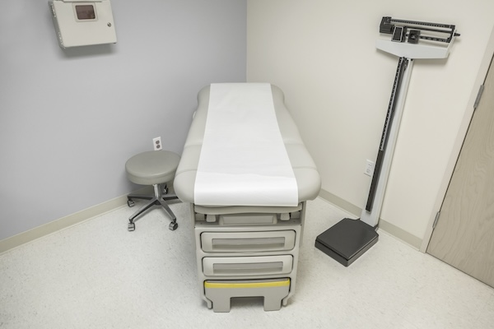
Barriers in the Clinic
Inaccessible facilities
Lack of accessible medical equipment
Lack of provider and staff knowledge
Legal obligations
Training on caring for disabled patients
Provider and staff biases and assumptions, medical mistreatment
Notes:
Once in the clinic, people with disabilities face more barriers to adequate healthcare.
Inaccessible facilities are a major barrier. A recent survey of specialty offices found that nearly a quarter of practices (22%) said their practices would not be accessible to a patient with hemiparesis. Gynecology offices had the highest rate of inaccessibility, with 44% of clinics found to be physically inaccessible.
In this same study, only 9% of clinics had adjustable exam tables, and 29% said they would just examine the patient in their wheelchair, which would be substandard care if the exam would not typically be done in a seated position.
Another study interviewing providers shows that a major barrier is a lack of knowledge: Physicians in one study noted the lack of knowledge and skills concerning care for people with disabilities, frequently mentioning patient transfer skills. Moreover, there seems to be a lack of understanding of ADA requirements and what our obligations are to provide accommodations, and some providers even cited providing accommodations as being burdensome, Other providers saw ADA education and compliance as a personal choice as opposed to a legal obligation.
Problematic biases and attitudes were evident in the study, with one provider referring to people with disabilities as an “entitled population,” and multiple providers who reported trying to transfer disabled patients out of their care. Additionally, multiple qualitative studies suggest that providers frequently assume that disabled patients are asexual, and often hesitate to discuss sexual health. Many also report relying on the caregiver rather than communicating directly with the patient, which makes it hard to take an appropriate sexual history.
So as you can tell, lots of barriers in the clinic!

Slide 28
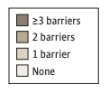
Barriers Compound & Limit Overall Care Access
Number of Barriers to Reproductive Health Services in the Past 3 Years by Disability Indicators
Types of Barriers
Logistical
Access
Cost
Privacy
Interpersonal Relationship
M. Antonia Biggs et al., Access to Reproductive Health Services Among People with Disabilities, JAMA Network Open (Nov. 29, 2023)
Notes:
A 2023 study looked at barriers to accessing reproductive care (defined as pap or family planning) for people with disabilities. The barriers discussed in the study were logistical (finding transportation, getting time off work, finding child care), access (finding a place that offers RH services, finding a place where comfy, speak my language), cost (paying, finding a place that accepts insurance), privacy (getting services without telling someone you dont want to tell), interpersonal relationship barrier (partner or family didn't want more to go).
PWD were significantly more likely to experience every single type of barrier than non disabled people. Nearly 70% of all disabled participants had experienced one or more of the barriers, compared to 43% of non-disabled patients.
Unfortunately there are a lack of studies on the barriers that PWD face when seeking abortion care specifically, and DREDF and WEI are facilitating a survey to try to understand this better
Describe the charts here
Bit.ly/DisabilityAbortionAccessSurvey

Slide 29
Legal Responsibilities of Healthcare Providers
Notes:
It is helpful for you to understand the legal responsibilities that sexual/reproducite health providers have under disability rights laws so that if you are a person with a disability you can advocate for yourself by better understanding your rights, or if you are an advocate or lawyer who works with people with disabilities you can inform them of their rights and help facilitate their access to care by advocating for them or supporting them through the process of getting care.

Slide 30
Note: Legal Services Corporation (LSC) Restrictions
Organizations funded by the LSC may not:
"provide legal assistance with respect to any proceeding or litigation which seeks to procure a nontherapeutic abortion or to compel any individual or institution to perform an abortion, or assist in the performance of an abortion, or provide facilities for the performance of an abortion, contrary to the religious beliefs or moral convictions of such individual or institution[.]" 42 U.S.C. § 2996f(b)(8).
Covered in LSC Program Letter 22-2
There are no special LSC restrictions on public education, training, or legal information concerning access to reproductive and sexual health services, including abortion.
LSC-funded organizations may also engage in any proceedings and litigation representing or advocating for clients seeking other types of reproductive and sexual health services (not abortion).

Slide 31
Disability Rights Laws
Americans with Disabilities Act ("ADA"): federal civil rights law that prohibits discrimination on the basis of disability in everyday activities
Privately owned entities are covered by Title III as "places of public accommodation"
Publicly owned and operated entities are covered by Title II as "public entities"
Section 504 of the Rehabilitation Act of 1973 ("Section 504"): federal law that prohibits discrimination on the basis of disability by employers and organizations that receive federal financial assistance
Section 1557 of the Affordable Care Act ("Section 1557"): federal law that prohibits discrimination on the basis of race, color, national origin, age, disability, or sex in health programs or activities that receive federal financial assistance
Notes:
So if a clinic recieves medicaid funding, they are likely dually covered by the ADA and section 504

Slide 32
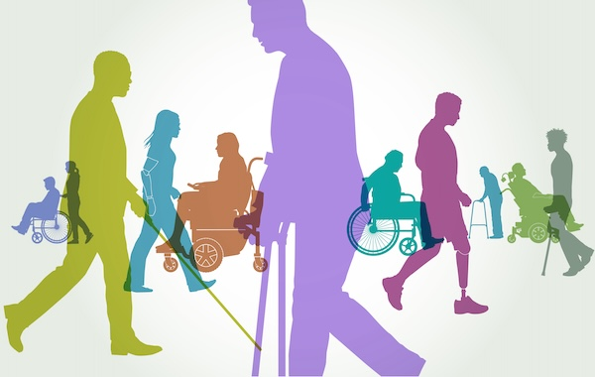
Clinics' Responsibilities
The ADA, Section 1557, and Section 504 prohibit discrimination against people with disabilities and require medical providers to make their services and programs available in an accessible manner. This includes:
Providing reasonable accommodations (RAs)
Ensuring effective communication
Having accessible facilities and equipment

Slide 33
Reasonable Accommodations (RAs)
Definition: Changes to the usual way of doing things to include people with disabilities and provide equal opportunity for them to benefit from services.
It is discrimination to fail to provide reasonable accommodations to disabled patients unless doing so will “fundamentally alter” the nature of the services or benefits provided or result in an “undue burden.”
Notes:
Fundamental alteration: changes the essential nature of the program or service or activity
Undue burden: significant difficulty or expense (generally a pretty high bar, the significant expense argument is considered in light of the entity's entire budget)

Slide 34
Examples of Common RAs
Reserving additional time for an appointment
Allow for physical transferring, engaging with interpreters, checking understanding
Allowing a support person to be present at an appointment
Utilizing supported decision-making
Performing a pelvic exam in an alternative position
Moving items that might block the path of travel
Reserving an appointment room that has accessible equipment
Allowing time for breaks
Turning down the brightness of the exam room lights
Providing a written outline of the information discussed
Wearing a mask if a patient requests one
The possibilities are endless!
Notes:
Non exhaustive list, pretty much anything that could be considered reasonable is possible. patient is the expert in their needs.

Slide 35
RA Spotlight: Supported Decision-Making
Supported decision-making ("SDM"): individualized arrangement in which a disabled adult chooses one or more people they trust as supporters to help them understand, communicate, make, or act on their own choices.
Looks different for each person
Can be formal (written) or informal agreement
Can strengthen capacity and avoid the need for a conservator in decision-making
Recognized under California law, see Probate Code §§ 1800(e), 1800.3(c), 1821(a)(1)(C)(i), 1836(b)(1), (d)(3), (4), 2113, Cal. Welf. & Ins. Code § 21000 to 21008
Notes:
So we wanted to introduce you to the concept of supported decision-making, which may be a useful tool for people with I/DD when making decisions about their medical care.
It could be a reasonable accommodation in sexual and reproducitve health care appointments including abortion appointments, and if you have a constituent with I/DD who you think might be a good fit for this tool, you could provide them with information about it.
For some context, some caretakers of people with disabilities may seek guardianship in order to exert control over a disabled persons reproductive health decisions, and obviously this can prevent disabled people from exercising bodily autonomy. Supported decision-making is a less restrictive alternative to reliance on guardians in decision-making. 84% of states mandate that less restrictive alternatives be used before a guardianship is put in place, and 22% name SDM as one of those options that should be considered. so its good to be aware of this tool and not assume that a person with a disability needs a guardian involved in order to make a decision

Slide 36
Supported Decision-Making v. Conservatorship
SDM
Conservatorship
Disabled person makes their own choices but receives help from supporters in the process
Disabled person chooses their own supporters
Can strengthen capacity and avoid need for conservatorship
Conservator makes choices for the person with a disability, often without consulting them.
Conservator is appointed by a court and can only be removed by a court
Conservator's decisions must be approved by a court

Slide 37
Capacity
Capacity is spectrum – not yes/no question
Changes with context, topic, emotional & physical state, etc.
Individual may have capacity to make medical or mental health decisions without understanding every aspect of diagnosis or treatment
Capacity is flexible and can be strengthened
Plain language can strengthen capacity
Reasonable accommodations can strengthen capacity: time of day; format, duration, location of meetings; breaks; repetition
Supported decision-making (SDM) can strengthen capacity
Assess capacity with preferred supports in place
Notes:
Often times in the context of big medical decisions like whether or not to have an abortion, undergo sterilization or choose contraception, the question of capacity arises. So its important to remmeber that capacity is not fixed --

Slide 38
Who Can Benefit From SDM?
Anyone! Everyone asks others for support when making important decisions.
SDM may be especially helpful for people who need additional help with:
Identifying and weighing options
Understanding the risks and benefits
Choosing between options
Communicating the choice
Acting on the choice
A person who has a guardian in a different part of their life (for example, their finances) may still be competent to make decisions about their medical care with or without support.

Slide 39
Effective Communication
Under the ADA, Section 504, and Section 1557 medical providers are required to ensure effective communication with disabled patients. This may include the provision of auxiliary aids and services.
Ensuring effective communication may require:
Qualified interpreters (in-person or through video remote interpreting (VRI));
Real-time captioning, particularly for video telemedicine;
Assistive listening devices and systems (e.g. hearing loop, pocket talker);
Offering written materials in alternative formats such as Braille materials or large print;
Providing written notes summarizing the information provided; and
Using plain language (e.g. sixth grade English) and visual aids
Notes:
Providers should consult with the disabled patient to determine the best way to ensure effective communication
When auxiliary aids and services are necessary, they must be provided in accessible formats, in a timely manner, and in a manner that appropriately protects the privacy of the patient

Slide 40
Accessible Facilities and Medical Equipment
The ADA and Section 504 require that medical providers give disabled people full and equal access to their facilities and medical equipment.
Government providers that receive federal money must make their programs as a whole accessible to and usable by individuals with disabilities.
Nondiscrimination includes:
Removing architectural barriers
Acquiring accessible medical equipment - now required under new Section 504 regulations
Where barrier removal would be an undue burden, making services available through an alternative location or method
Notes:
DREDF is currently working on a factsheet about the new MDE regulations

Slide 41
New Section 504 Regulations
On May 9, 2024, HHS released their finalized rule for Section 504 regulations which goes into effect on July 8, 2024:
Prohibits provision, denials or limitations of medical treatment when based on:
Bias or stereotypes about an individual’s disability;
Judgments that they will be a burden on others due to their disability, including, but not limited to caregivers, family, or society; or
A belief that the life of a person with a disability has lesser value than a person without a disability, or that life with a disability is not worth living.
Prohibits discrimination in child welfare, including decisions based on stereotypes or generalizations about a child with a disability; or that a parent or caregiver with a disability cannot safely care for a child.
Web, kiosk, and mobile accessibility is required
Incorporates the U.S. Access Board’s 2017 Standards for Accessible Medical Diagnostic Equipment (MDE)
45 CFR § 84
Notes:
If a covered entity uses MDE, then 10% of units (and no less than 1) must meet the Standards
Within 2 years, covered entities must have at least 1 exam table and 1 weight scale that meet the Standards, provided they use such equipment

Slide 42
New Section 1557 Regulations
On April 26, HHS released their finalized rule for Nondiscrimination in Health Programs and Activities which goes into effect July 5, 2024:
Requires covered health care providers, insurers, grantees, and others to let people know that language assistance and accessibility services are available to patients at no cost. Covered entities are also required to train their staff on these policies and procedures.
Clarifies that covered health programs and activities offered via telehealth must also be accessible to individuals with limited English proficiency and individuals with disabilities.
Protects against discrimination by codifying that Section 1557’s prohibition against discrimination based on sex includes LGTBQI+ patients.
42 CFR Parts 438, 440, 457, 460; 45 CFR Parts 80, 84, 92, 147, 155, 156

Slide 43
New HIPAA Regulations
On April 22, HHS released the finalized rule for HIPAA Privacy Rule To Support Reproductive Health Care Privacy which went into effect on June 25, 2024:
Prohibits the use or disclosure of protected health information (PHI) by a covered health care provider, health plan, or health care clearinghouse—or their business associate—for either of the following activities:
To conduct a criminal, civil, or administrative investigation into or impose criminal, civil, or administrative liability on any person for the mere act of seeking, obtaining, providing, or facilitating reproductive health care, where such health care is lawful under the circumstances in which it is provided.
The identification of any person for the purpose of conducting such investigation or imposing such liability
Creates a presumption that the reproductive health care provided by a person other than the covered entity receiving the request was lawful.
42 CFR § 2
Notes:
We should add cites for each

Slide 44
Resources
National Network of Abortion Funds is a directory of abortion funds and other support resources in the US.
Abortion Finder is a comprehensive directory of trusted (and verified) abortion service providers and assistance resources in the US.
I Need an A is a comprehensive resource guide for abortion seekers in the US.
All Options Talkline is a free peer counseling support network for anyone at any stage in or after their pregnancy. They can be reached at (888) 493-0092.
Exhale Pro-Voice is a free talkline for people who need emotional support after having an abortion. They can be reached at (866) 439-4253.
If/When/How Repro Legal Helpline provides free, confidential legal services for your reproductive life, including abortion, pregnancy loss, and birth. They can be reached at (844) 868-2812 or at https://www.reprolegalhelpline.org/

Slide 45
Questions?

Slide 46
Thank You!
Presenter Contact Info
Jillian MacLeod: jmacleod@dredf.org
Amanda Spriggs Reid: a.spriggs@womenenabled.org

