Slide 1
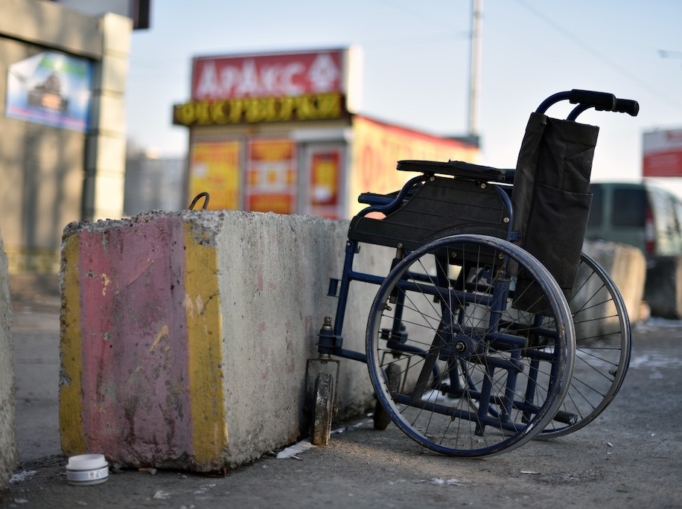
How Reasonable Accommodations Under the Americans with Disabilities Act Can Help Unhoused People with Disabilities
February 20, 2024
Presented by
Erin Nguyen Neff, Staff Attorney
Michelle Uzeta, Deputy Legal Director
Disability Rights Education & Defense Fund

Slide 2
Training Agenda
Background: What is the ADA? What does the ADA cover?
Explanation of reasonable accommodation/modification.
Using reasonable accommodations while living in an encampment and examples.
Using reasonable accommodations in a shelter and examples.
How to request a reasonable accommodation.
Example Reasonable accommodation
Reasonable accommodation process.
Questions

Slide 3
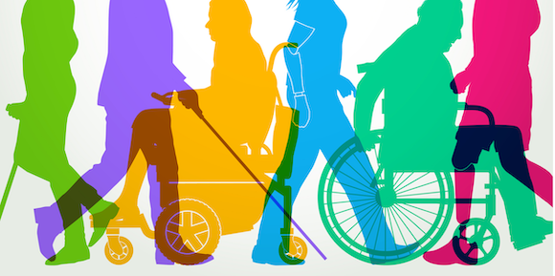
What is the Americans with Disabilities Act (ADA)?
Federal law that makes it illegal to discriminate against people with disabilities
Title II - Covers activities, programs, and services of state and local governments, including departments, agencies, etc. (42 U.S.C. § 12131(1)(B); Lee v. City of Los Angeles, 250 F.3d 668, 691 (9th Cir. 2001)).
Title III covers privately owned “public accommodations” like restaurants, hotels, gyms, stores, etc. and can include shelters (42 U.S.C. § 12181(7)(k))
Exemptions may apply to religious organizations (42 U.S.C. § 12187)

Slide 4
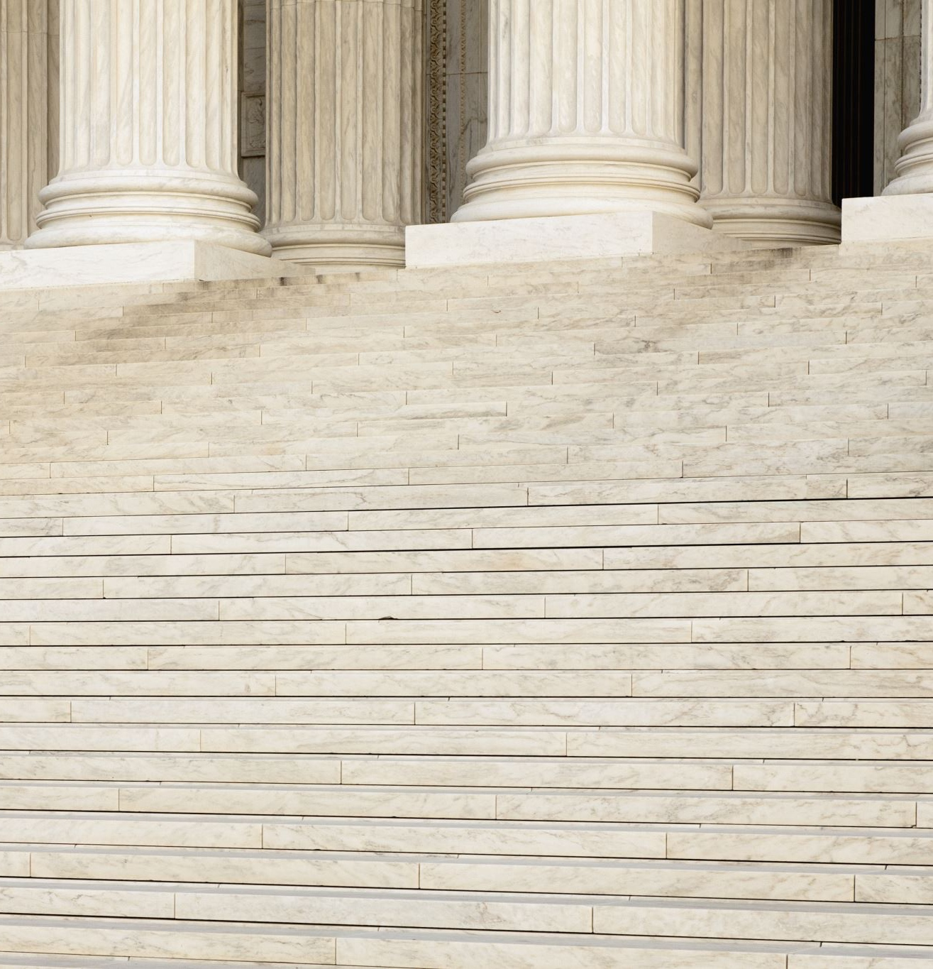
What Does “Discrimination” Include?
Excluding from participation or denying benefits
Providing aid, benefits, or services that are unequal, not as effective or segregated (integration mandate)
Operating a service, program or activity in a way that has a discriminatory effect (methods of administration)
Selecting inaccessible facility sites and locations
Failure to maintain accessible features
Utilizing discriminatory eligibility criteria
Failure to provide effective communication
And more! (see 28 C.F.R. Part 35, Subparts B, D, E)

Slide 5
What is a reasonable accommodation?
Changes to a public service, benefit, or program for people with disabilities so they can take part in the service. (28 CFR 35.130(b)(7)(i); McGary v. City of Portland, 386 F.3d 1259, 1265–66 (9th Cir. 2004).
Change the way a city or state law works so the law is not harder on people with disabilities than people without disabilities (McGary v. City of Portland, 386 F.3d 1259, 1265–66 (9th Cir. 2004)).
Modifications of health & safety regulations that seem neutral but is harder on people with disabilities. (Crowder v. Kitagawa, 81 F .3d 1480, 1482, 1485 (9th Cir. 1996)
Example: A local law requires unhoused people to remove camp belongings everyday by 9am. An unhoused person who has physical limitations can ask for a reasonable accommodation to change how the law applies to them to allow them to keep their belongings outside or have more time.

Slide 6
Reasonable Modifications/Accommodations
The government has an affirmative obligation to provide “reasonable modifications.
A public entity shall make reasonable modifications in policies, practices, or procedures when the modifications are necessary to avoid discrimination on the basis of disability, unless the public entity can demonstrate that making the modifications would fundamentally alter the nature of the service, program, or activity.
(28 C.F.R. § 35.130(b)(7)(i); Tennessee v. Lane, 541 U.S. 509, 512, 124 S. Ct. 1978, 1982, 158 L. Ed. 2d 820 (2004))

Slide 7
Reasonable Accommodations continued.
Alterations to a public service, benefit, or program for people with disabilities so they can take part in or benefit from the service.
Changes in the way a city or state law works so it is not harder on people with disabilities than people without disabilities
Modifications of health & safety regulations that seem neutral but disproportionately burden people with disabilities.
See, e.g. McGary v. City of Portland, 386 F.3d 1259, 1265–66 (9th Cir. 2004); Crowder v. Kitagawa, 81 F .3d 1480, 1482, 1485 (9th Cir. 1996)

Slide 8
What is a government service, program, activity?
“Anything a public entity does.” like work to carry out city ordinances to maintain public spaces (Barden v. Sacramento, 292 F.3d 1073, 1076 (9th Cir. 2002)).
Arrests / Police activities (Sheehan v. City & County of San Francisco, 743 F.3d 1211, 1232 (9th Cir. 2014), rev’d in part, cert. dismissed in part sub nom. City & County of San Francisco, Calif. v. Sheehan, 575 U.S. 600 (2015))
Clearing encampments – (Where Do We Go Berkeley v. California Dep't of Transportation, 32 F.4th 852, 861 (9th Cir. 2022))
Case management, housing search, other support services.
Safe camping sites, shelters

Slide 9
Removing Encampments
An encampment sweep is considered a service of the local government and therefore covered under the ADA.
(Cooley v. City of Los Angeles, 2019 WL 3766554, at *6 (C.D. Cal. Aug. 5, 2019); McGary v. City of Portland, 386 F.3d 1259, 1265–66 (9th Cir. 2004); Tyson v. City of San Bernardino, Case No. EDCV 23-01539 (motion for preliminary injunction granted 01/12/24))

Slide 10
Examples of Reasonable Accommodations for People in Encampments
More time to move camp after getting a notice to move
Assistance with moving items
Changes in time/manner of moving items
Special care for medical equipment/medication
Keeping items instead of storing them
Request to stay in a certain location to be near doctor, hospital, treatment center, food, etc.
Exceptions to laws

Slide 11
Other state and local government requirements
Effective communication, auxiliary aids and services when needed to give people with disabilities the ability to take part in the service (28 CFR 35.160)
Covers any notices including notice that a sweep will happen.
Make sure people with disabilities, including persons with impaired vision or hearing, can get information on accessible services, activities, and facilities (28 CFR 35.163)
Must let people know the location of accessible shelters and services.

Slide 12
Reasonable Accommodations for Shelters and safe camping site
Shelters or safe camping sites must provide reasonable accommodations [Fair Housing Laws may also apply]
Must have accessible bathrooms, transportation (if provided)
RA Examples:
Allowing service animals or emotional support animals even if shelters have a no pet policy.
Particular type of bedding to help someone with physical needs.
Private space for someone who can’t be around others because of a disability
Being with an aide, friend, or other person who provides support or personal care services
Accommodations around bathrooms, showers, etc. for physical needs.

Slide 13
How to make a reasonable accommodation request
Check if your city has a reasonable accommodation process.
ADA requires state and local entities to have at least one employee or “ADA Coordinator” to work on ADA needs. (28 CFR 35.107).
Might have online request form or email or phone number (supposed to be publicly available)
Requests may be made to other government entities that are not ADA coordinators.
Example: Made directly to a police officer giving notice to move encampment.
Request can be verbal or in writing. Writing is best!
Requests can be made at anytime, including during a sweep.

Slide 14
Information to include in your request
Name
How to contact you (phone, email, location of tent, friend’s phone)
State you are a person with a disability
(Do not need to give exact diagnosis)
Describe accommodation you need
Describe connection between disability and accommodation
Give a timeline or specific date and time for a response.

Slide 15
Tips when making a request
Keep records of your request, keep all emails, writing, names of witnesses, etc.
Note who you made the request to and who responded
Post your request on your tent or other visible place in an encampment
Make request as soon as possible
Be specific:
Bad: I need time to move my camp.
Good: I need until December 3rd at 5:00 to move my camp.
You don’t need to make the request yourself; someone can help you or make the request on your behalf.

Slide 16
Camp Integrity San Rafael, CA
Dear ADA Coordinator,
My name is [Name] and I live at the Camp Integrity camp site in a blue North Face tent near the entrance of the Mahon Creek Path. I have a physical disability and must use a wheelchair. Because of my disability I would like to ask for a reasonable accommodation under the Americans with Disabilities Act to put in wheelchair accessible portable bathrooms at the campsite. Please let me know by June 30, 2024, if you will accept my request. Please contact me at 555-7398.
Thank you,
Camp Resident

Slide 17
What happens after you make a request?
City makes a fact specific investigation (Wong v. Regents of Univ. of Cal., 192 F.3d 807, 818 (9th Cir. 1999)).
May engage in an interactive process.
Your exact request may not be granted
City can suggest different accommodation
You may be asked to give documentation of your disability.
Doctor’s note, proof of SSI, social worker attestation, proof of veteran benefits, other medical professional note, medication, prescriptions.
Documentation not required if disability is obvious – wheelchair, cane, hearing aids, physical appearance.

Slide 18
A Reasonable Accommodation Request May be Rejected if:
Request is not reasonable
Example: Requesting six months to move a camp
Fundamentally changes the service, benefit, activity (28 C.F.R. § 35.130(b)(7)(i))
Example: Requesting a shelter provide regular therapy services, when the shelter’s only function is to give people a place to sleep.
A person is a direct threat to health or safety of others ((28 C.F.R. § 35.139(b)

Slide 19
Direct Threat to Health and Safety
Must be based on the personal characteristics of each person and current medical knowledge (28 C.F.R. § 35.139(b))
Cannot be based on stereotypes or assumptions.
A person with schizophrenia is not automatically considered a direct threat to health and safety.
Probability that an injury would actually happen.
Type of risk, how long it would last, and how bad it is.
Example: A person who may yell and insult people but who otherwise does not act violently toward people is likely not a risk to health and safety.
Not a threat if a reasonable accommodation removes risk. (28 C.F.R. § 35.139(b))
Example: A reasonable accommodation for a private space for a person who had a physical conflict with someone else.

Slide 20
Hypothetical
A local law requires people who are unhoused to remove their belongings from the public park everyday by 7 a.m. Chris, an unhoused person who sleeps in the park has physical limitations and requires additional time and assistance to move their belongings. Chris has a friend that can help them move at 10 a.m.
What are Chris’ rights in this situation, if any?
Is there a potential violation of the ADA?
How would you proceed in helping / supporting Chris?

Slide 21
Hypothetical
Quyen wants to enter a shelter and she has an anxiety disorder that makes her uncomfortable being around other people. The sleeping arrangement in the shelter is a big open space with cots for people.
Is there any potential violation of the ADA?
What reasonable accommodation can Quyen ask for?
What is the likely response of the shelter/city?

Slide 22
Questions?
If you have additional questions, please email Erin at eneff@dredf.org

