Slide 1
Disability Community Briefing: What You Can Do to Stop the Attack on Section 504
February 12, 2025

Slide 2
Welcome
Notes:
There are a lot of people here! Welcome!

Slide 3
Welcome!
Disability Community Briefing on Texas v. Becerra (N.D. Tex.)
Case filed in federal court attacking Section 504 of the Rehabilitation Act
Historical photo from the Section 504 Sit Ins

Slide 4
Presenters
Claudia Center (she/her), Legal Director, Disability Rights Education & Defense Fund
Alison Barkoff (she/her), Director, Hirsh Health Law & Policy Program at GWU. Previous: Acting Administrator & Asst. Secretary for Aging, Principal Deputy Administrator, ACL, U.S. Dep’t of Health & Human Services
Steven Schwartz (he/him), Founder & Special Counsel, Center for Public Representation
Theo Braddy (he/him), Executive Director, National Council on Independent Living
Howard Rosenblum (he/him), Chair, Deaf Equality
Chloe Rothschild (she/her), Autistic Self-Advocate, Presenter, Author, Board Member of The Arc of the United States

Slide 5
Topics to Be Covered
What is Section 504? What is the Spending Clause? What are Section 504 regulations?
Updated (May 2024) HHS Section 504 regulations
What is Texas v. Becerra? What risks does this case pose?
How does Section 504 and the updated regulations support independent living?
Video: Perspective of an autistic self-advocate
Action Alert
Questions & Answers

Slide 6
Section 504 of the Rehabilitation Act
Short statute first enacted 1973 – 46 words!
Applies to any entity that receives “federal financial assistance” – this means federal dollars
504 = “Spending Clause” statute
This is a clause in the U.S. Constitution (Article I, Section 8, Clause 1)
Other Spending Clause statutes cover race and sex discrimination
All the detail is in the Section 504 regulations
First adopted in 1977
The Power of 504
Crip Camp

Slide 7
Department of Health and Human Services (HHS)
Updated Section 504 Regulations
Updated Section 504 regulations cover all HHS-funded programs and activities, including:
Doctors, hospitals and medical facilities that take Medicaid or Medicare
State Medicaid, disability and aging programs
Child welfare systems
Clinical research
Longstanding discrimination in health and human services became even more visible during the COVID-19 pandemic
Discrimination in accessing lifesaving treatment
People losing services and forced into institutions with the highest death rates
Inaccessible information, websites, and vaccination sites

Slide 8
The Disability Community Shaped the Section 504 Regs
Disability community pushed to update the Section 504 regulations
Disability advocates identified the major areas where updated regulations were needed
Notice of Proposed Rulemaking (NPRM) issued in September 2023
Described evidence and reasons for updating rule and asked for feedback
More than 5,000 comments from disabled people, advocacy organizations and other stakeholders
Final Section 504 rule issued in May 2024
Responded to all public comments
Described the changes made (and not made) in response to comments and why

Slide 9
This is the disability community’s rule!

Slide 10
Major Areas in the Updated Section 504 Regs
No Discrimination in Medical Treatment
Prohibits medical decisions based on bias/stereotypes, judgments that disabled people are a burden, or beliefs that the lives of disabled people are worth less
Applies to organ transplantation, life-sustaining treatment, clinical research, and crisis standards of care
Prohibits the use of value assessment methods that place a lower value on the lives of disabled people (like Quality Adjusted Life Years or QALYs) when used to limit of deny access to benefits or services

Slide 11
Major Areas in the Updated Section 504 Regs (2)
Accessible Medical Equipment
Requires covered providers to ensure accessible medical equipment
Exam tables, mammogram machines and weight scales
Set number of accessible equipment items within two years
Aligned with DOJ Title II rules for public entities
Accessible Websites and Mobile Apps
Sets accessibility standards for websites and mobile apps (WCAG 2.1)
Aligned with DOJ Americans with Disabilities Act (ADA) Title II standards for public entities
Requires accessible kiosks

Slide 12
Major Areas in the Updated Section 504 Regs (3)
Integration and Olmstead
Puts into regulation extensive case law interpreting the integration mandate and the Olmstead decision
Defines integration & segregation
Explicit application to residential, day and educational services
Coverage of people in or at risk of institutionalization & segregation

Slide 13
Major Areas in the Updated Section 504 Regs (4)
Effective Communication
Aligned with strong DOJ Title II standards for public entities
“Primary consideration” to requests of disabled person
Examples: sign language, captions, alternative formats, plain language
Reasonable modifications
Includes supported decision-making

Slide 14
Major Areas in the Updated Section 504 Regs (5)
Child Welfare Systems
Prohibits discrimination against parents/prospective parents with disabilities and disabled children with disabilities in or at risk of entering foster care
Covers child welfare services like parent-child visitation, reunification services, child placement, parenting skills programs and in- and out-of-home services
Service animals, accessibility standards, mobility devices, etc. aligned with ADA regulations

Slide 15
The Section 504 Regs Are Now In Effect
Section 504 Regulations became effective July 8, 2024 (60 days after publication
Can be enforced by HHS’ Office for Civil Rights or private lawyers (like protection and advocacy agencies)
The law and regulations remain in place unless and until a court makes a decision otherwise or HHS changes them through notice and comment rulemaking
More info on the regulations (working pages as of 2/10/25):
HHS OCR webpage
HHS Administration for Community Living webpage

Slide 16
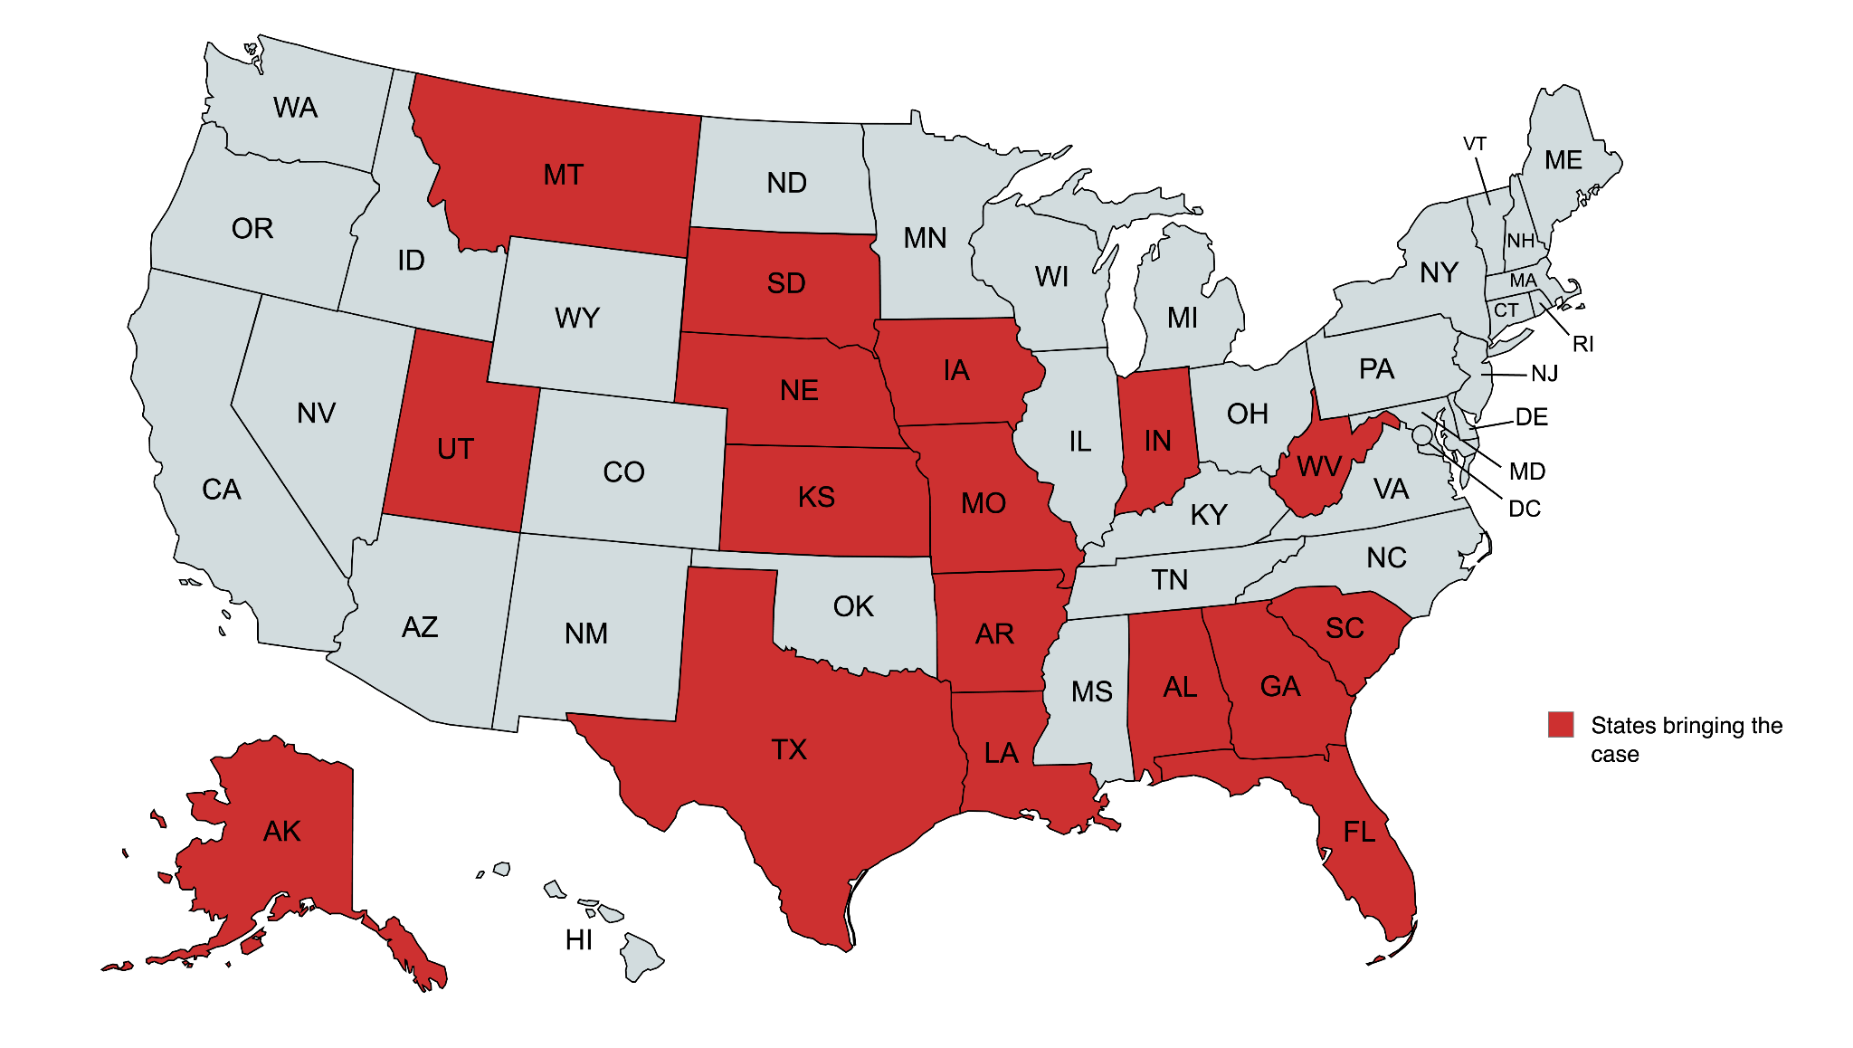
The Legal Challenge to 504 – Texas v. Becerra
On September 26, 2024, Texas and 16 other states (in red) filed a lawsuit in the Northern District of Texas
The case challenges the new 504 rule
And even the constitutionality of Section 504 of the Rehabilitation Act
The challenge to the rule attacks transgender people, disabled people, and people living at the intersection of both identities. Hence, a need for a united response.

Slide 17
The Legal Challenge to 504 – Texas v. Becerra (2)
The lawsuit also claims that requirements to provide services “in the most integrated setting” and to people “at risk of institutionalization”
Are illegal and improper
And are inconsistent with the Olmstead decision
It claims that the entire rule is arbitrary and capricious (invalid), because it interferes with the State’s discretion in providing disability services
Mostly the states are concerned with the cost of compliance, particularly for Medicaid and Medicare health care services

Slide 18
The Legal Challenge to 504 – Texas v. Becerra (3)
Screenshot from the complaint

Slide 19
The Legal Challenge to 504 – Texas v. Becerra (4)
Fifty years after Section 504 of the Rehabilitation Act was passed, this new lawsuit claims that banning discrimination in all federally-funded programs is – and always was – unconstitutional because Congress cannot restrict the use of all federal funds in this way.
What this could mean…
That other civil rights statutes which prohibit discrimination on the basis of race, sex, and ethnicity are also unconstitutional.
And because the Americans with Disabilities Act (ADA)’s enforcement scheme cross-references Section 504 and other discrimination statutes, it may imperil the ADA as well.

Slide 20
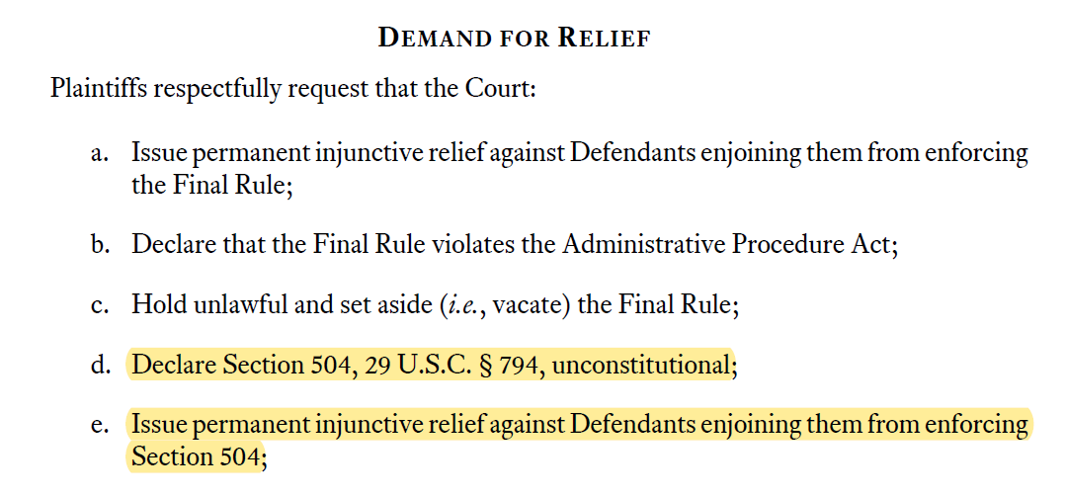
The Legal Challenge to 504 – Texas v. Becerra (5)
Screenshots from the complaint

Slide 21
The Status of the Case
Initially, DOJ planned to aggressively defend both the rule and the statute, and agreed to a tight timeline for filing all briefs, which the Court adopted
Recently, the parties asked to pause this timeline while the confer about the status of the rule and the case
The Court ordered a status report by February 25, 2025
There now is great uncertainty about whether DOJ will defend the rule, the statute, or the case
Similarly, there is uncertainty whether Texas and the other states will dismiss the case even if HHS withdraws or reconsiders the rule

Slide 22
Next Steps
Given these uncertainties, which may not be fully resolved later this month, disability advocates are preparing for all options
Some organizations may be willing to join the case or present arguments in favor of the rule and statute through amici briefs
Some members of Congress and progressive attorneys general may be willing to help as well
But this is a clear threat to the rights of disabled people everywhere, and even to the basic, long standing laws which we fought hard to pass

Slide 23
Testimony: Theo Braddy
Executive Director, National Council on Independent Living

Slide 24
Testimony: Howard Rosenblum
Chair, Deaf Equality

Slide 25
Testimony: Chloe Rothschild Autistic Self-Advocate, Presenter, Author, Board Member of The Arc of the United States

Slide 26
How You Can Take Action

Slide 27
Tell Your State Attorney General to Stop Attacking Section 504
Visit dredf.org/protect-504
Contact Your State Attorney General
By email (next slide has sample language)
By contact form / website
By phone
Notes:
List of all the state AGs: https://docs.google.com/document/d/e/2PACX-1vRDybwpX8OLsOhc6ldIje6atdlmmS8VwdYh4uEEE-ibyGPG1N7HDT9v71RBi-IZeU0mEurDLgPhO2v_/pub
Stay up to date link: https://dredf.us2.list-manage.com/subscribe?u=d8372142072c8ce7f2e90e349&id=c15e323206

Slide 28
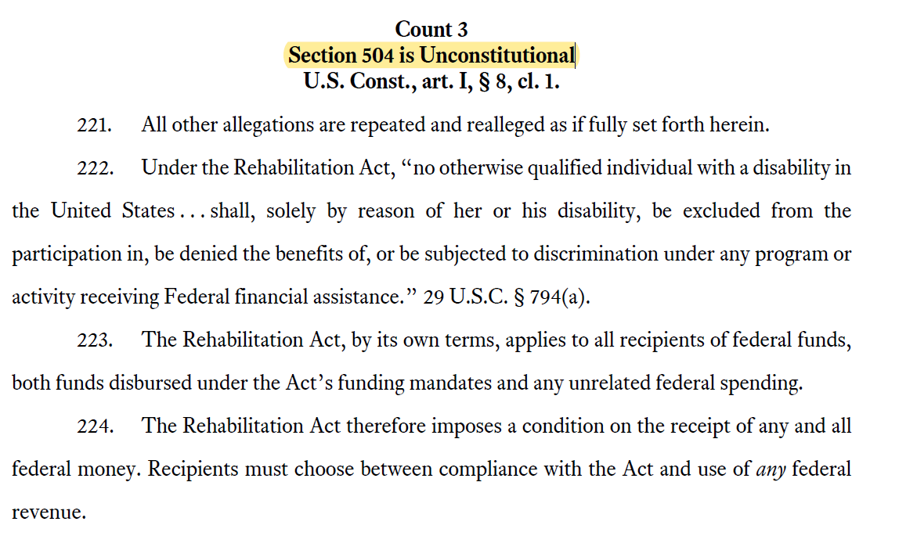
Tell them, this is not ok!
Notes:
Link to the complaint: https://www.texasattorneygeneral.gov/sites/default/files/images/press/HHS%20Rehabilitation%20Act%20Complaint%20Filestamped.pdf

Slide 29
Example Email
To: attorney.general@alaska.gov Subject: Stop Attacking Section 504! Drop Out of Texas v. Becerra!
Dear Attorney General [Treg Taylor],
[Say who you are] I live in Juneau, Alaska, and I have a disability. I am hard of hearing and use a wheelchair. I volunteer for the Southeast Alaska Independent Living Center. I go to college part time.
[Say why you support Section 504 and its rules] I care about Section 504. I can go more places in my wheelchair because of Section 504. I can go to the doctor and use a scale for people who use wheelchairs. I can get captions for my college classes. I support the updated Section 504 rules. The updated rules are stronger and give more examples of what disability discrimination is.

Slide 30
Example Email (continued)
[Say why Texas v. Becerra is bad] I am very upset and angry that you have joined a case in Texas called Texas v. Becerra that goes against Section 504 and the updated rules. You are asking the court to get rid of the Section 504 rules and the entire law. If the court does what you ask, I will not be able to go to the doctor or my college classes and get equal treatment. I will not have equal rights. This will be true for all the other disabled people in Alaska.
[Say you want them to drop out of the case] I want you to drop out of Texas v. Becerra. You should support Section 504 and its rules. You should not be attacking our rights.
[Ask for a meeting] I want you to meet with me and other people with disabilities. We want to talk to you about the case and why we are so concerned about it.
Sincerely,
[Your name]

Slide 31
We must continue to work in coalition with each other to protect Section 504, and other disability rights laws, no matter where the threat is coming from.

Slide 32
Questions?

