Slide 1
Legal Advocacy for Unhoused People with Disabilities: Toolkit to Challenge California Laws Criminalizing Homelessness
March 6, 2025
Erin Nguyen Neff, Senior Staff Attorney
Disability Rights Education & Defense Fund

Slide 2
Agenda
Overview of DREDF and Toolkit Content
Americans with Disabilities Act: Disparate Impact
Americans with Disabilities Act: Reasonable Modifications
Question and Answers
Brigitte Nicoletti, Staff Attorney/Clinical Supervisor, East Bay Community Law Center
EmilyRose Johns, Attorney, Siegel, Yee, Brunner & Mehta
Jason Sarris, Formerly Unhoused and Community Activist
Robbie Powelson, Community Activist
Sabyl Landrum, Senior Staff Attorney, East Bay Community Law Center

Slide 3
Disability Rights Education & Defense Fund
DREDF – Support Center For qlsp
Contact Information
Website: www.dredf.org
Email: eneff@dredf.org or info@dredf.org
Phone (510) 644-2555 ext. 5256
Specialized knowledge on disability
Unhoused rights
Housing Rights/Tenant Rights
Special Education
Health/Medical
Transportation
Reproductive Rights

Slide 4
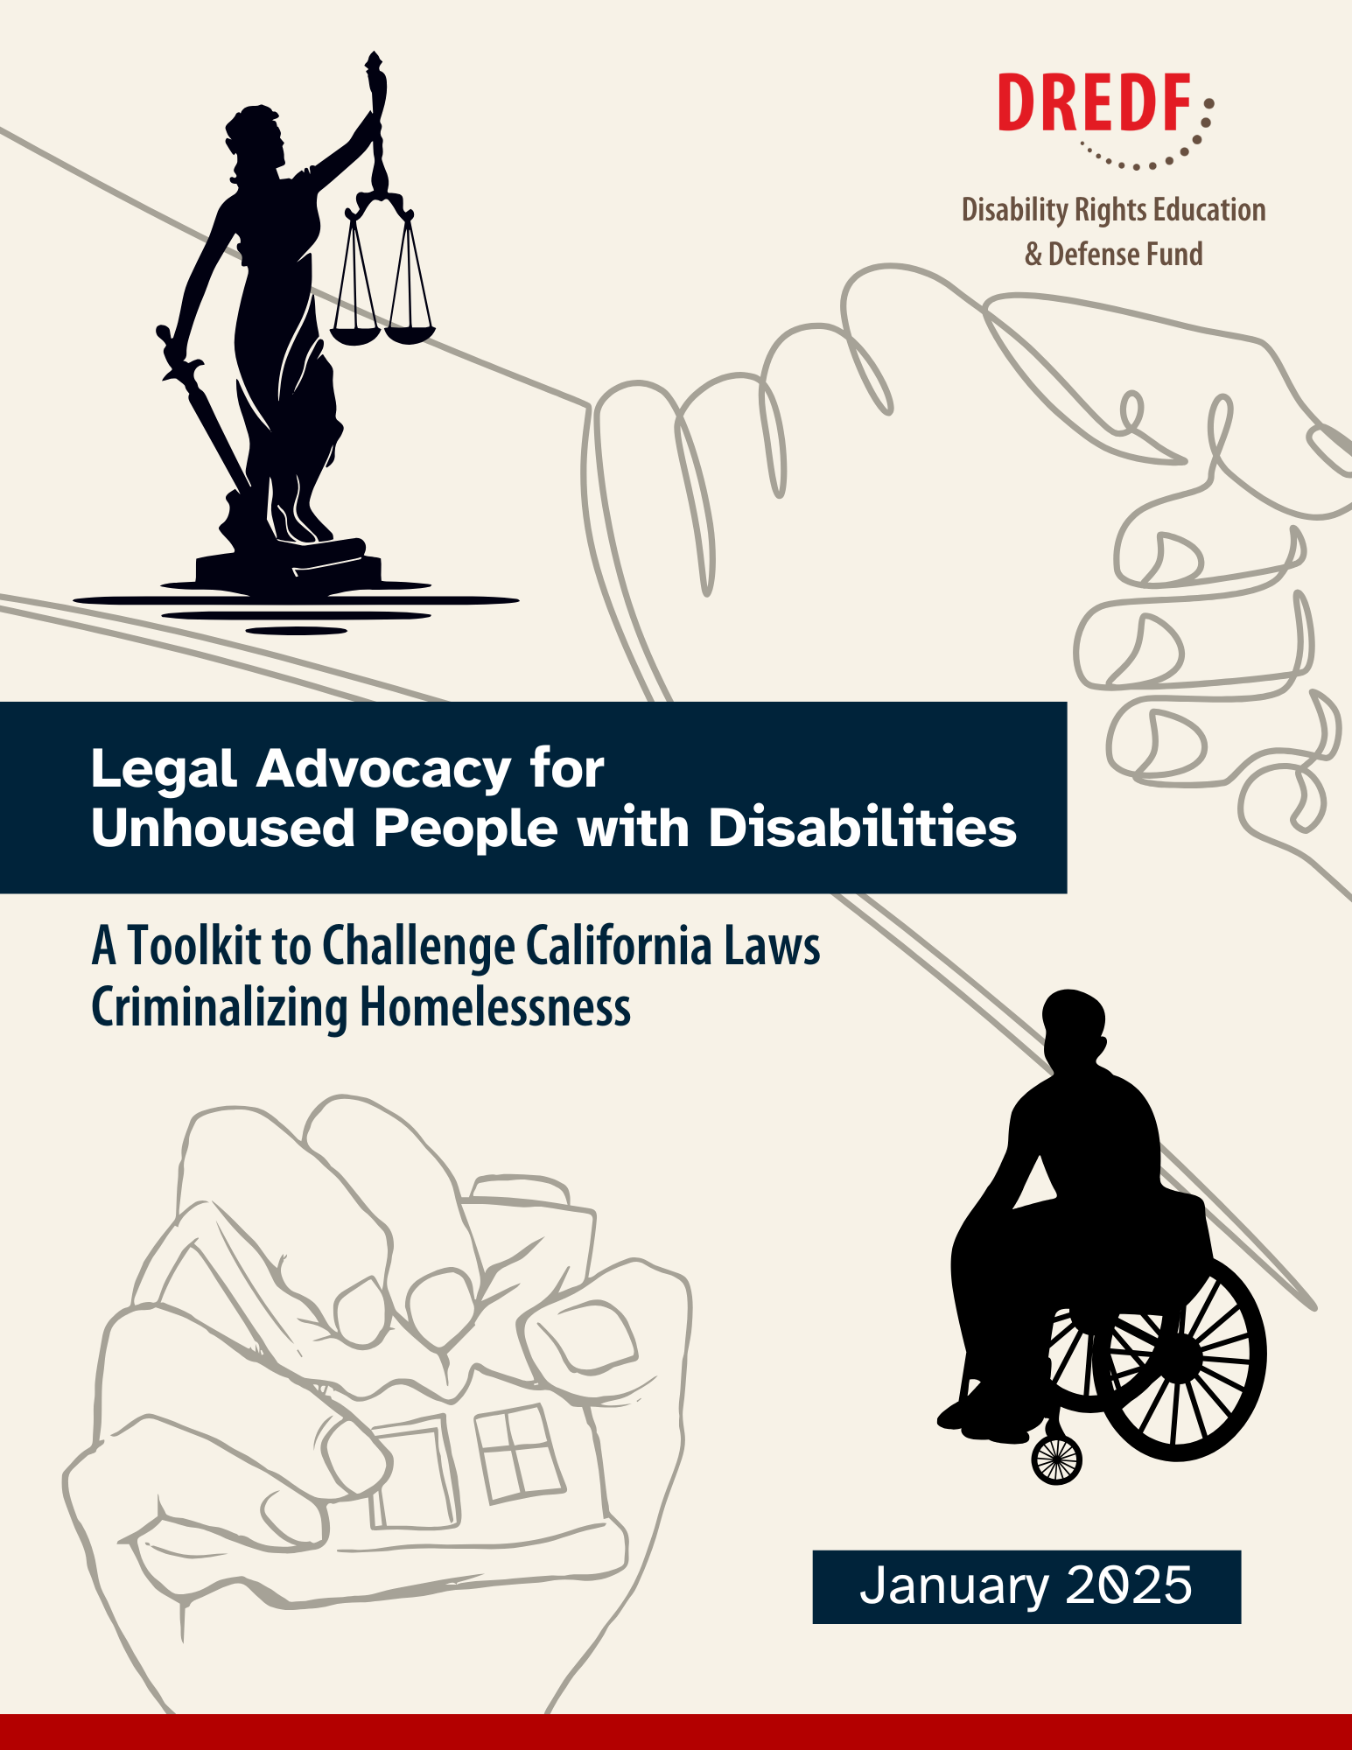
Toolkit Table of Contents
Chapter 1: Background
Chapter 2: Disability Law
Chapter 3: Title II of the Americans with Disabilities Act
Chapter 4: Reasonable Modifications under Title II of the Americans with Disabilities Act
Chapter 5: Government Responses to Title II of the Americans with Disabilities Act
Link: https://dredf.org/legal-advocacy-for-unhoused-people-with-disabilities-toolkit/

Slide 5
Americans with Disabilities Act: Title II
Application of Title II
Title II Prohibits
“[S]ervices, programs, or activities” of city and state government, law enforcement, and other government departments and agencies.
Anything public entity does
Encampment sweeps
Disparate Treatment
Disparate Impact
Failure to make a reasonable modification/accommodation

Slide 6
ADA Title II: Disparate Impact
“[F]acially neutral government policy or practice has the ‘effect of denying meaningful access to public services’ to people with disabilities.” Payan v. Los Angeles Cnty. Coll. Dist., 11 F.4th 729, 737 (9th Cir. 2021)
Neutral policy with disproportionate burden on a disabled person.
Person with disability has burden of proof.
Do not need to show discriminatory intent.

Slide 7
Anti-Camping Laws & Disparate Impacts
Legal Provision
Disparate Impact
Requirement to move every 24 hours
Limitations on the number of people in an encampment
Some people with mobility disabilities will not be able to move in 24 hours and are thus more likely to lose their items and be arrested.
People with disabilities who rely on others to help with daily activities or provide emotional support cannot camp with others.

Slide 8
Anti-Camping Laws & Disparate Impacts continued
Legal Provision
Disparate Impact
Limitations on locations of camping, such as no camping in parks, near schools, near critical infrastructure, etc.
Could prevent a disabled person from being near public transit, doctor’s offices, and resources. Forces people with I/DD into unfamiliar places causing distress.

Slide 9
Bloom v. San Diego
RV parking ordinance
Applied to disabled and non-disabled people equally
Enforcement burdened disabled "persons in a manner different and greater than it burdens others.”
People with disabilities were uniquely dependent on RVs to live
Therefore, the City's ordinances "effectively denie[d] these persons…meaningful access to the City's services, programs, and activities, which are easily accessible by others.”

Slide 10
ADA: Reasonable Modifications
Changes to a public service, benefit, or program for people with disabilities so they can take part in the service. (28 CFR 35.130(b)(7)(i); McGary v. City of Portland, 386 F.3d 1259, 1265–66 (9th Cir. 2004).
Affirmative Obligation (28 C.F.R. § 35.130(b)(7)(i); Tennessee v. Lane, 541 U.S. 509, 512, 124 S. Ct. 1978, 1982, 158 L. Ed. 2d 820 (2004))
Examples:
More time to move before an encampment sweep
Assistance in moving belongings
Exceptions to location limitations

Slide 11
Reasonable Modifications
A reasonable modification in one context may be unreasonable in another
Fact specific
Individualized
Provide a clear and concrete description of the benefit denied
Fit the requested modification within the benefit.
Prado v. City of Berkeley:
Reasonable modification request to include mental health professional as part of the housing navigation services.
Benefit Denied: Outreach services
Reasonable Modification: Mental health professionals that enable people to use outreach services.
Without outreach services, the modification would likely be a “fundamental alteration”

Slide 12
Glover v. City of Laguna Beach
Local shelter inaccessible to people with disabilities
Benefit Denied: “safe, legal place to sleep”
Modification: Permanent supportive housing
Court denied modification request, ruling it was a fundamental alteration
“Plaintiffs' lengthy list of grievances with the City's homelessness program, however well-founded, reaffirm that Plaintiffs are not likely focusing their ADA claim on any particular service provided by the City, but instead on the amorphous aim of "the provision of a safe, legal place to sleep."

Slide 13
Government Denial Of Request
Fundamental alteration
Undue financial burden
Undue administrative burden
Direct threat to health and safety

Slide 14
For More On Reasonable Accommodations
To learn how to make a reasonable accommodation for unhoused people in encampments and shelters, please check out our previous training:
How Reasonable Accommodations Under the ADA Can Help Unhoused People with Disabilities

Slide 15
Question and Answer
Brigitte Nicoletti, Staff Attorney/Clinical Supervisor, East Bay Community Law Center
EmilyRose Johns, Attorney, Siegel, Yee, Brunner & Mehta
Jason Sarris, Formerly Unhoused and Community Activist
Robbie Powelson, Community Activist
Sabyl Landrum, Senior Staff Attorney, East Bay Community Law Center

