Slide 1
Services and Supports for Care Court Respondents
March 25, 2025
DREDF + Keris Jän Myrick

Slide 2
Presenters
Keris J. Myrick MBA, MS, CPMC, Vice President of Partnerships at Inseparable
Claudia Center Legal Director, Disability Rights Education and Defense Fund
Kavya Parthiban Staff Attorney, Disability Rights Education and Defense Fund

Slide 3
Topics
Introduction
Person-Centered Planning
Available Services and Supports
Specialty Mental Health Services
Full Service Partnerships
Peer Support
Psychiatric Advance Directives (PADs)
Supported Decision Making
CalAIM & Enhanced Case Management
4. Advocacy for Dismissal / Graduation
5. Appendix
Alternatives to CARE Court and Evidence-Based Practices
Peer Support Resources
Regional Centers
IHSS
Bridge Housing Links

Slide 4
Introduction

Slide 5
Quote from Chimamanda Ngozi Adichie

Slide 6
What is the problem C.A.R.E. Court trying to solve?
“If I had an hour to solve a problem and my life depended on the solution, I would spend the first 55 minutes determining the proper question to ask, for once I know the proper question, I could solve the problem in less than five minutes.”
― Albert Einstein

Slide 7
Do You……..

Slide 8
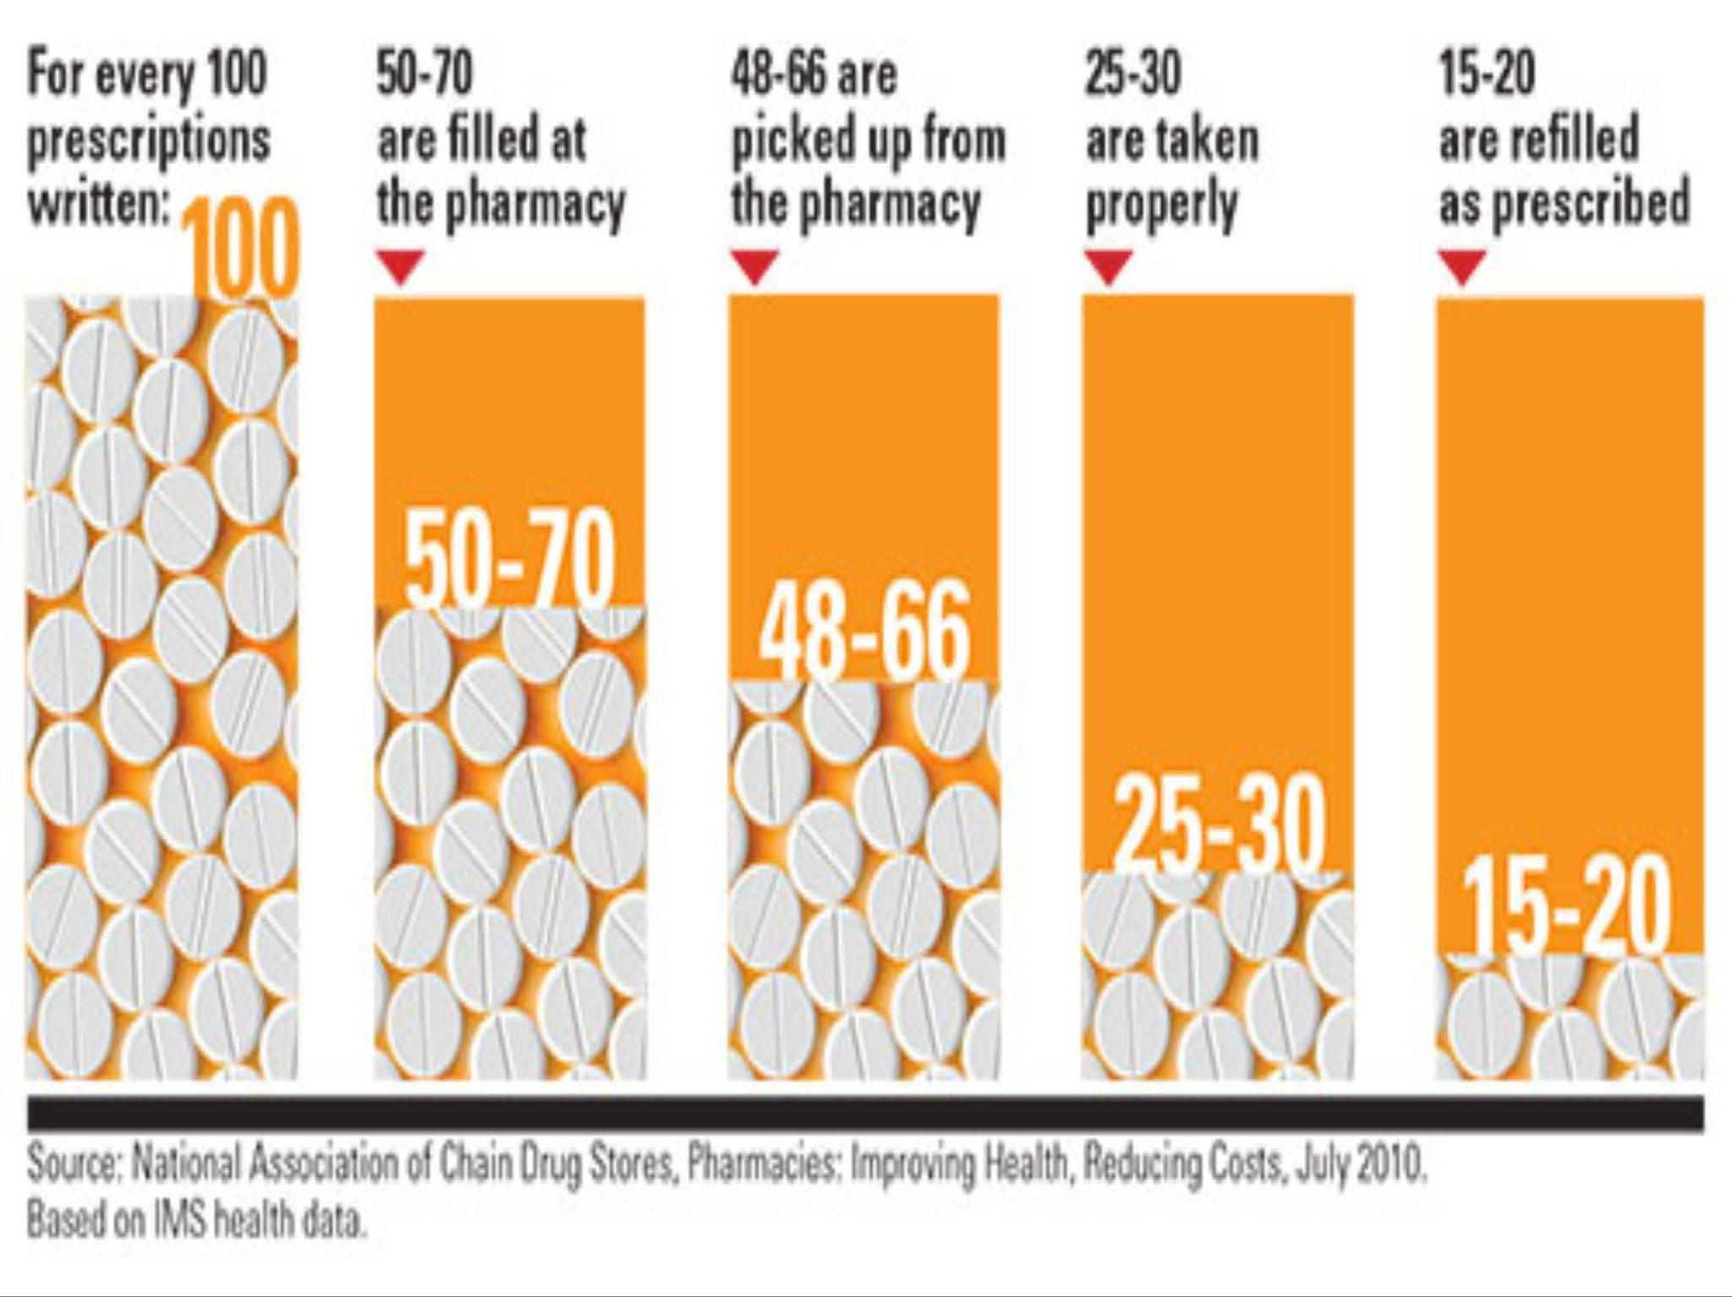
Prescription Data

Slide 9
Why Respondent Might Oppose CARE Court Participation
Loss of autonomy – considers outside petitioner’s view of a person’s ability to make decisions about their mental health to force a court-ordered process
Lack of guaranteed housing
Voluntary community-based services are more effective than court-mandated care
2001 Rand Study showed connection to community-based mental health intervention that combined clinical treatment with intensive case management was effective.
Coercion has no measurable independent effect on outcomes beyond access to quality services
CARE Court records may be referenced in future Lanterman-Petris-Short (LPS) conservatorship proceedings

Slide 10
Person-Centered Planning

Slide 11
What is Person-Centered Planning?
Strengths, goals, needs
Choice, control, and self-determination
Accessibility – no wrong door, coordinated, easy to use
Meeting people where they are
Not just medical needs but recreation, transportation, friendships, therapies, housing, vocational training and employment, family relationships, social activities, culture, language
Dignity of risk

Slide 12
Mental Illness & Professional Care
Education
Spiritual
Work
Family
Social
Network
Relationships
Mental Illness
&
Professional Care
Community
Graphic © Keris Jän Myrick, MBA, MS

Slide 13
Balanced Framework
Professional
Care
Education
Spiritual
Work
Family
Social
Network
Relationships
Mental
Illness
Community
Graphic © Keris Jän Myrick, MBA, MS

Slide 14
Duty of Care / Dignity of Risk

Slide 15
The Buffet Table Problem

Slide 16
Buffet Table Problem
While having as many services available for someone may seem beneficial, services are often overlapping and duplicative
Too many services can create confusion and stress – especially when clients may have to repeat information and manage conflicting recommendations
Streamlining services can ensure support is comprehensive, necessary, and not chaotic
Mandating too many uncoordinated duplicative services is like forcing a person to eat all of the food at a buffet – overwhelming and potentially harmful
Instead, focus on allowing a person to make a decision on what they want on their plate (a streamlined selection of what a person wants and needs) to ensure the right amount of support without overload and confusion
What makes a buffet enjoyable is the ability to choose what you want and how much of it

Slide 17
Accessibility: Provider Coordination
Having a dedicated point of contact to help respondents keep up with important appointments that connect them with resources and care, stay engaged in their care, and receive the support they need without falling through the cracks. These points of contact can:
Schedule and attend appointments with respondent
Provide transportation
Fill out necessary paperwork and releases of information
Manage communications between various providers to share important information and limit duplication of services
Ensure an individual’s personal choices are respected by knowing the respondent’s individual goals and preferences and ensuring other systems of care fall in line, and guide individuals through mental health care system

Slide 18
Available Services and Supports

Slide 19
What Does CARE Court Provide?
The CARE Court can provide a CARE Agreement or a CARE Plan. The Plan or Agreement is not separately funded, but is based on existing programs. It may include:
Behavioral health services including through Medi-Cal and MHSA
Medically necessary stabilization medications*
Housing resources funded through existing programs
Services provided through programs like SSI, Cash Assistance Program for Immigrants (CAPI), CalWORKs, IHSS, and CalFresh
Citation: Cal. Welf. & Inst. Code § 5982

Slide 20
What Does CARE Court Provide? (Continued)
CARE Court respondents have priority for the Behavioral Health Bridge Housing program
Grant program funding interim housing projects (from @ 60 days to @ 2 years)
If respondents are not enrolled in FSP, the court may ask the County why not
Again, no separate funding: “All CARE plan services and supports ordered by the court are subject to available funding and all applicable federal and state statutes and regulations, contractual provisions, and policy guidance governing initial and ongoing program eligibility.”
Citation: Cal. Welf. & Inst. Code § 5982

Slide 21
Difference Between CARE Agreement and CARE Plan
Cal. Welf. & Inst. Code § 5971(a) & (b)
 | CARE Agreement | CARE Plan
Voluntary? | Voluntary settlement between respondent and local government agencies on what services are accepted and provided | Not voluntary but ordered when parties unable to reach agreement. Details what services respondent is ordered to accept and agencies must provide
Court- Ordered | Yes, once approved by court | Ordered by court after hearing with no agreement
Review | Reviewed only once 60 days after | Reviewed at least every 60 days
Risks | Unclear | Reasons for respondent’s failure could be facts considered in LPS conservatorship

Slide 22
Why CARE Plans are Risky
When parties don’t reach CARE agreement at case management hearing and not likely to enter an agreement, court must order clinical evaluation, clinical evaluation hearing, and CARE Plan review hearing
The Clinical Evaluation must address whether the respondent has capacity to give informed consent regarding psychotropic medications [§ 5977.1(b)(2)]
The court may order medication as component if they find by clear and convincing evidence respondent lacks capacity to give informed consent to administration of medically necessary stabilization medication [§ 5977.1(d)(3)]
While noncompliance cannot result in direct penalties, it may lead to termination from CARE Court and influence future legal proceedings (e.g. LPS conservatorship)

Slide 23
Specialty Mental Health Services

Slide 24
What Are “Specialty Mental Health Services”?
Package of Medi-Cal benefits that are available to a subset of Medi-Cal beneficiaries who have a mental health condition causing significant impairment
Organized and provided through a County’s mental health plan (MHP) which is approved by the state Department of Mental Health
Counties may provide SMHS directly or by contracting with agencies

Slide 25
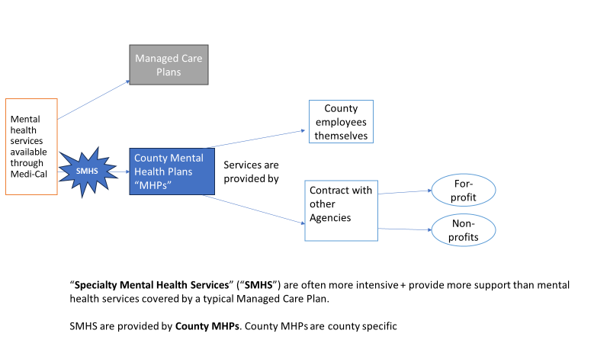
Mental Health Services
Managed Care Plans

Slide 26
Who Is Eligible for Specialty Mental Health Services?
Medi-Cal beneficiary 21+ years with:
Functional Impairment
Significant impairment (distress, disability, or dysfunction) in social, occupational or other important activities OR
Reasonable probability of significant deterioration in important area of functioning
due to Mental Health Disorder
Criteria for people younger than 21 are broader
Citation: Cal. Welf. & Inst. Code § 14184.402

Slide 27
What Are Specialty Mental Health Services?
More intensive and provide more support than mental health services covered by regular Medi-Cal. Services include:
Targeted case management to help beneficiaries access community services
Treatment and diagnosis services provided by licensed psychiatrists and psychologists
Rehabilitative mental health services – services for daily living and social functioning
Psychiatric inpatient hospital services – psychiatric services provided on an inpatient basis in a hospital
Psychiatric nursing facility services for people in certain skilled nursing facilities

Slide 28
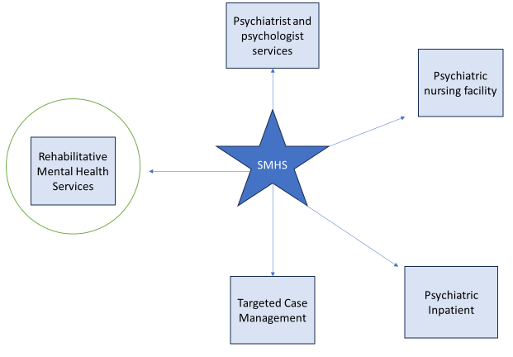
What Are Specialty Mental Health Services? (Continued)

Slide 29
Rehabilitative Mental Health Services
Services to help beneficiaries improve, maintain, or restore skills in daily living and social functioning, including:
Mental health services (individual and group therapy)
Medication support (services related to psychiatric medications)
Day rehabilitation and day treatment intensive (community-based day therapy programs)
Crisis intervention and crisis stabilization (services provided quickly and at various sites)
Adult residential treatment and crisis residential treatment (24/7 services provided in community-based settings as alternative to psychiatric hospitalization)
Psychiatric inpatient hospital services (services provided in psychiatric hospital setting)
Citations: 9 CCR § 1810.247; Disability Rights California Publication

Slide 30
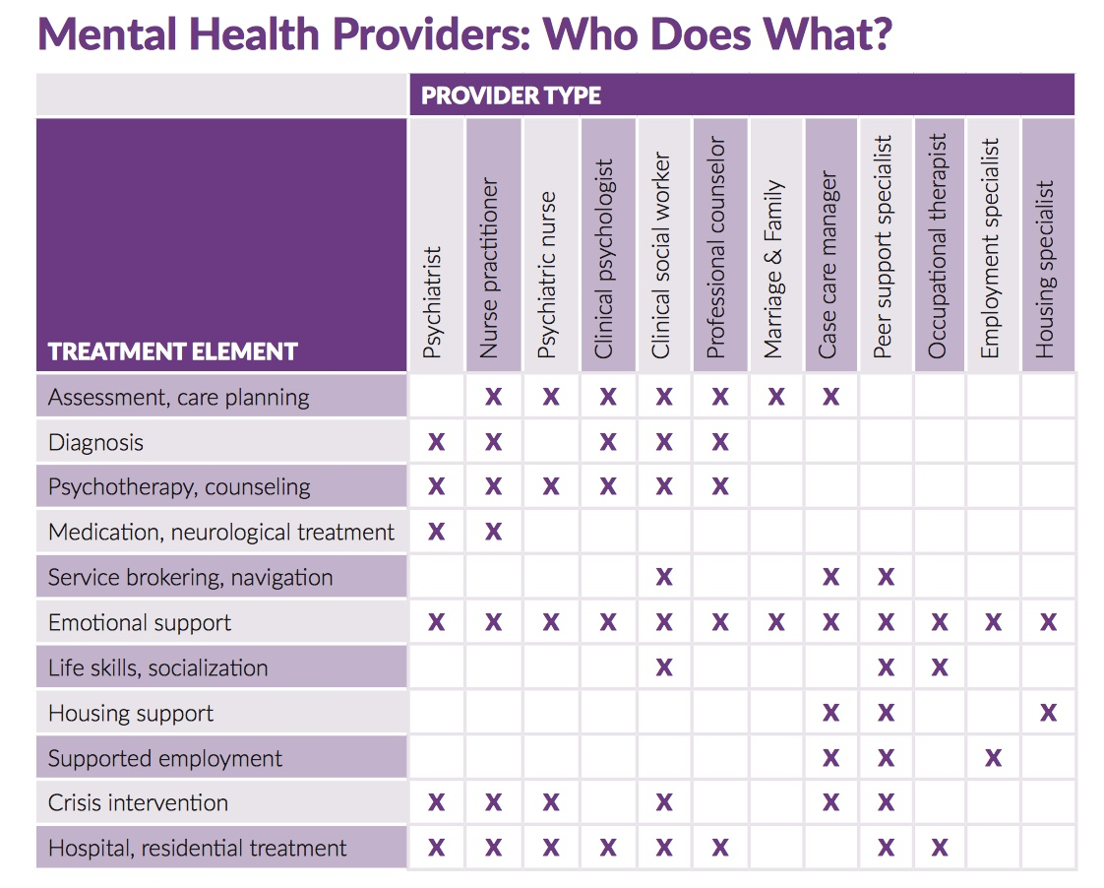
Circle of Care: A Guidebook for Mental Health Caregivers

Slide 31
How Do People Get Specialty Mental Health Services?
People must apply through the County’s screening process.
Note: Different counties screen in different ways.
One way is to call the County’s Access Line.
These phone numbers are published online by the Department of Health Care Services.

Slide 32
What Happens Once People are Approved for SMHS?
Once a person is approved for SMHS, they are entitled to a care plan
The beneficiary of SMHS helps make the care plan and agrees to it
The care plan includes
Goals/ treatment objectives AND
Services to be provided
Citations: 9 CCR §§ 1810.205.2, 1810.440(c)

Slide 33
What Are the Rights of People Receiving SMHS?
Medi-Cal services are an entitlement and people receiving SMHS have “due process” rights. They may file:
a grievance about their experiences as a client
an appeal about an “adverse benefit determination” such as a denial or reduction in services, or a long delay
after an appeal there is a right to a “fair hearing”
The County must provide information about how to file grievances and appeals, and how to seek a fair hearing
Citations: 9 CCR §§ 1810.360, 1810.405, 1850.205, 1850.215; DRC Publication

Slide 34
Full Service Partnership

Slide 35
What is Full Service Partnership?
Concept: partnership between person being served and service provider in which client is offered a full array of services, through a “whatever it takes” approach to meeting needs
Targeted toward people with significant mental illness who are unhoused, at risk of being unhoused, have history of criminal legal involvement, and/or have repeat hospitalizations
Person must have “serious mental disorder” + high level of functional impairment
Citation: Cal. Welf. & Inst. Code § 5600.3

Slide 36
“Serious Mental Disorder” Under FSP
Serious mental disorder is “severe in degree” and “persistent in duration” such as:
behavioral functioning substantially interferes with activities of daily living
inability to maintain stable independent functioning without treatment and support for indefinite period of time
Includes people with “serious mental disorder” who have other mental and physical conditions – like substance abuse, I/DD, TBI
Examples: schizophrenia, bipolar disorder, PTSD, another “severely disabling mental disorders”
Citation: Cal. Welf. & Inst. Code § 5600.3

Slide 37
Level of Functional Impairment Required For FSP
Person must be:
Unserved and:
Homeless or at risk of becoming homeless OR
Involved in the criminal legal system OR
Frequent user of hospital and/or emergency room services as the primary resource for mental health treatment
Underserved and at risk of:
Homelessness OR
Involvement in the criminal legal system OR
Institutionalization
Citation: Cal. Welf. & Inst. Code § 5600.3; 9 CCR § 3620.05

Slide 38
How Are FSPs Funded?
Mental Health Service Act – renamed Behavioral Health Services Act (BHSA) in 2023 – gives money to counties for FSPs
Newsom’s 2023 amendments: 30% of BHSA dollars to housing interventions, 35% to FSPs
MHSA / BHSA money should only cover costs that cannot be paid for with other funds
NOT designed as entitlement but “to the extent resources are available”
Component that is SMHS / funded by Medicaid comes with due process rights

Slide 39
Who Decides Who “Gets” an FSP Slot?
No strict rules about how the County decides who get an FSP slot, other than prioritizing people who are “unserved”
County must periodically report to the state Department of Mental Health on the number of clients, by age group, to be served by FSP and how County selections for FSP reduce disparities
Citation: 9 CCR §§ 3200.310, 3620, 3650

Slide 40
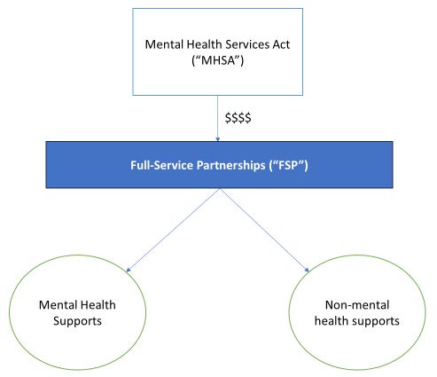
What Can an FSP Provide?
Note: Medi-Cal $$ used here when possible

Slide 41
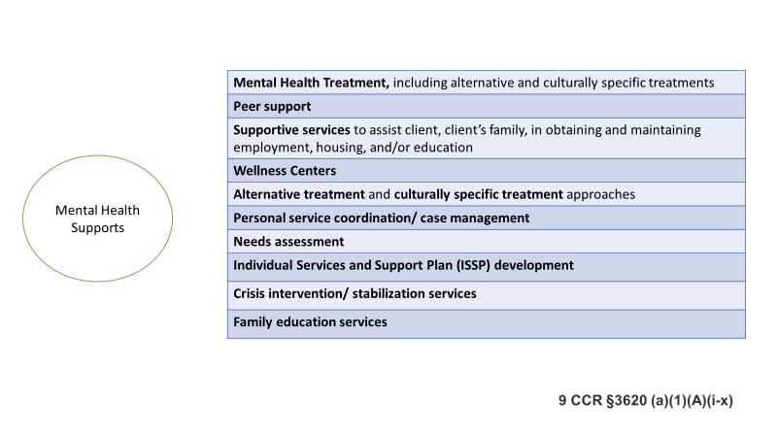
What Can an FSP Provide? (Part 2 of 3)

Slide 42
What Can an FSP Provide? (Part 3 of 3)

Slide 43
What Does an FSP Client Receive?
Client may receive services necessary to attain goals stated in an “Individual Services and Supports Plan” (ISSP)
Citation: 9 CCR § 3620

Slide 44
Does FSP Provide Housing?
Under the regulations, an FSP can cover housing. But in practice, FSPs do not provide permanent housing. They may cover temporary housing at times.

Slide 45
Peer Support

Slide 46
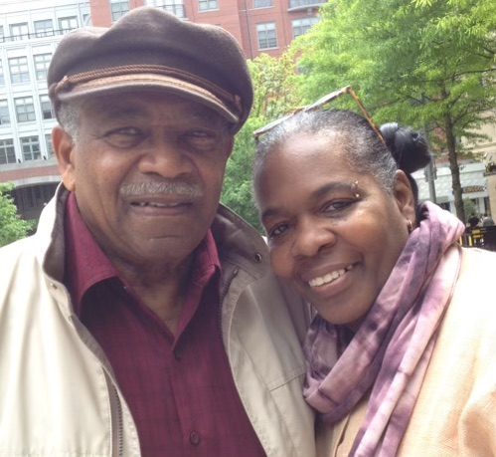
Peer Support:
Lived Experience and/or Family/Parent/Caregiver
Ms. Jacki McKinney, MSW
Founding Member, National People of Color Consumer Survivor Network

Slide 47
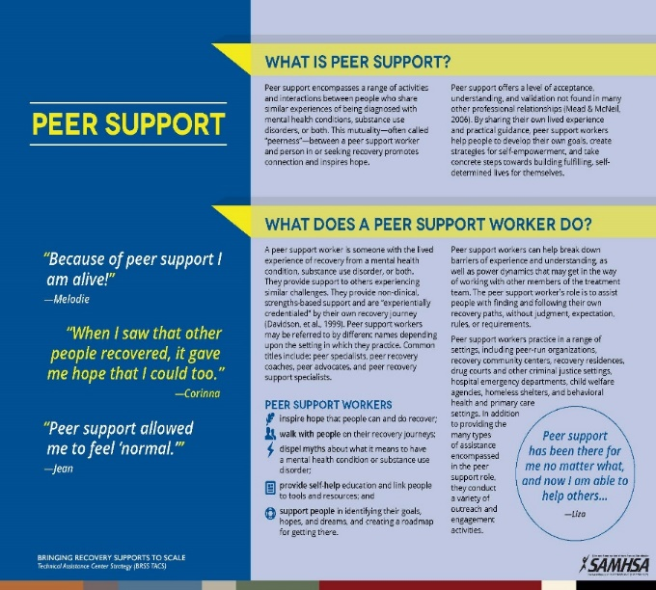
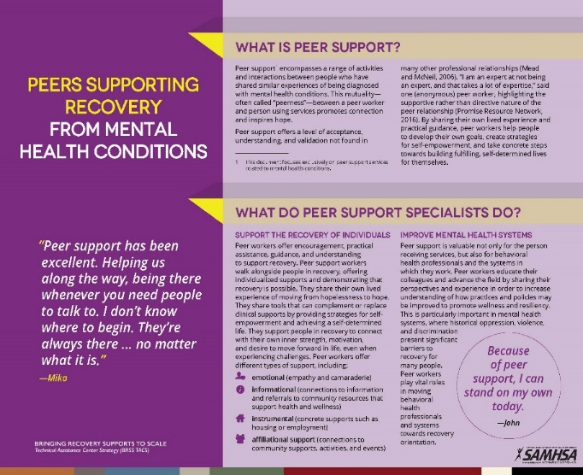
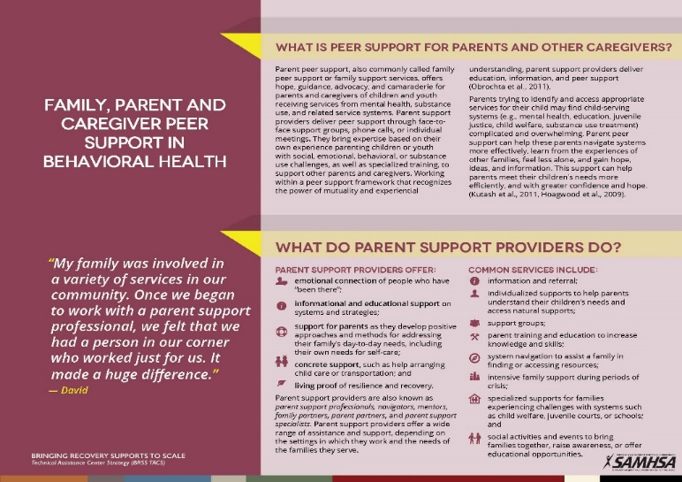
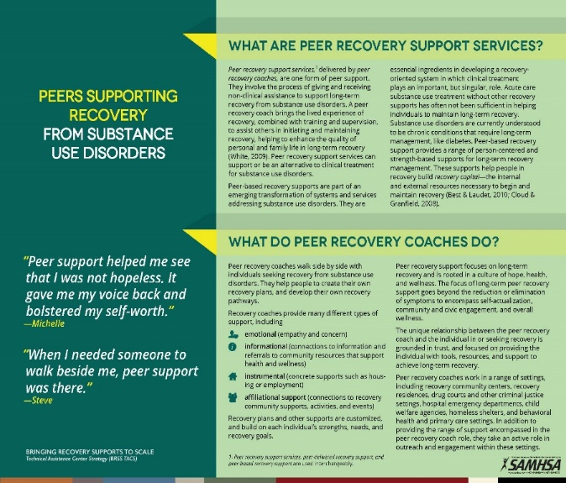
Value of Peer Support
To access the Peer Support Briefs visit: https://www.samhsa.gov/brss-tacs/recovery-support-tools/peers

Slide 48
SAMHSA – Core Competencies
For Peer Workers
Engages peers in collaborative and caring relationships
Provides support
Shares lived experiences of recovery
Personalizes peer support
Recovery planning
Links to resources, services and supports
Teaches information and skills related to health, wellness and recovery
Helps peers to manage crises
Communication
Collaboration and teamwork
Leadership and advocacy
Growth and development

Slide 49
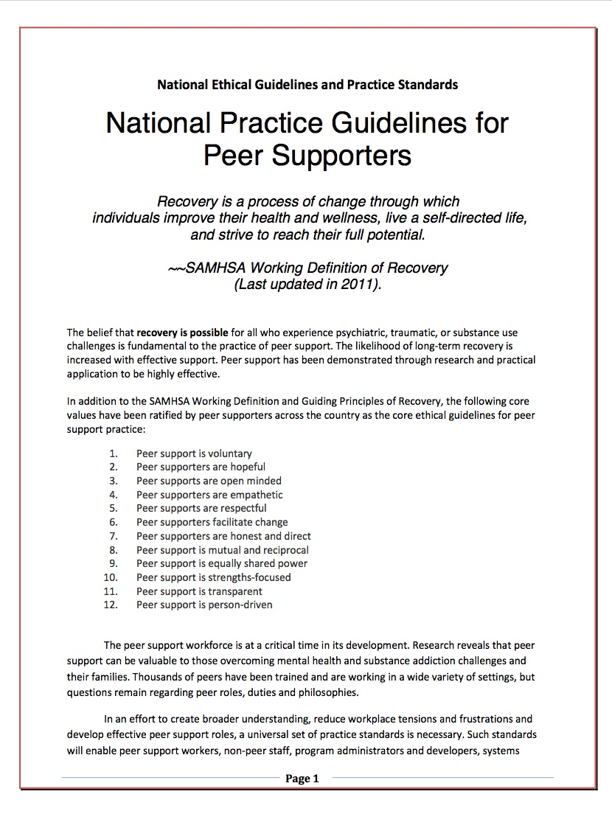
National Practice Guidelines
Developed through a partnership between the Addiction and Mental Health Peer disciplines
Operationalize peer performance expectations, skills and knowledge in the workplace
https://na4ps.files.wordpress.com/2012/09/nationalguidelines1.pdf

Slide 50
National Practice Guidelines of Peer Supporters
Peer Support is Voluntary
Peer Supporters are Hopeful
Peer Supporters are Open Minded
Peer Supporters are Empathetic
Peer Supporters are Respectful
Peer Supporters Facilitate Change
Peer Supporters are Honest and Direct
Peer Support is Mutual and Reciprocal
Peer Support is Equally Shared Power
Peer Support is Strengths-Focused
Peer Support is Transparent
Peer Support is Person-Driven

Slide 51
National Peer Practice Guidelines for Peer Supporters and Supervisors

Slide 52
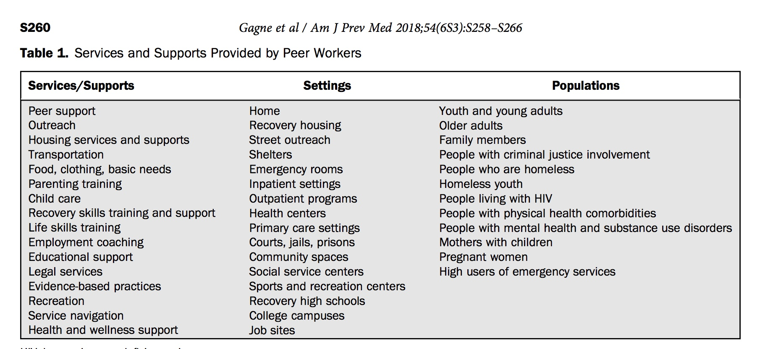
Gagne C, Finch W, Myrick K, Davis L : Peer Workforce in the Behavioral Health Workforce: Opportunities and Future Direction.American Journal of Preventive Medicine 2018;54:S258-266.

Slide 53
Psychiatric Advance Directives

Slide 54
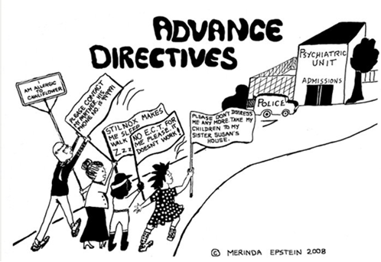
What are Psychiatric Advance Directives?
https://nrc-pad.org/

Slide 55
Reproductive Psychiatric Advance Directives
What is it?
A written document that provides individuals with SMI the opportunity to articulate preferences regarding reproductive choices and psychiatric treatment in advance, to be applied during obstetric emergencies and psychiatric crises when patients do not have capacity
How is it different from a regular PAD?
Addresses reproductive healthcare: family planning; pregnancy continuation vs termination; perinatal mental healthcare; labor and delivery options; custody planning
Why is it important?
Protect patient autonomy and reproductive rights, particularly for BIPOC and other marginalized groups
Prevent adverse and potentially fatal outcomes, including maternal suicide and infanticide
Prevent moral distress for healthcare providers

Slide 56
Tinland A, Loubière S, Mougeot F, et al. Effect of Psychiatric Advance Directives Facilitated by Peer Workers on Compulsory Admission Among People With Mental Illness: A Randomized Clinical Trial. JAMA Psychiatry. Published online June 06, 2022. doi:10.1001/jamapsychiatry.2022.1627
In this randomized clinical trial, 394 adults with schizophrenia, bipolar I disorder, or schizoaffective disorder with a previous compulsory hospitalization were randomized into 2 groups (ratio 1:1). Participants in the PW-PAD group experienced significantly fewer compulsory admissions than those in the control group.
These findings support the use of peer worker–facilitated psychiatric advance directives to prevent compulsory rehospitalization in people with severe mental illness.

Slide 57
Supported Decision Making

Slide 58
What is Supported Decision Making?
An individualized arrangement in which an adult with a disability chooses one or more people they trust as supporters to help them understand, make, communicate, implement, act on, their own choices.
An alternative to conservatorship or guardianship that can strengthen the capacity of a person with disabilities and avoid the need for conservatorship or guardianship.
Can be formal or informal
Trusted, chosen supporters help the person understand, consider, or communicate choices
SDM can strengthen capacity – assess capacities with supports
California formally recognizes SDM, AB 1663 (2022); Cal. Stats. 2022 Ch. 894

Slide 59
What Role Supporters Can Play
If a client requests a supporter, supporters can
Assist client in logistics such as scheduling meetings and arranging transportation
Help client communicate – for example, supporter re-speaks the client’s words if speech is difficult to understand
Help client understand legal, medical, or other complex concepts
Enact plan from supportive decision making
But remember, the client is the client, not the supporter

Slide 60
Supported Decision Making Visual

Slide 61
CalAIM

Slide 62
Enhanced Care Management (ECM) and
Community Supports (CS)
CalAIM = “California Advancing and Innovating Medi-Cal,” recently launched managed care initiative funded via Medicaid waiver
Enhanced Care Management (ECM) benefit:
Designed for highest risk, highest-cost plan members with most complex needs
ECM providers responsible for coordinating and managing care across provider
Client gets “lead care manager”
Optional Community Service (CS) benefits cover housing supports:
Short-Term Post-Hospitalization Housing
Housing Transition Navigation Services
Housing Tenancy and Sustaining Services
Housing Deposits
Citations: New LAO report; DREDF Training; DREDF PowerPoint; DHCS on CalAIM; DHCS on ECM and CS

Slide 63
Reality is Local
Each County’s mental health plan and phone number is published online
If your county has limited resources, they may contract out to another county
Connect with your County mental health agency
Develop relationships and regular communication
Questions:
What skills and material resources are available in your county?
What are the doors to programs in your county?
Where are the “low barrier doors” for respondents?

Slide 64
Successfully Getting Out of CARE Court

Slide 65
What Supports Dismissal of CARE Petition
According to CARE Early Implementation Report, 220 of 550 petitions submitted were dismissed
Dismissal could be due to
Voluntary engagement in stabilizing care prior to hearing
Not eligible for CARE
CARE court takes time [more petitions are awaiting disposition (240) than have resulted in Care Plans (100)] – gives people a chance to engage in voluntary treatment or provide more information of lack of qualifying mental health disorder
County Behavioral Health departments and Public Conservators are least likely to use CARE Court and instead divert people local services without court involvement

Slide 66
Legal Strategies for Dismissal of CARE Court Petitions
Demonstrate client’s active participation in some voluntary treatment, housing efforts, or support services of their choice
Did they enter some mental health support program?
Are they regularly going to some day programming?
Did they connect consistently with an intensive case management team
Doing so challenges eligibility
It shows they are clinically stabilized in ongoing voluntary treatment
CARE plan or CARE agreement is not least restrictive because they are voluntarily engaging in alternative services to support mental health
Argue that person voluntarily engaging in quality services is more beneficial than coercion
You can also argue that there is insufficient evidence person has qualifying serious mental disorder

Slide 67
Case Example
Lisa, a 30-year old Latine woman diagnosed with schizoaffective disorder. A family member filed a petition alleging her mental health is deteriorating and she is wandering the streets creating risk.
Prior to initial CARE Court hearing, counsel successfully supports Lisa in entering transitional housing program.
Counsel and Lisa present documentation showing she voluntarily engaged in county FSP program and can receive consistent therapy sessions, medication support, and is working towards stable housing.
Counsel can argue Lisa’s engagement in voluntary treatment and securing of relatively stable housing means she does not meet CARE eligibility criteria – she is already participating in the least restrictive, appropriate alternative

Slide 68
Legal Advocacy Strategies to Advocate for Graduation
At status review hearings (every 60 days following adoption of Care plan), counsel builds case for graduation by pointing to respondent’s engagement in supportive services
One year status review of CARE Plan – request graduation from program
“Graduation plan” ordered if parties work towards voluntary agreement that supports transition out of court jurisdiction
Show evidence that client is engaged in treatment
Consider creating a psychiatric advance directive

Slide 69
Case Example 2
Jason is a 40-year old Black man diagnosed with schizophrenia in Los Angeles who is experiencing homelessness and challenges with substance use. Someone filed a CARE Court petition seeking more intensive supervision.
Jason meets CARE criteria but Jason and counsel are not able to reach CARE Agreement with county.
Jason does not want to remain in CARE Court for long, he is against medication for schizophrenia but is open to substance use treatment and other alternatives.
If CARE plan is being ordered, counsel should point to Jason’s informed refusal to medication to avoid medication order (basic understanding of diagnosis and why medication is proposed; ability to say why medication unhelpful and alternatives)
Counsel advocates for a more limited CARE plan that avoids duplicative services and focuses on immediate concerns (housing, substance use support, case management/ peer support)

Slide 70
Case Example 2 (Continued)
Within 60 days, Jason connected with a peer supporter who helped him enter a shelter
Within several months, Jason accessed wellness groups, SMHS services, and intensive outpatient programs. He worked with his peer supporter to be on waitlists for supportive housing.
While Jason may not be “medication compliant,” counsel advocated for graduation plan that supports stabilization of mental health with alternatives and points to Jason’s voluntary steps that indicate progress
Built community of supports and knows how to access services in crisis
PAD

Slide 71
Request from Disability Rights California
Disability Rights California is monitoring the implementation of CARE Court and would like to hear directly from respondents about their experiences. We are hoping to better understand how CARE Court is being implemented in different counties and its impact on people with disabilities.
If you know CARE Court respondents who may be willing to share their experiences, please refer them to:
Samuel.Jain@disabilityrightsca.org, (916) 504-5929.

Slide 72
Questions and Answers

Slide 73
Appendix of
Additional Resources

Slide 74
Alternatives to CARE Court and Evidence-Based Practices
Assertive Community Treatment (ACT) is a community-based, team-based service that includes multidisciplinary mobile teams that provide wraparound services
Typically includes psychiatrist, nurse, case managers, peers, and other mental health professionals
Provides services on day-to-day basis and 24/7 crisis intervention
Look up if your county covers ACT
Housing First – connection to permanent supportive housing
Volunteer peer support

Slide 75
Family Peer Support
A parent provides experiential knowledge with a parent receiving support (Robbins, et al., 2009)
Offers hope, guidance, advocacy and camaraderie for parents and caregivers

Slide 76
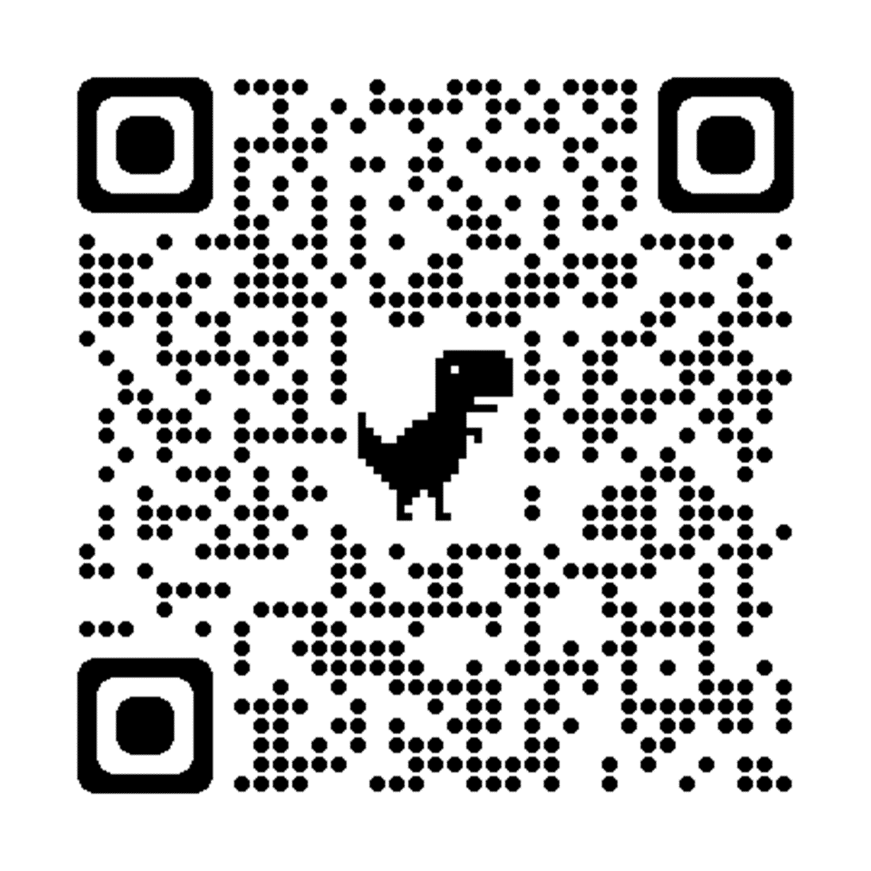
National Practice Guidelines of Peer Supporters – QR Code
Scan this QR code to download the National Practice Guidelines

Slide 77
The Power of Peer Respites
Unapologetically Black Unicorns Podcast Episode 91:
Nze Okoronta
https://podcasts.apple.com/us/podcast/unapologetically-black-unicorns/id1568804071?i=1000600968430

Slide 78
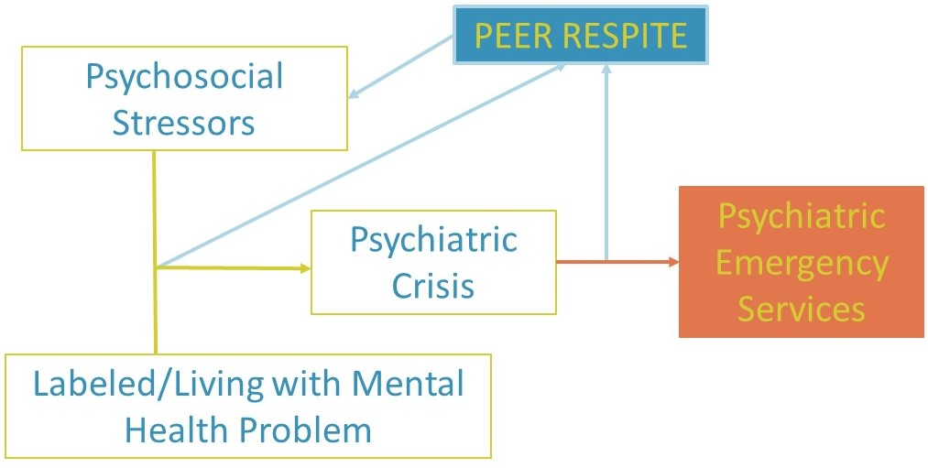
Peer Respite
A peer respite is a voluntary, short-term, overnight program that provides community-based, non-clinical crisis support to help people find new understanding and ways to move forward.
It operates 24 hours per day in a homelike environment.
Peer respites are staffed and operated by people with psychiatric histories or who have experienced trauma
https://www.peerrespite.com/

Slide 79
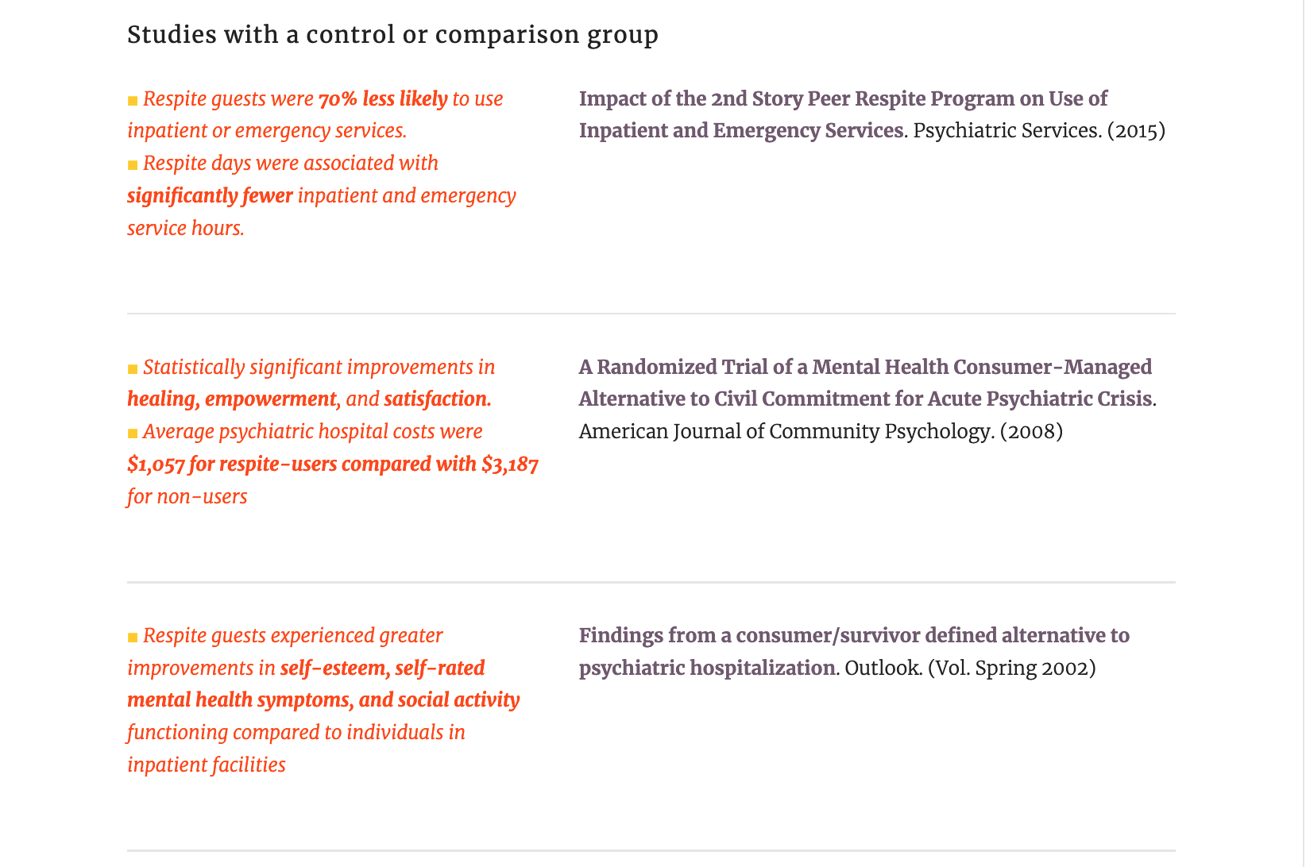
Peer Respite - Outcomes
https://www.peerrespite.com/

Slide 80
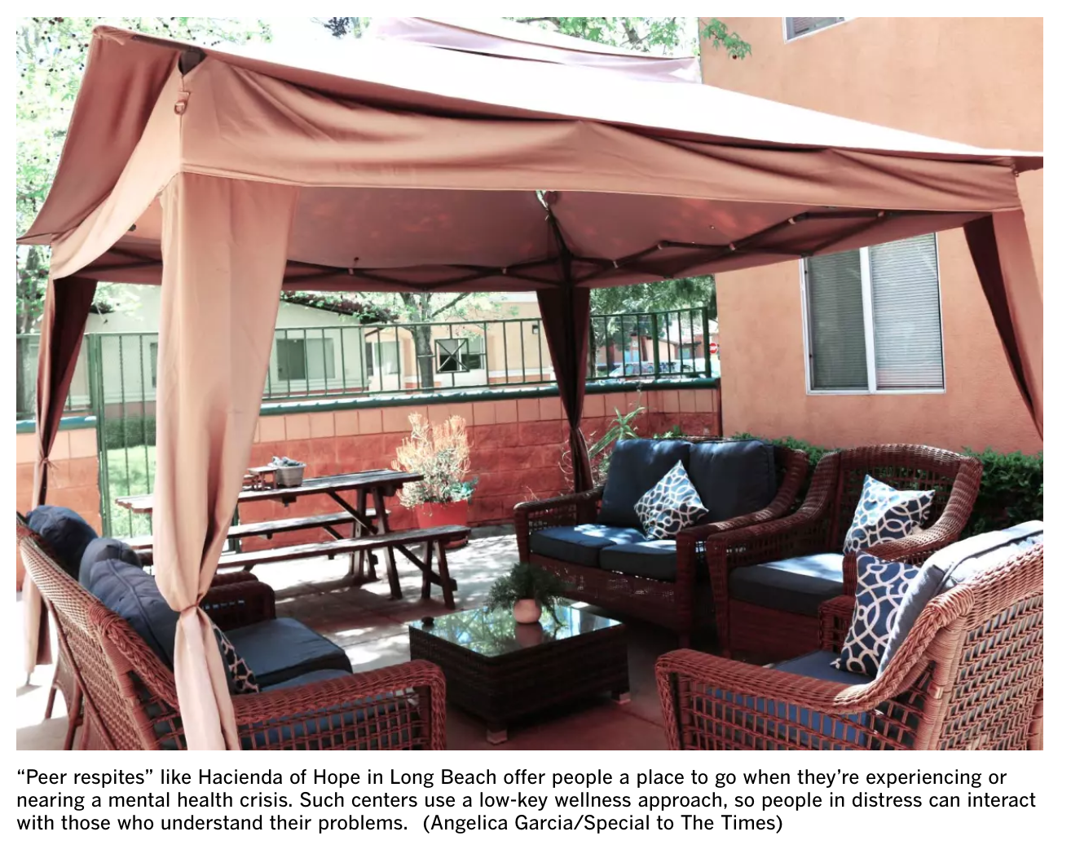
California Peer Run Respites:
2nd STORY PEER RESPITE HOUSE
Website: https://www.encompasscs.org/second_story Location: Santa Cruz, CA
BLACKBIRD HOUSE PEER RESPITE
Website: http://www.fcservices.org/blackbird-house-respite/ Location: Santa Clara County, CA
CEDAR HOME
Location: Weaverville, CA
HACIENDA OF HOPE
Website: https://prpsn.org/services-peer-support-network.html?id=171 Location: 2241 W. Williams Street, Long Beach, CA 90810
SHARE! RECOVERY RETREAT
Website: www.shareselfhelp.org Location: Monterey Park, CA and North Hollywood, CA
SALLY’S PLACE
Website: www.livelafamilia.org Location: Alameda County, CA
https://www.latimes.com/california/story/2021-01-11/peer-respites-people-facing-mental-health-crises-pandemic
https://power2u.org/directory-of-peer-respites/

Slide 81
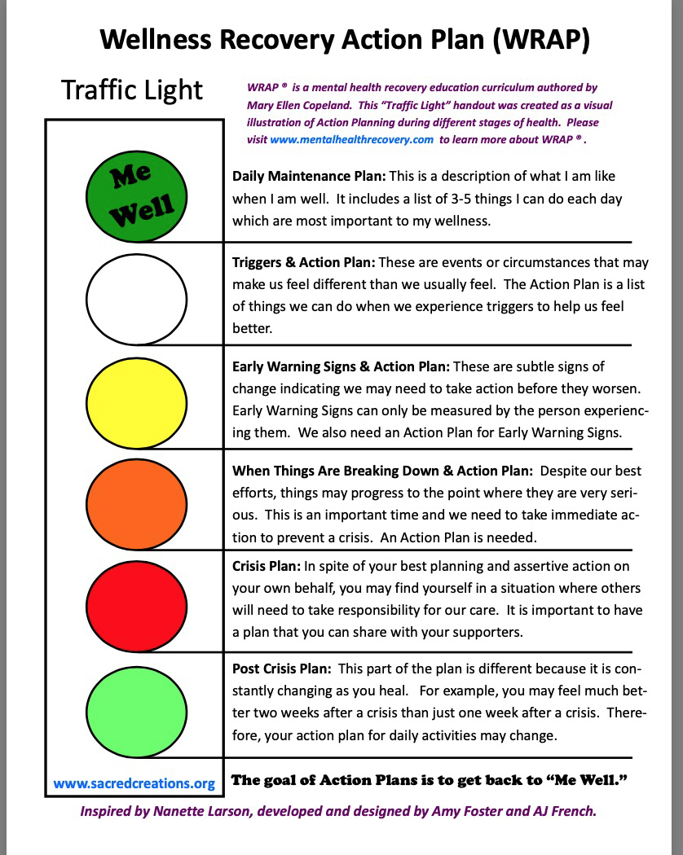
WRAP
WRAP Is…
Wellness Recovery Action Plan (WRAP) is a simple and powerful process for creating the life and wellness you want. With WRAP, you can:
Discover simple, safe, and effective tools to create and maintain wellness
Develop a daily plan to stay on track with your life and wellness goals
Identify what throws you off track and develop a plan to keep moving forward
Gain support and stay in control even in a crisis

Slide 82
Regional Centers
Regional Centers serve people with developmental disabilities and must:
Evaluate and decide if person is eligible
Coordinate services
Develop an Individual Program Plan (IPP) with consumer that considers their needs/choices
Make sure that consumers receive all supports and services listed in IPP
Citation: Cal.Welf.Inst. Code 4500; DRC Publication on RC Eligibility; DRC Publication on IPP; DRC Chapter on IPP; DRC Chapter on Community Living for Adult RC Clients

Slide 83
Regional Centers (Continued)
Regional Centers typically provide services that are not available elsewhere
Can be difficult to get someone approved for RC later in life
Some Care Court respondents may already be RC clients – but unserved
Citation: Cal.Welf.Inst. Code 4500; DRC Publication on RC Eligibility; DRC Publication on IPP; DRC Chapter on IPP; DRC Chapter on Community Living for Adult RC Clients

Slide 84
IHSS
In-Home Services and Supports (IHSS) is a Medi-Cal program that pays for in-home care (caregivers) for people with disabilities; most caregivers are family members; bureaucratic delays but no “waitlist”
Covered services may include:
Housework and laundry
Meals, dressing, bathing
Assistance with self-administration of medications
Money management
IHSS can prevent homelessness
IHSS can be provided to people who are marginally housed such as in a shelter or RV (“alternative living arrangement”)
Citations: DRC Publication; 2020 All County Letter

Slide 85
Bridge Housing Links
https://bridgehousing.buildingcalhhs.com/
https://bridgehousing.buildingcalhhs.com/county-behavioral-health-agencies#CBHAR3Awards
https://bridgehousing.buildingcalhhs.com/county-behavioral-health-agencies#CBHAR1Awards

