Slide 1
Disability Community Briefing: Defending Section 504 & Civil Rights
June 10, 2025

Slide 2
Presenters
Claudia Center (she/her), Legal Director, Disability Rights Education & Defense Fund
Amy Robertson (she/her), Partner, Fox & Robertson
Larkin Taylor-Parker (they/them), Legal Director, Autistic Self-Advocacy Network

Slide 3
Topics to Be Covered
Department of Energy (DOE) proposals
Section 504 (disability)
Title VI (race, ethnicity)
Title IX (sex)
Age Discrimination
How to file comments
Make your voice heard
Questions and answers
History of Section 504 rules
Section 504’s approach to buildings
Existing facilities
New construction and alterations

Slide 4
History of Section 504 Rules
May 4, 1977: first Section 504 rules, 45 C.F.R. Part 84
Written by Department of Health, Education & Welfare (HEW)
governs recipients of dollars from HEW (now HHS)
May 19, 1976, HEW shared draft rules and analysis of economic impact
HEW held 10 public meetings across the country
Public submitted 300 written comments
July 16, 1976, HEW published revised rules
analyzed 300 comments
revised proposed regulation for public comment
HEW extended comment period from 60 to 90 days
HEW held 22 public meetings – transcribed and reviewed
May 4, 1977: HEW published final rule
analyzed more than 850 comments

Slide 5
History of Section 504 Rules (Part 2)
Jan. 13, 1978: second Section 504 rules, now at 28 C.F.R. Part 41
Written by HEW; transferred to DOJ in 1981
“Coordination” regulations
minimum guidelines for other agencies
June 24, 1977: HEW published draft rules
based on May 1977 rule
Jan. 13, 1978: HEW published final rule
analyzed 50 comments

Slide 6
Section 504 Rules – Brief History (Part 3)
Extensive Congressional review of Section 504 regulations
Prior to May 1976 draft, HEW talks with Senate and House committees
May 5, 1976: Senate hearing on Section 504 regulations
Jan. 1977: HEW sends rules to every member of Congress
Apr. 1977: HEW sends revised rules to every member of Congress
Sept. 1977: additional Senate & House hearings
Nov. 1978: Congress reenacts and strengthens Section 504
Legislative history describes bill as codifying rules
Supreme Court on Section 504 rules:
In enacting the 1978 amendments to Section 504, “Congress incorporated the substance of the Department’s regulations into the statute.”
– Consol. Rail Corp. v. Darrone, 465 U.S. 624 (1984)

Slide 7
Section 504 Rules – Brief History (Part 4)
More than 80 federal agencies adopt their own Section 504 regulations
Based on the HEW regulations
June 13, 1980, Department of Energy adopts Section 504 rules at 10 CFR Part 1040
Proposed rule on Nov. 16, 1978, reviewed 511 comments
Rules also cover Title VI (race, national origin, ethnicity) and Title IX (sex)
August 7, 1984: the “Uniform Federal Accessibility Standards” were published
Dec. 19, 1990: DOE and 14 other agencies agree to use UFAS as measure

Slide 8
Section 504 and the Built Environment:
Foundational Compromise
Different rules for “existing facilities” versus “new construction”
New construction:
Must be “readily accessible to, and useable by” people with disabilities, measured by access standards
Alterations:
Must be “readily accessible to, and useable by” people with disabilities, “to the maximum extent feasible,” measured by access standards
Existing facilities:
More flexibility so long as disabled people can access programs and activities; recipients must carefully plan to remove barriers where necessary – this is called a “transition plan”

Slide 9
Section 504 and the Built Environment:
Foundational Compromise (Part 2)
Compromise balances equities and advances accessibility goals:
Making all existing buildings fully accessible would be challenging
Still need to provide access to programs and activities in existing buildings
program as a whole must be accessible (not every building)
entity must make a careful plan to remove barriers
New construction and alteration provides an opportunity to create a more accessible built environment going forward
Goal of Section 504: more accessible society going forward

Slide 10
Department of Energy Proposal re: Section 504
Deletes 10 C.F.R. § 1040.73 regulation stating that new construction and alterations must be “readily accessible to, and useable by” people with disabilities as measured by access standards
Deletes part of 10 C.F.R. § 1040.72 – the part stating that recipients must make a transition plan for removing barriers in existing facilities
This provision has a “deadline” of decades ago
Even so, advocates use the transition plan requirement as a tool or model in settlement agreements with institutional systems
DOE: These changes may be approved quickly as a “direct final rule”
Direct final rule: something routine or noncontroversial

Slide 11
Department of Energy Proposal re Title VI
Title VI: recipients of federal dollars may not discriminate based on race, ethnicity or national origin
DOE proposes to edit sections of its Title VI regulations at 10 CFR Part 1040
Only “intentional” discrimination counts
Deletes references to language access at 10 C.F.R. § 1040.5(c) and § 1040.6(c) – these include Braille
DOE says this is “direct final rule” (routine or noncontroversial)

Slide 12
“Unintentional” Discrimination Under Title VI
Description and Examples
Recipient makes decisions or maintains policies without considering the negative impact on people of color and immigrants
Examples:
County recipient closes hospital that serves Black neighborhood; disproportionate impact on Black residents of county
Prison system recipient fails to ensure that limited English proficient people have access to prison programs and activities; disproportionate impact on incarcerated people who are Latino

Slide 13
Department of Energy Proposal re Title IX
Title XI: education programs that receive federal dollars may not discriminate based on sex
DOE proposes to edit and delete parts of its Title IX regulations at 10 CFR Part 1042:
Delete 10 C.F.R. § 1042.110(b), section encouraging recipients to take affirmative steps to increase participation in programs where one or the other sex is underrepresented
Delete 10 C.F.R. § 1042.110(c), section requiring recipients to evaluate their programs and to remedy any sex discrimination
Edit 10 C.F.R. § 1042.450(b) to remove rule that girls may try out for boys’ team (when there’s no girls’ team and it’s not a contact sport)
DOE says this is “direct final rule” (routine or noncontroversial)

Slide 14
Department of Energy Proposal re Age Discrimination
Age Discrimination Act of 1975: entities that receive federal dollars may not discriminate based on age
DOE proposes to delete parts of its age discrimination regulations at 10 CFR Part 1040:
Delete 10 C.F.R. § 1040.88(b) and (c), sections encouraging recipients to take affirmative steps to increase participation in programs where there is limited participation based on age
DOE says this is a “direct final rule” (routine or noncontroversial)

Slide 15
How to File a Comment to Defend Section 504
First, check the deadline and make sure you have a plan:
Here the deadline is Monday, June 16, 2025, at 11:59 pm Eastern Time (8:59 pm Pacific Time)
Second, write your comment to DOE about the Section 504 rules.
Tell DOE why you care about accessibility. Explain why they should not get rid of the 504 rules.
You can download a template and edit it to make it your own:
plain language template comment
standard template comment
The most important parts of the comment are:
Telling DOE more about yourself and/or your organization
Say why you care about accessibility of buildings

Slide 16
How to File a Comment to Defend Section 504 (Part 2)
Where to find template comments:
https://dredf.org/action-alert-doe-civil-rights-and-section-504/
ASAN helped DREDF write plain language template comment
Additional templates comments available here, https://www.lflegal.com/2025/06/energy-department-rollback/
Amy Robertson wrote template about access standards

Slide 17
How to File a Comment to Defend Section 504 (Part 3)
Third, submit your comment online.
How do you figure out where to submit your comment?
The easiest way is to use DREDF’s website:
Go to DREDF.org and scroll down until you see the action alert, https://dredf.org/action-alert-doe-civil-rights-and-section-504/
We provide the two links related to Section 504:
https://www.regulations.gov/document/DOE-HQ-2025-0015-0001 is about deleting the rules on new construction
https://www.regulations.gov/document/DOE-HQ-2025-0024-0001 is about deleting the rule about transition plans

Slide 18
How to File a Comment to Defend Section 504 (Part 4)
How do you figure out where to submit your comment?
Another way to find, go to regulations.gov
Type in document number if you have it: DOE-HQ-2025-0015
Or – click on Or view all recently added … Documents
On the left toolbar, select the agency
Here, Department of Energy, and hit Apply
Then click on Only Show Documents Open for Comment
Scroll through 24 results to find relevant proposed rules
Can add search term nondiscrimination to get to 5 results
1 about Section 504; 1 about Section 504 & Title VI; 2 about Title IX; one about age discrimination
NOTE: search term function is very limited, for example, Section 504 will not work
You can always email any of us to ask for help

Slide 19
How to File a Comment to Defend Section 504 (Part 5)
Step by Step on regulations.gov
Start on the link we gave you, https://www.regulations.gov/document/DOE-HQ-2025-0015-0001, it says Rescinding New Construction Requirements at the beginning

Slide 20
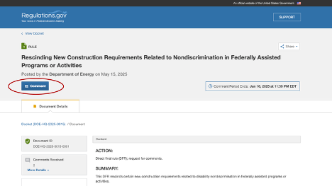
How to File a Comment to Defend Section 504 (Part 6)
Click on the blue Comment button, circled in red in the picture

Slide 21
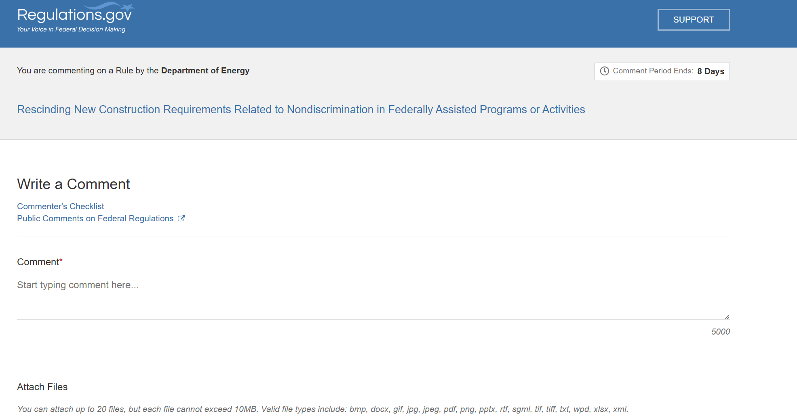
How to File a Comment to Defend Section 504 (Part 7)
The next screen will look like this, it will say at the beginning, You are commenting on a Rule by the Department of Energy

Slide 22
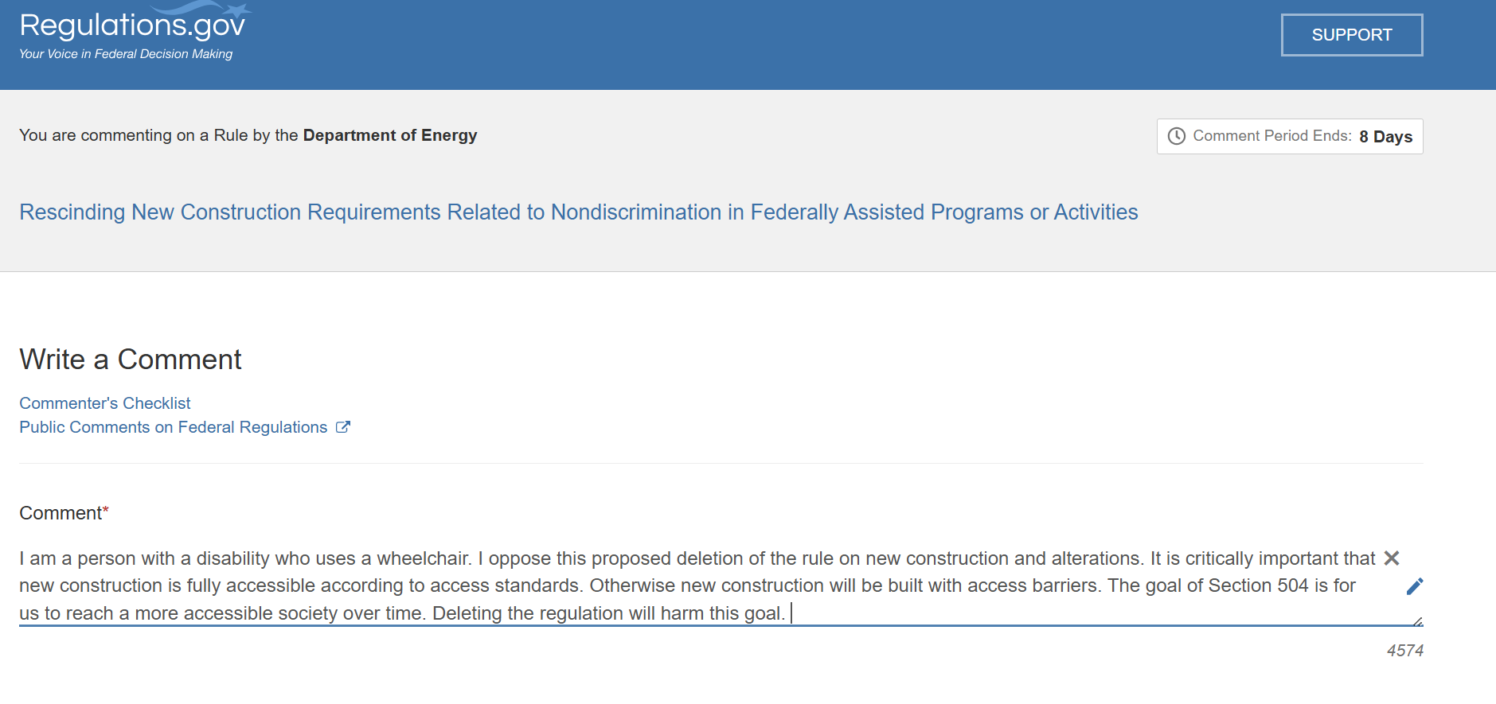
How to File a Comment to Defend Section 504 (Part 8)
You can write your comment right in the Comment box if it fits. To fit, your comment has to be less than 5,000 characters.

Slide 23
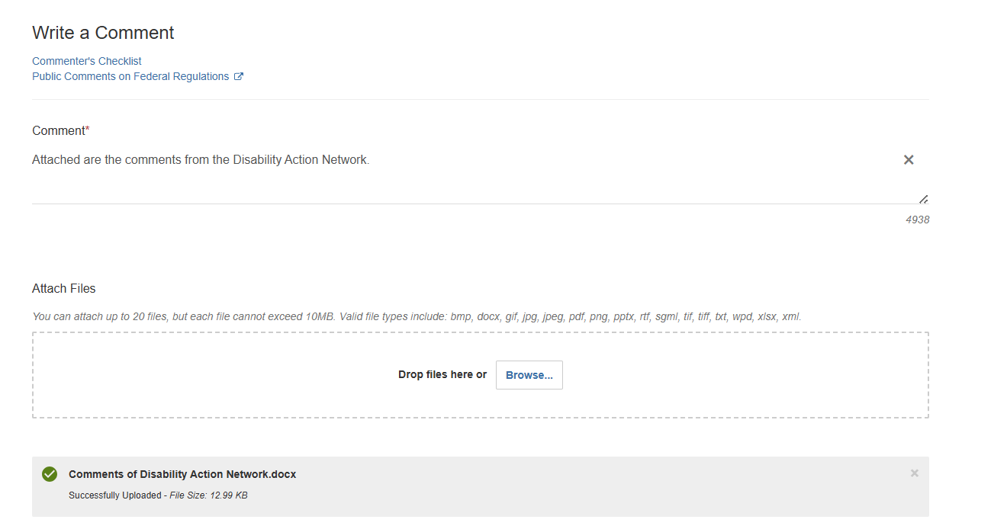
How to File a Comment to Defend Section 504 (Part 9)
You can also write your comments in a document like a Word or PDF file. The document can be longer than 5,000 characters. Then, you can attach the file with your comments. Write a cover note in the Comment box (required field).

Slide 24
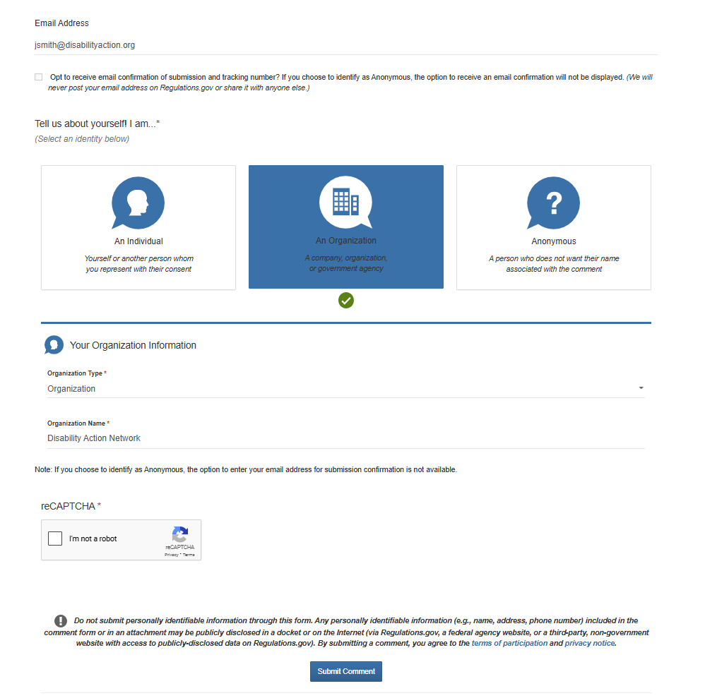
How to File a Comment to Defend Section 504 (Part 10)
Then you have to fill out the rest of the fields
Email address (optional)
Whether you are an individual, organization, or anonymous
If Organization, fill in:
Organization Type (there is drop-down menu with options and Organization Name

Slide 25
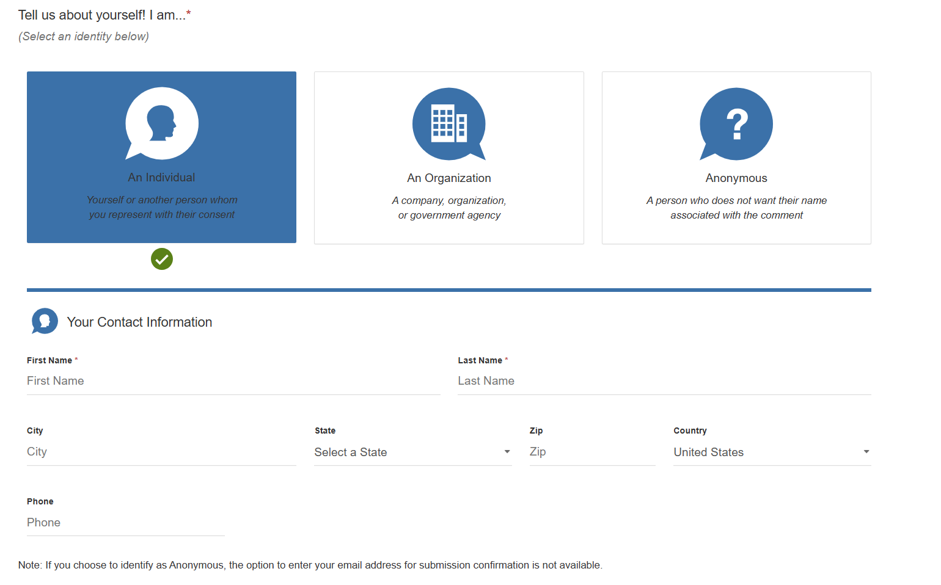
How to File a Comment to Defend Section 504 (Part 11)
If Individual, fill in:
First and Last Name
City, State, Zip, Country, Phone (all optional)

Slide 26
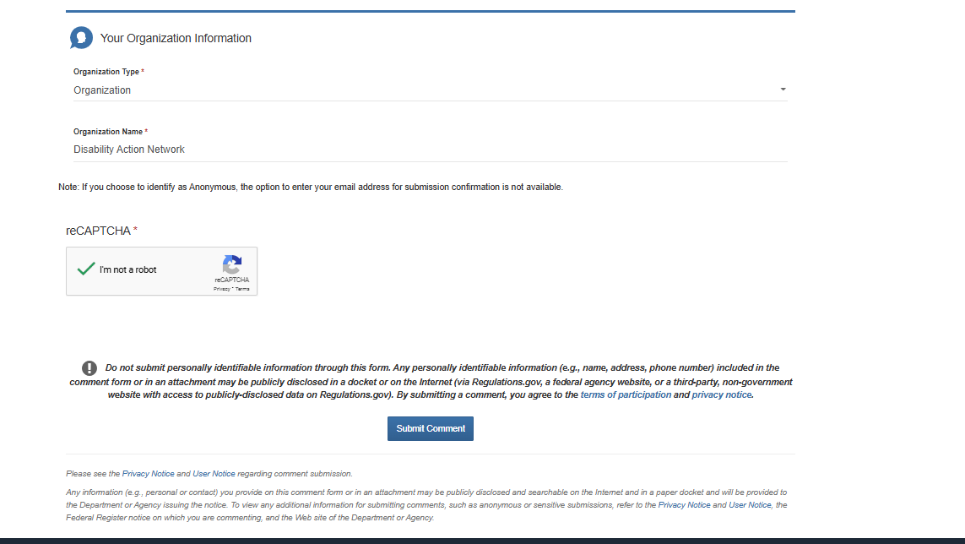
How to File a Comment to Defend Section 504 (Part 12)
Finally, complete the reCAPTCHA (required) and click on the blue Submit Comment button:

Slide 27
How to File Comments to Defend Section 504 and Civil Rights
We would like you to make a comment in a second place, see link below. This rulemaking eliminates the transition plan requirement for Section 504. It also changes the rules for Title VI (race discrimination):
https://www.regulations.gov/document/DOE-HQ-2025-0024-0001:
Section 504: deletes part of 10 C.F.R. § 1040.72 which states that recipients must make a transition plan for removing barriers in existing facilities
Title VI (race discrimination):
edits sections to state that only “intentional” race discrimination counts
deletes sections about language access at 10 C.F.R. § 1040.5(c) and § 1040.6(c), which also reference Braille

Slide 28
How to File Comments to Defend Title IX
You can use two portals set up by the National Women’s Law Center:
https://act.nwlc.org/a/doe-titleix-comments1 – oppose deletions of provisions encouraging affirmative steps to include participants where one or the other sex is underrepresented, and requiring that recipients remedy sex discrimination – may block efforts to recruit girls into STEM programs
https://act.nwlc.org/a/doe-titleix-comments2 – oppose deletion of provision allow girls to try out for boys’ team (when there’s no girls’ team and it’s not a contact sport), and vice versa – related to Administration’s attacks on trans students

Slide 29
How to File Comments to Defend Title IX (Continued)
https://www.regulations.gov/document/DOE-HQ-2025-0025-0001:
Title IX (sex discrimination): deletes 10 C.F.R. § 1042.110(b), (c), and (d), sections encouraging recipients to take affirmative steps to increase participation in programs where one sex is underrepresented, and requiring recipients to evaluate their programs and to remedy any sex discrimination
https://www.regulations.gov/document/DOE-HQ-2025-0016-0001
Title IX (sex discrimination): edits 10 C.F.R. § 1042.450(b) to remove rule that girls may try out for boys’ team (when there’s no girls’ team and it’s not a contact sport), and vice versa – related to Administration’s baseless, harmful definition of “sex” and anti-trans attacks

Slide 30
How to File Comments to Defend the Age Discrimination Act
https://www.regulations.gov/document/DOE-HQ-2025-0023-0001:
Age discrimination: deletes 10 C.F.R. § 1040.88(b) and (c), sections encouraging recipients to take affirmative steps to increase participation in programs where there is limited participation based on age

Slide 31
We Still Have Rights!
Federal laws like ADA, Section 504, and IDEA still exist! The Department of Energy cannot change statutes enacted by Congress or by our state Legislatures
We can still:
Ask for accommodations
Complain about physical and program barriers that violate the law
File discrimination complaints with federal agencies, including the US Department of Justice and agency OCRs
File discrimination complaints with state agencies
File a case in state or federal court
Consult an attorney to assist with any of the above

Slide 32
Make Our Voices Heard!
File comments opposing the Department of Energy’s proposals
Find your elected representatives and contact them!
Use this tool to find your reps, usa.gov/elected-officials
Tell your elected representatives to defend civil rights
And tell your elected representatives to defend Medicaid against billions in cuts
Get more information on DREDF’s page, dredf.org/hands-off-our-medicaid/

Slide 33
Make Our Voices Heard – Protest!
Health Care Cuts will Kill Rally
Upper Senate Park in Washington, DC | June 11, 2025
Gather at 11 am ET
mobilize.us/mobilize/event/798010/
California Disability Leadership Alliance Day
State Capitol (West Steps) in Sacramento, CA | June 16, 2025
Gather at 11 am PT eventbrite.com/e/california-disability-leadership-alliance-cdla-day-tickets-1374713106909
United Spinal Roll
Capitol Hill in Washington, DC | June 24, 2025
unitedspinal.org/roll-on-capitol-hill/
Moral Mondays
Washington, DC | June 30; August 4; and September 8
breachrepairers.org/get-involved/events/moral-mondays-in-dc/

Slide 34
Make Our Voices Heard – Protest! (Continued)
ADA anniversary = disability community events
July 21, 2025, National Council on Independent Living rally
Gather: 2:00 pm 11th + G Streets NW, Washington, D.C.
March: 3:00 pm
Rally: 4:00 pm US Capitol
Contact your state and local disability organizations and ask about local rallies! Or organize one yourself!
State protection and advocacy agencies, https://www.ndrn.org/
Independent living centers, https://ncil.org/

Slide 35
Questions?

