Slide 1
Disability Community Briefing:
Defending Students with Disabilities in the Age of Trump
June 5, 2025

Slide 2

Welcome!
Disability Community Briefing
Defending students from the current Administration’s attacks on students and the Department of Education
Photo of Jennifer Keelan participating in Capital Crawl, taken by Tom Olin

Slide 3
Presenters
Santiago Orosco (he/they or él/elle), Director of Organizing, New Disabled South
Winston Berkman-Breen (he/him), Legal Director, Student Borrower Protection Center
Julea Seliavski (they/them), Co-President, National Disabled Law Students Association
Mary J. Goodwin-Oquendo (she/her), Founder and President, The Goodwin-Oquendo Law Firm; Adjunct Professor, Fordham Law School
Karma Quick-Panwala (she/her), Director of Children and Family Advocacy, Disability Rights Education & Defense Fund
Catherine E. Lhamon (she/her), incoming Executive Director, Edley Center on Democracy & the Rule of Law; Previous: Assistant Secretary, OCR, Department of Education
Auden Perino (they/them), Senior Counsel for LGBTQI+ Equality, National Women’s Law Center

Slide 4
Topics to Be Covered
What is the Department of Education? Why is it important?
What has happened to the Department so far?
  Staff and funding cuts
  Removal of discipline guidance
What students are particularly targeted?
Why student loans are a disability issue
What might happen next?
We still have rights!
How we make our voices heard
  Action Alert
  July 2025 Protests
Questions & Answers

Slide 5
Department of Education – Core Functions for Students
Enforcement of civil rights laws
  Laws that bar discrimination based on race, ethnicity, sex, age and disability
Enforcement of laws that help students with disabilities
  Section 504 of the Rehabilitation Act
  Individuals with Disabilities Education Act (IDEA)
Research and data collection
  Civil Rights Data Collection

Slide 6

Department of Education – Core Functions for Students (Continued)
Funding for students and schools
  Title I and Head Start funds
  IDEA funds
Student loans and aid, student loan repayment programs

Slide 7

Department of Education – Staff and Funding Cuts
March 20, 2025: Executive Order to close Department
  This requires Congress to say yes
Staff cut in half nationwide
  1,300 fired, another 600 resigned / retired
  Hundreds of staff cut from Office for Civil Rights (OCR) and Federal Student Aid (FSA)
  Note: also staff cuts at Bureau of Indian Education

Slide 8
Department of Education – Staff and Funding Cuts (Continued)
Offices closed
  Half the field offices closed
  7 of 12 regional OCR offices closed, 5 left
Complaints on hold
  About 10,000 OCR complaint on hold
    About 6,000 disability
  Preference to investigations ordered by Administration
Funds cut
  $1 billion mental health
  $600 million teacher training

Slide 9
Department of Education – Discipline Guidance
April 23, 2025: Executive Order on school discipline
  Removed 2014 guidance on discipline and race
  Following guidance is itself discrimination
  Discourages school districts from taking affirmative steps to reduce disproportionate discipline, such as:
    Positive behavior supports and interventions
    Rewriting discipline policies re “willful defiance”
Important: July 2022 Guidance on Discipline and Students with Disabilities is still in effect, available here: https://www.ed.gov/media/document/504-discipline-guidance-2022-21258.pdf

Slide 10

Civil Rights of Trans and Nonbinary Students
Remember: trans & nonbinary students have civil rights at school
Title IX protects students from discrimination based on sex, including stereotypes–broad remedy
White House and Department of ED cannot undo Title IX, limited authority delegated by Congress
Schools still must protect students who are trans, nonbinary, and intersex
All youth, including trans and nonbinary students, deserve:
Opportunity to learn and grow up as truest selves
Inclusion in every part of school

Slide 11
Civil Rights of Trans and Nonbinary Students (Continued)
Safety and opportunity at school go hand and hand for:
LGBTQI+ students
Black and Brown students
Girls and women
Disabled students
  Many disabled students are trans and nonbinary
  Many trans and nonbinary students have disabilities
Anti-trans school sports bans rely on sex testing and body policing
adults inappropriately scrutinizing students’ bodies
we know Black and brown women & girls targeted worst for body policing
Anti-trans policies attempting to enforce a narrow definition of sex
increased policing of cisgender girls who do not conform to gender stereotypes

Slide 12
White House Attacks on Trans & Nonbinary Students
Short version:
Series of destructive attacks against core US institutions
Goal: end existence of safe and inclusive public K-12 schools, eliminate equal opportunity
Tactics include:
Weaponizing federal civil rights laws to harm LGBTQI+ and BIPOC students
Using confusion, disinformation, and fear to target, bully, and scapegoat trans, nonbinary, and intersex students
Emboldening worst actors who support a bigoted, discriminatory regime
Manufactured panic by extreme far-right
Trans and nonbinary students go to school
like every other young person. The “controversy” is fake.

Slide 13
White House Attacks on Trans & Nonbinary Students
(Continued)
Anti Trans Sports Ban Executive Order, 2/5/25
  Pushing schools and athletic orgs to ban trans girls and women from sports
Interfering with Curriculum Executive Order, 1/29/25
  Pushing schools to ignore and distort race and gender in country’s history
  Erases and harms transgender, nonbinary, and intersex students
Anti-LGBTQI “Sex Definition” Executive Order, 1/20/25
  Directs federal agencies to use baseless, harmful definition of “sex”
  Effort to roll back regulations and policies protecting transgender, nonbinary, and intersex people
Note: this material does not repeat misleading names of orders. It does not cover trans healthcare (gender affirming care) or policies involving the US military & veterans

Slide 14
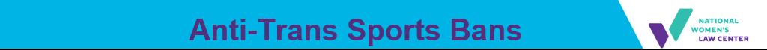
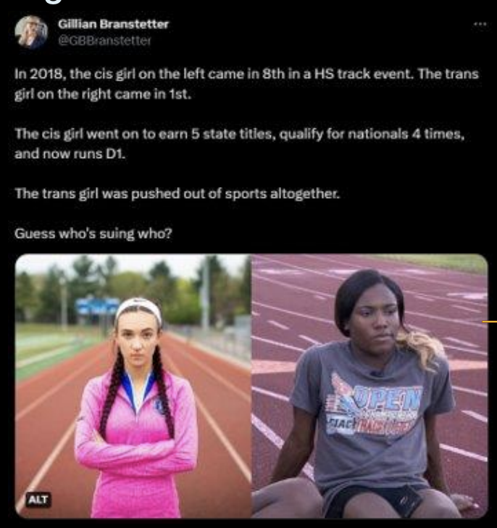
Exploiting Trans Students & Fake Moral Panic
Recent history: Targeting trans students as scapegoats traces back to Soule case filed by hate group ADF
"Historian Gillian Frank has noted the parallels between the myths about trans women making bathrooms unsafe for cis women and girls... and the racist myths pushed by segregationists stoking fears about integration's purported threat to white women's virtue and purity. The idea of protecting girls is meant to win, and with it, they can fuel a stigmatizing moral panic about trans people." - Melissa Gira Grant, The Soapbox, 2021, (link)
There is one best, evidence-supported intervention to mitigate crisis level health risks to trans youth: social support, from even one adult. Sometimes that life sustaining adult is a coach.

Slide 15
Department of Education Actions
January 24, 2025: ED dismisses complaints about K-12 book bans amid an unprecedented wave of state-level censorship efforts, targeting books about:
  LGBTQIA+ people and history; racism, segregation, and colonization; reproductive rights and sexual health; sexual harassment, violence, and abuse; student civil rights
March 28, 2025: ED guidance letter directing schools to forcibly out (and endanger) trans and nonbinary youth
April 4, 2025, DOJ and ED special investigation team to intimidate schools that support and include trans students in sports, restrooms, etc.

Slide 16

Other Federal Agencies Bullying Trans & Nonbinary Students
Health & Human Services: failed attempt to bully Maine schools
  Settlement restored child nutrition funds
Department of Energy (DOE)
  Ignoring correct process
  Targeting Title IX requirement schools allow girls to join boys’ teams if there is no team for girls, etc.
  Note: DREDF webinar next week to comment on DOE rules

Slide 17
Department of Education – Student Loans and Assistance
Department of ED, Federal Student Aid (FSA) runs:
Public Service Loan Forgiveness (PSLF)
Income-Driven Repayment (IDR) Plans
Total & Permanent Disability (TPD) Discharge
March 2025: more than 300 staff cut from FSA
Student loans are a disability issue! Disabled people, disability rights advocates, special ed teachers, nonprofit staff – we all need student loans and affordable payment plans!

Slide 18

Department of Education – Student Loans and Assistance
(Part 2)
Public Service Loan Forgiveness
  Historically dysfunctional
  Biden Administration took steps to fix -> +1 million debt free
  New option called “BuyBack” allows borrowers to cure past ineligible payments
Direct Loans
IDR
Public Service Employer [30 hours]
120 payments

Slide 19
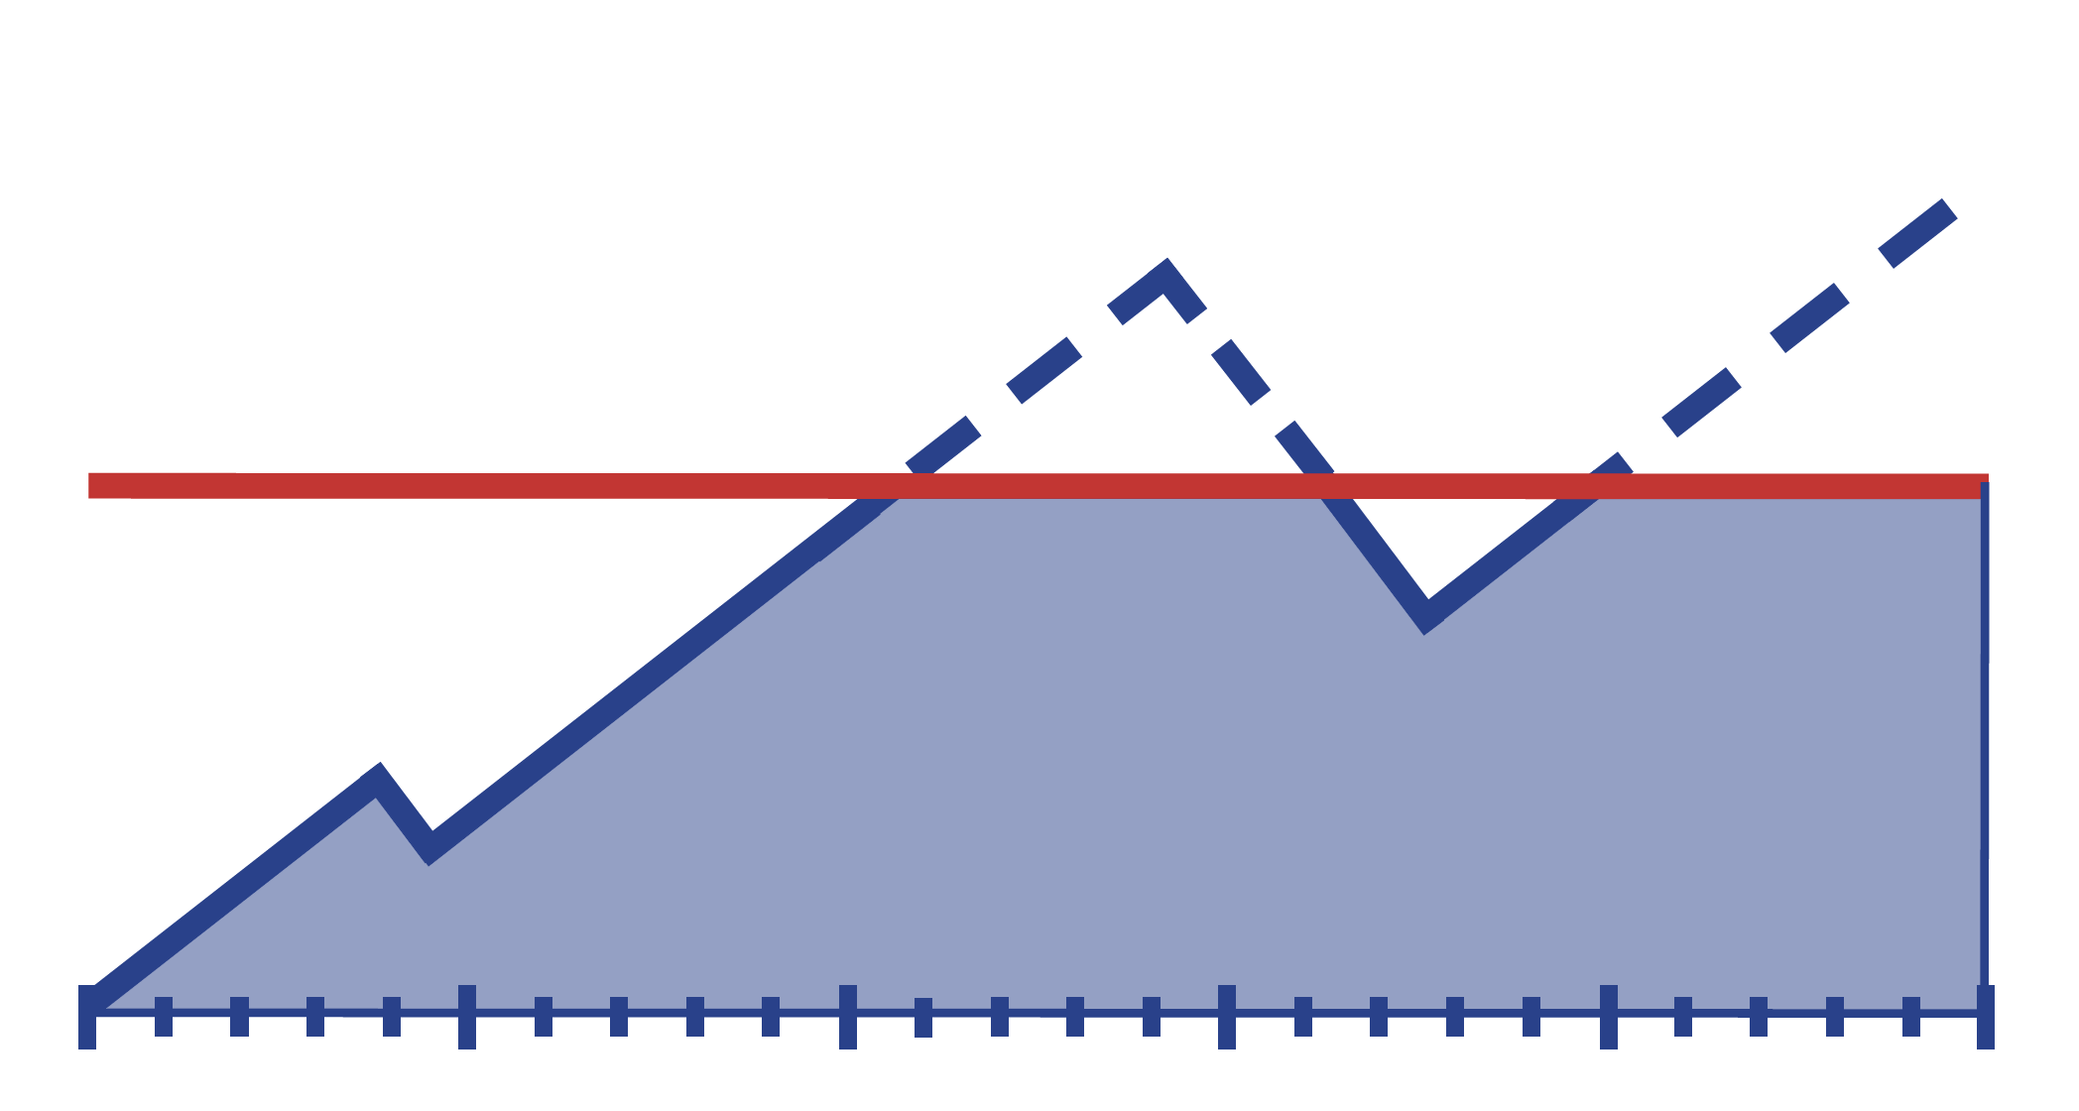
Department of Education – Student Loans and Assistance
(Part 3)
IDR Plans
  Affordable payments, debt cancellation
  Biden Administration took steps to fix -> +1.4 million debt free
  Biden introduced newest plan, SAVE Plan

Slide 20
Department of Education – Student Loans and Assistance
(Part 4)
IDR SAVE Plan
Aug. 2023: Introduced
Spring 2024: 18 states sue
Feb. 2025: court blocks SAVE
  8 million SAVE borrowers in “forbearance” – this means no payments required, no interest, no credit toward forgiveness
Feb. to Mar. 2025: IDR application offline, then back online after American Federation of Teachers sued

Slide 21
Department of Education – Student Loans and Assistance
(Part 5)
PSLF
  About 50,000 BuyBack applications waiting for review
  March EO and summer rulemaking
IDR Plans
  About 2 million applications waiting to be processed
  Reconciliation bill would eliminate ICR, PAYE, and SAVE plans and replace with new RAP*
  Summer rulemaking
No staff to help borrowers solve their problems
SAVE litigation continues (brought by states and by American Federation of Teachers)

Slide 22
Department of Education – What Might Happen Next
Administration wants to:
  move parts of ED to the Department of Health and Human Services
  move student aid to Small Business Administration
  eliminate Head Start
Budget Reconciliation (huge topic):
  “School choice” via federal voucher tax credit
    Increased discrimination against disabled students
    Decrease Medicaid $ for special education health services
FY 2026 ED Budget
  > 15% cut overall
  $4.5 billion cuts to K-12 programs including for homeless youth
  huge cuts to federal work-study
  Pell grants cut from $7,395 to $5,710

Slide 23

Department of Education – What Might Happen Next (Continued)
Litigators are fighting back:
  At least 7 cases filed to challenge Administration actions against Department of ED
  District of Massachusetts granted preliminary injunction in case brought by 21 states re staff cuts
    BUT District of D.C. denied preliminary injunction in case brought by students, parents, and COPAA re staff cuts

Slide 24
Students of Immigrant Families
January 20, 2025: Executive Order stating that undocumented immigrants must register
February 2025 to present: media campaign targeting undocumented immigrants, “self-deport” or face fines and imprisonment
March 12, 2025: Department of Homeland Security (DHS) sets out process for registration, effective April 11, 2025
Coming forward to register will be extremely dangerous for most undocumented community members. It could lead to detention, deportation, and possibly criminal prosecution.
– National Immigration Law Center

Slide 25
Students of Immigrant Families (Part 2)
January 24, 2025: DHS directive rescinding decade-old guidance re ICE enforcement in “sensitive” areas – including schools and churches
“Criminals will no longer be able to hide in America’s schools and churches to avoid arrest.” – Benjamine Huffman, Acting Secretary, Department of Homeland Security

Slide 26
Students of Immigrant Families (Part 3)
Impacts on millions of children in immigrant families (one in four children nationwide):
  increased fear and stress affecting daily life
  problems sleeping and eating
  headaches and stomachaches
  mental health conditions like depression and anxiety
  decreased performance in school
  reluctance to access programs and services
  long-term health consequences
Source: KFF

Slide 27
Autistic and Neurodiverse Students
"Autism destroys families, and more importantly, it destroys our greatest resource, which is our children … And these are kids who will never pay taxes, they’ll never hold a job, they’ll never play baseball, they’ll never write a poem, they’ll never go out on a date. Many of them will never use a toilet unassisted.”
– Robert F. Kennedy Jr.,
United States Secretary of Health and Human Services

Slide 28
We Still Have Rights!
Laws like ADA, Section 504, and IDEA still exist!
The White House and the Department of ED cannot change statutes
Students can still:
  Ask for accommodations at school
  File a discrimination complaint with OCR, U.S. Department of Education or state/local administrative agencies
  Participate in the IEP process
  File a due process complaint
  File a compliance complaint with their state department of education
  File a case in state or federal court
  Consult an attorney to assist with any of the above
Don’t forget state laws – for example, CA AB 2657 (2018)

Slide 29
Make Our Voices Heard! Action Alert
Find your elected representatives and contact them!
  Use this tool to find your reps, https://www.usa.gov/elected-officials
Tell your elected representatives to defend students and ED
  You can write your own email or you can use tools by COPAA https://copaa.salsalabs.org/OpposePlanstoCloseEDProtectStudentswithDisabilities/index.html and the Council for Exceptional Children, https://exceptionalchildren.org/lac?vvsrc=/Campaigns/121668/Respond
And tell your reps to defend Medicaid against billions in cuts!!
  Medicaid supports students with disabilities at school with screening, early intervention, occupational therapy, mental health counseling, specialized medical equipment, and transportation
  Get more information on DREDF’s page, https://dredf.org/hands-off-our-medicaid/

Slide 30
Make Our Voices Heard – Protest!
Join a disability community protest!
June 16, 2025, Sacramento, California
  Gather: 11 am, State Capitol, West Steps
ADA anniversary = disability community events
  July 21, 2025, National Council on Independent Living rally
    Gather: 2:00 pm 11th + G Streets NW, Washington, D.C.
    March: 3:00 pm
    Rally: 4:00 pm US Capitol
  Contact your state and local disability organizations and ask about local rallies! Or organize one yourself!
    State protection and advocacy agencies, https://www.ndrn.org/
    Independent living centers, https://ncil.org/

Slide 31
Upcoming Webinars
Defending Section 504 Regulations: June 10, 2025
10:30 am to 12 pm Pacific Time / 1:30 pm to 3 pm Eastern Time
Learn how to file comments on Regulations.gov
Defending Medicaid in the Senate: TBD
Watch your email and social media for announcements

Slide 32
Questions?

