Slide 1


Services and Supports for
Care Court Respondents Part II
April 21, 2025
DREDF + Keris Jän Myrick

Slide 2
Presenters
Keris J. Myrick
MBA, MS, CPMC, Vice President of Partnerships at Inseparable
Claudia Center
Legal Director, Disability Rights Education and Defense Fund
Kavya Parthiban
Staff Attorney, Disability Rights Education and Defense Fund

Slide 3
Topics
Continued Services and Supports
Regional Centers
IHSS
Evidence-Based & -Informed Practices
  Medication Empowerment
  WRAP©
  Psychiatric Advance Directives (PADs)
  Recovery Oriented Cognitive Therapy (CT-R)
Supported Decision Making
Peer Support (Cont.)
Bridge Housing
Access, Engagement, Activation
Recap of Part I
Person-Centered Planning
Specialty Mental Health Services (SMHS)
Full Service Partnerships (FSP)
Peer Support
CalAIM & Enhanced Case Management

Slide 4
Moving Beyond Engagement to Activation

Slide 5
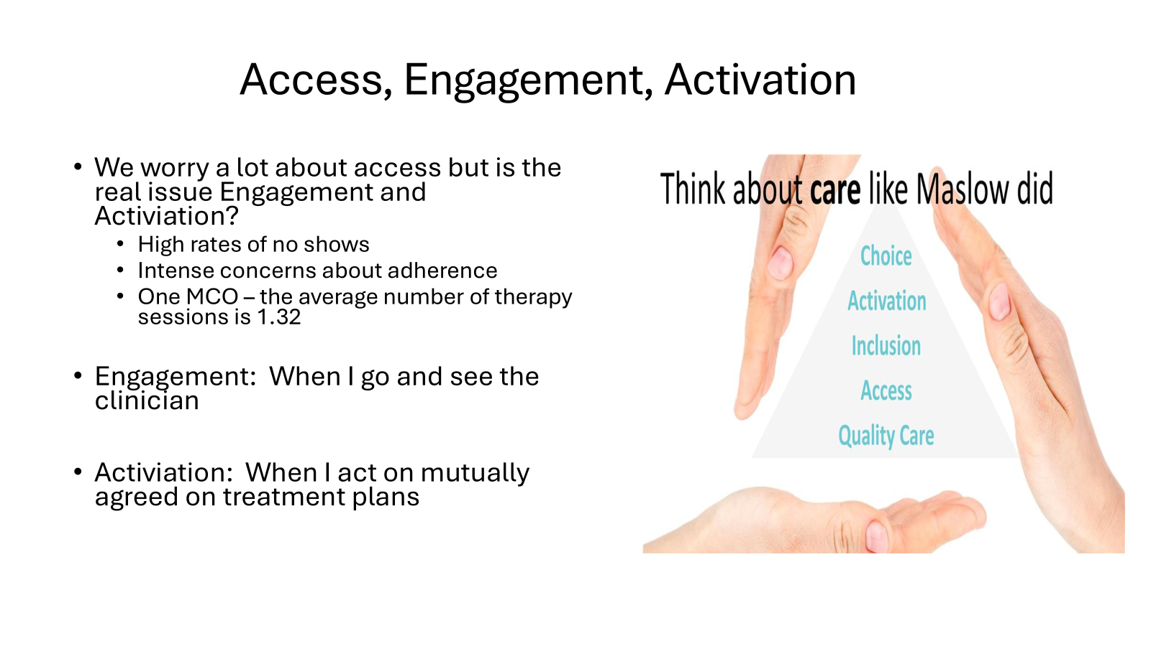
Access, Engagement, Activation
We worry a lot about access but is the real issue Engagement and Activation?
High rates of no shows
Intense concerns about adherence
One MCO - the average number of therapy sessions is 1.32
Engagement: When I go and see the clinician
Activation: When I act on mutually agreed on treatment plans

Slide 6
Recap of Part I

Slide 7
What is Person-Centered Planning?
Strengths, goals, needs
Choice, control, and self-determination
Accessibility – no wrong door, coordinated, easy to use
Meeting people where they are
Not just medical needs but recreation, transportation, friendships, therapies, housing, vocational training and employment, family relationships, social activities, culture, language
Dignity of risk

Slide 8
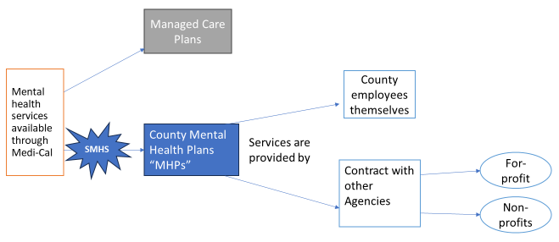
What are Specialty Mental Health Services?
Provided directly by county Mental Health Plan (MHP)
More intensive, more supports, than typical managed care plan
Apply through County screening systems
Managed Care Plans

Slide 9
What Are the Rights of People Receiving SMHS?
Person approved for SMHS gets a care plan
  Beneficiary helps make the care plan and agrees to it
  Care plan includes goals, treatment objectives, services
Medi-Cal services are an entitlement and people receiving SMHS have “due process” rights. They may file:
  grievance about their experiences as a client
  an appeal about an “adverse benefit determination” such as a denial or reduction in services, or a long delay
    after an appeal there is a right to a “fair hearing”
County must provide information about how to file grievances and appeals, how to seek a fair hearing
Citations: 9 CCR §§ 1810.205.2, 1810.360, 1810.405, 1810.440(c); 1850.205, 1850.215; DRC Publication

Slide 10
What is Full Service Partnership?
Concept: partnership between person being served and service provider in which client is offered a full array of services, through a “whatever it takes” approach to meeting needs
Targeted toward people with significant mental illness who are unhoused, at risk of being unhoused, have history of criminal legal involvement, and/or have repeat hospitalizations
Person may get “Individual Services and Supports Plan” (ISSP)
No strict rules about how the County decides who get an FSP slot, other than prioritizing people who are “unserved”
Citation: Cal. Welf. & Inst. Code § 5600.3, 9 CCR §§ 3200.310, 3620, 3650

Slide 11
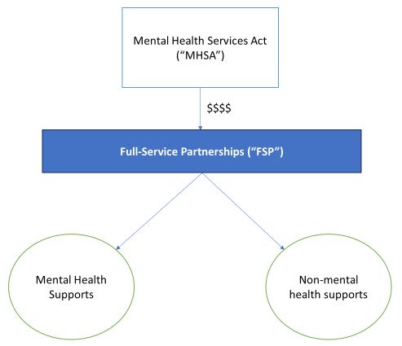
What Can an FSP Provide?
Note: Medi-Cal $$ used here when possible

Slide 12
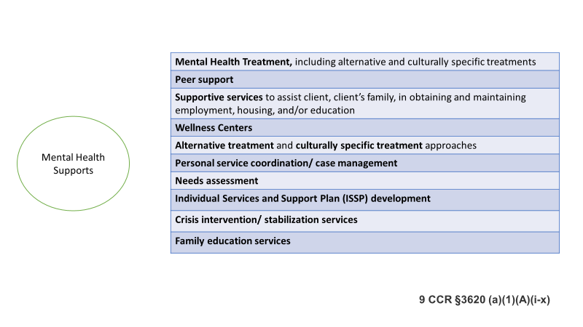
What Can an FSP Provide? (part 2 of 3)

Slide 13
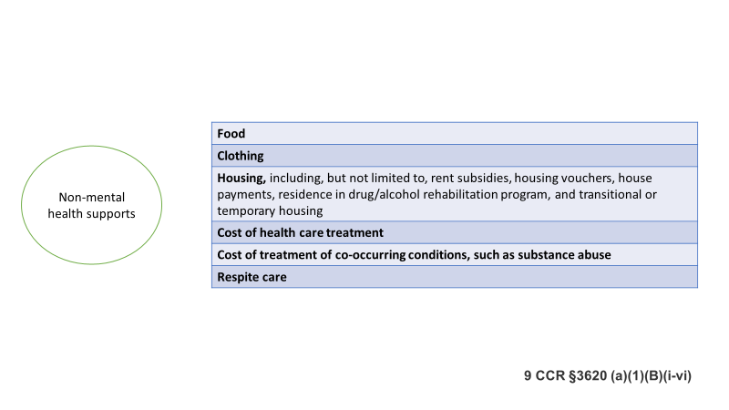
What Can an FSP Provide? (part 3 of 3)

Slide 14

Reality is Local
Each County’s mental health plan and phone number is published online
  If your county has limited resources, they may contract out to another county
Connect with your County mental health agency
  Develop relationships and regular communication
Questions:
  What skills and material resources are available in your county?
  What are the doors to programs in your county?
  Where are the “low barrier doors” for respondents?

Slide 15
What is peer support? What does a peer worker do?
Engages peers in collaborative and caring relationships
Provides support
Shares lived experiences of recovery
Personalizes peer support
Recovery planning
Links to resources, services and supports
Teaches information and skills related to health, wellness and recovery
Helps peers to manage crises
Communication
Collaboration and teamwork
Leadership and advocacy
Growth and development
Source: SAMHSA, Core Competencies for Peer Workers in Behavioral Health Services
15

Slide 16
What is CalAIM?
CalAIM = “California Advancing and Innovating Medi-Cal,” recently launched managed care initiative funded via Medicaid waiver
Enhanced Care Management (ECM) benefit:
  Designed for highest risk, highest-cost plan members with most complex needs
  ECM providers responsible for coordinating and managing care across provider
  Client gets “lead care manager”
Optional Community Service (CS) benefits cover housing supports:
  Short-Term Post-Hospitalization Housing
  Housing Transition Navigation Services
  Housing Tenancy and Sustaining Services
  Housing Deposits
Citations: New LAO report; DREDF Training; DREDF PowerPoint; DHCS on CalAIM; DHCS on ECM and CS

Slide 17
Regional Centers

Slide 18
Respondents with Developmental Disabilities
Between 6% to 17% of unsheltered individuals have a developmental disability in California (California Health Policy Strategies Brief (2025))
CARE Court respondents may additionally have a developmental disability which make follow-through on services and treatment more complicated
Developmental disability generally describes a range of conditions including intellectual disability, cerebral palsy, epilepsy, autism spectrum disorder (“ASD”), or similar conditions

Slide 19
Respondents with Developmental Disabilities (continued)
Some developmental disabilities qualify for services and supports under the Lanterman Act
  Meant to help people with developmental disabilities to live full productive lives as independently as possible
Under the Lanterman Act qualifying disability:
  Starts before the age of 18
  One of five conditions: cerebral palsy, epilepsy, autism, intellectual disability (“ID”), other conditions closely related to ID
  “Substantial disability”

Slide 20
Regional Centers (part 1 of 3)
Regional Centers serve people with developmental disabilities and must:
  Evaluate and decide if person is eligible
  Coordinate services
  Develop an Individual Program Plan (IPP) with consumer that considers their needs/choices
  Make sure that consumers receive all supports and services listed in IPP
Citation: Cal.Welf.Inst. Code 4500; DRC Publication on RC Eligibility; DRC Publication on IPP; DRC Chapter on IPP; DRC Chapter on Community Living for Adult RC Clients

Slide 21
Regional Centers (part 2 of 3)
The Lanterman Act says regional services must provide emergency and crisis intervention services to help a person stay in their family home
If services are unsuccessful, must provide emergency housing in the person’s community
Citation: Cal.Welf.Inst. Code 4500; DRC Publication on RC Eligibility; DRC Publication on IPP; DRC Chapter on IPP; DRC Chapter on Community Living for Adult RC Clients

Slide 22
Regional Centers (part 3 of 3)
Regional Centers typically provide services that are not available elsewhere
Can be difficult to get someone approved for RC later in life due to inability to find records and difficulty of RC diagnosing someone with concurrent mental illness
Still, Care Court respondents who may have a qualifying developmental disability should apply for RC services
Citation: Cal.Welf.Inst. Code 4500; DRC Publication on RC Eligibility; DRC Publication on Applying for Regional Center Services

Slide 23
In-Home Services and Supports

Slide 24
IHSS
In-Home Services and Supports (IHSS) is a Medi-Cal program that pays for in-home care (caregivers) for people with disabilities; most caregivers are family members; bureaucratic delays but no “waitlist”
Covered services may include:
  Housework and laundry
  Meals, dressing, bathing
  Assistance with self-administration of medications
  Money management
IHSS can prevent homelessness
IHSS can be provided to people who are marginally housed such as in a shelter or RV (“alternative living arrangement”)
Citations: DRC Publication; 2020 All County Letter

Slide 25
Evidence-Based /
Evidence-Informed Practices
Medication Empowerment
Wellness Recovery Action Plan (WRAP ©)
Psychiatric Advance Directives (PAD)
Recovery Oriented Cognitive Therapy (CT-R)

Slide 26
Medication Adherence to Medication Empowerment

Slide 27
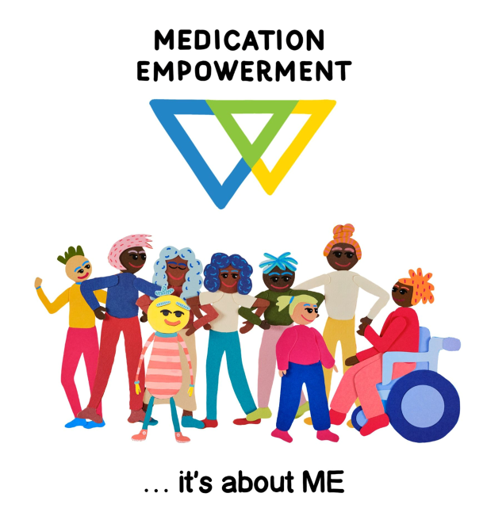
Medication Empowerment
Helping people have a voice and a choice in finding the treatment that is right for them
Medication empowerment is about having the life "I want"
"Medication Empowerment helps individuals identify and move through challenges related to using psychiatric medication. It also teaches staff to identify 9 common challenges related to using psychiatric medications and provides them with the tools to effectively support individuals facing these challenges."
patdeegan.com/medication-empowerment

Slide 28
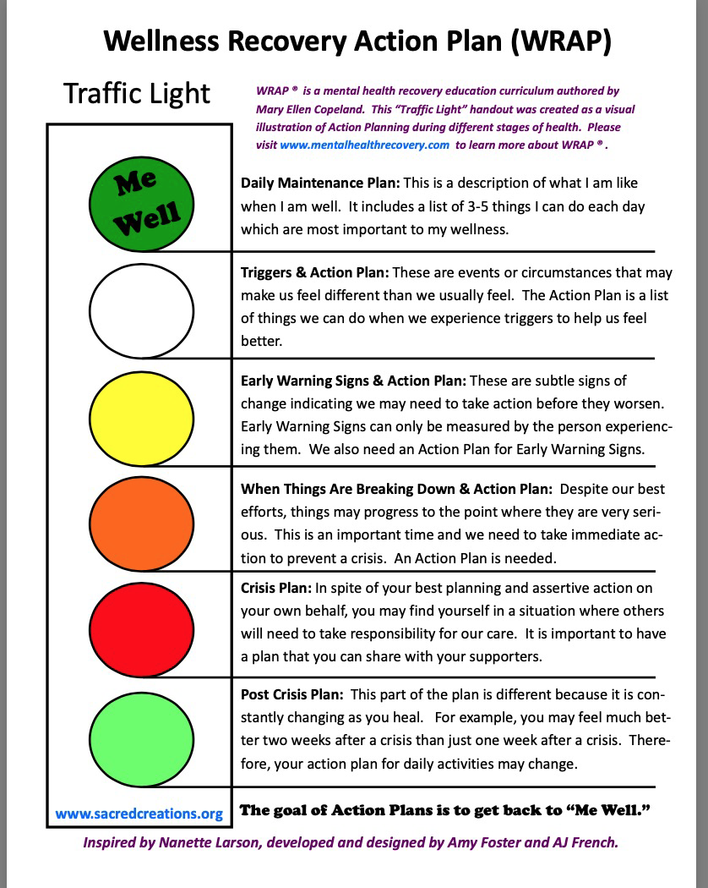
WRAP
WRAP Is…
Wellness Recovery Action Plan (WRAP) is a simple and powerful process for creating the life and wellness you want. With WRAP, you can:
Discover simple, safe, and effective tools to create and maintain wellness
Develop a daily plan to stay on track with your life and wellness goals
Identify what throws you off track and develop a plan to keep moving forward
Gain support and stay in control even in a crisis

Slide 29
Psychiatric Advance Directives
PAD is a legal document that documents a person’s preferences for future mental health treatment, and allows appointment of mental health proxy to interpret those preferences during a crisis
Drafted when person is well enough to consider preferences and used when person becomes unable to make decisions during mental health crisis
Research findings show that peer worker-facilitated PADs showed fewer compulsory rehospitalization compared to control group

Slide 30
Using a CT-R Framework

Slide 31
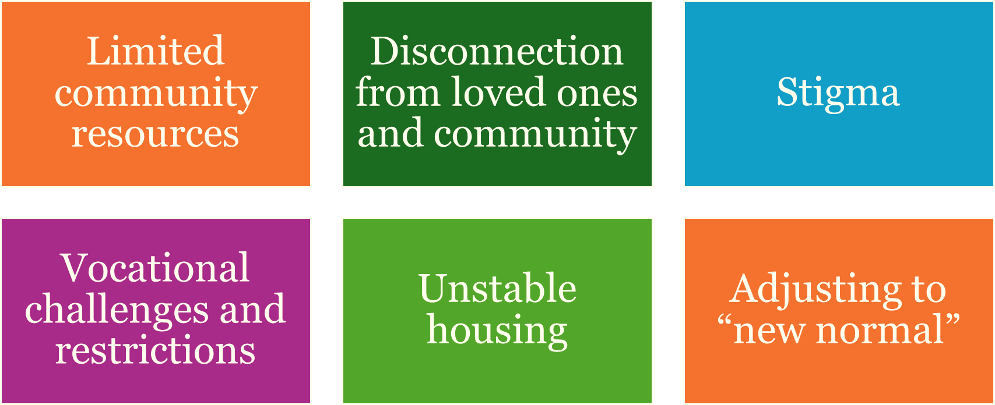
Why Recovery Oriented Cognitive Therapy
Common Challenges to Community Flourishing

Slide 32
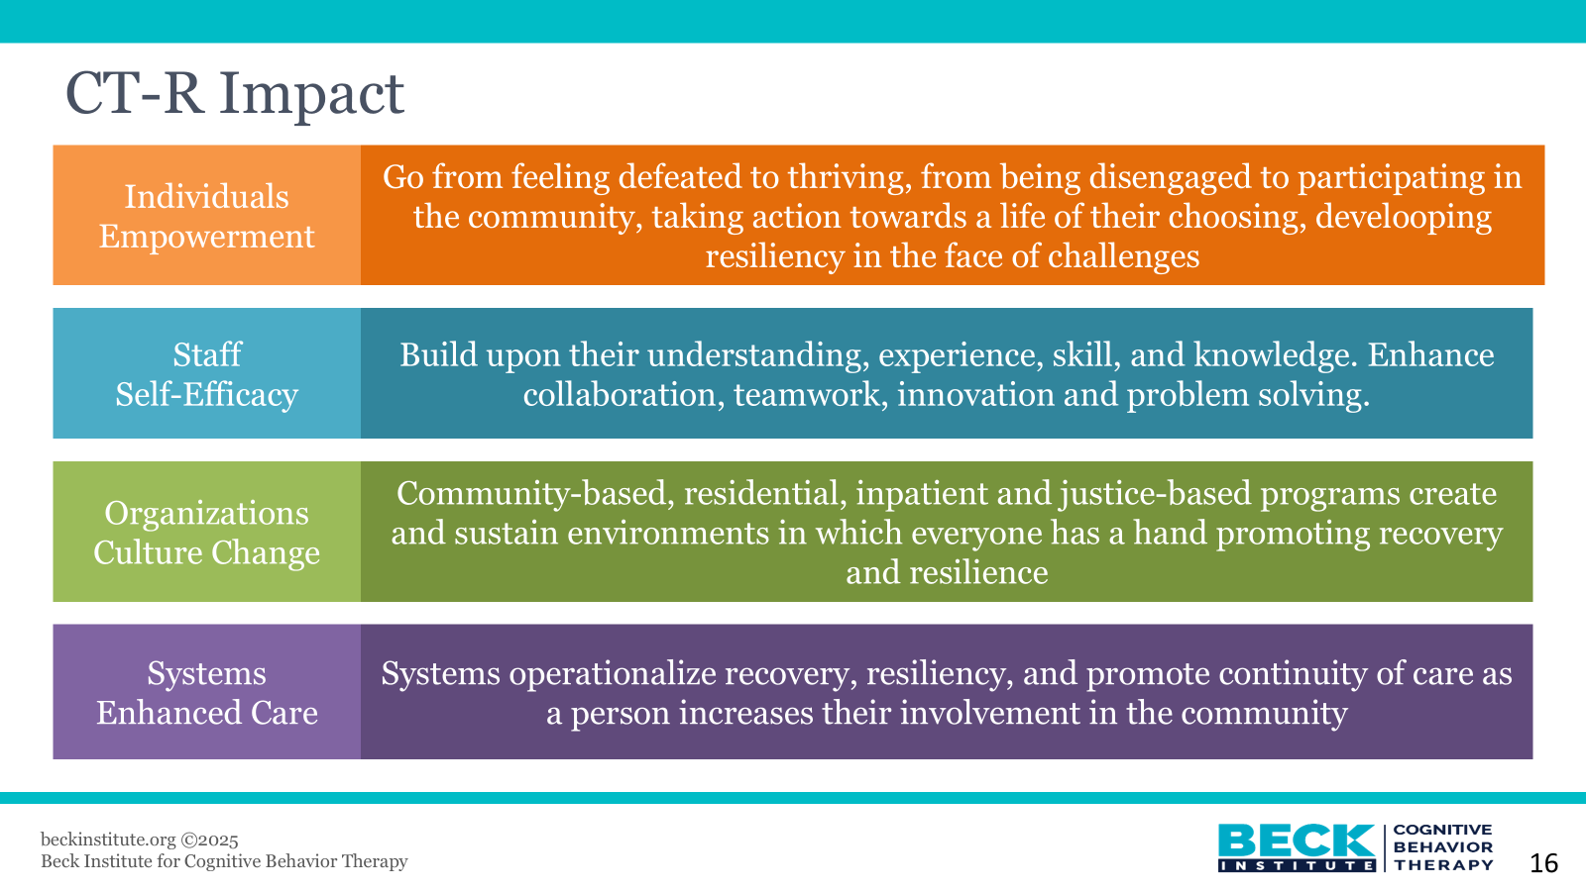
CT-R Impact

Slide 33
Recovery Oriented Cognitive Therapy
Research shows people struggle with identity

Slide 34
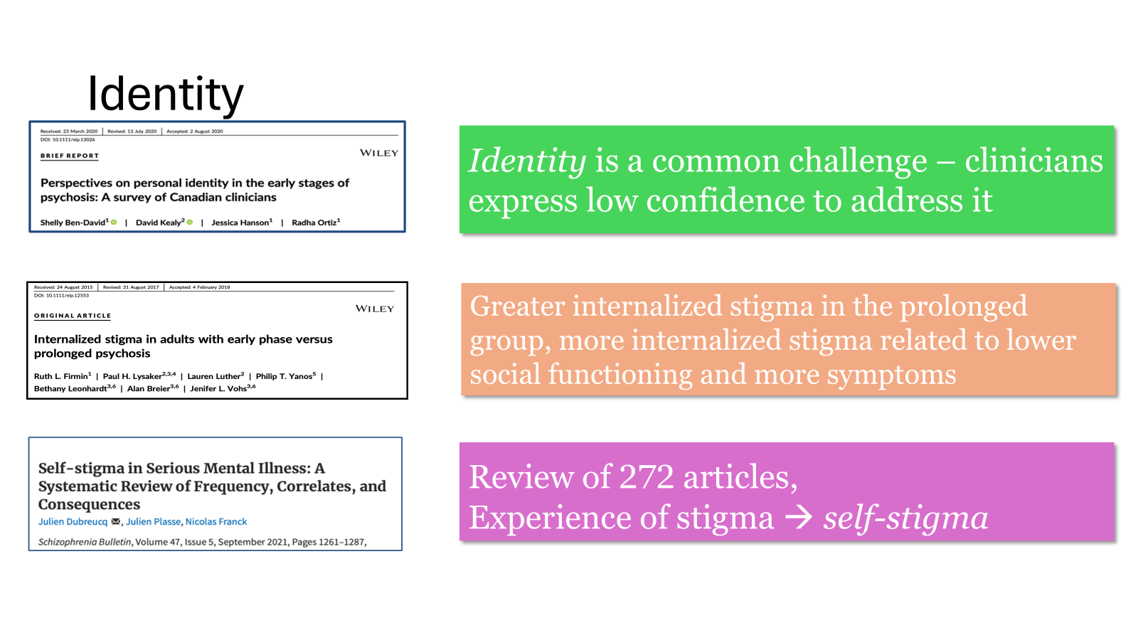
Identity

Slide 35
Impact of Identity Loss & Stigma on Families
Individual Beliefs
I am broken
I am a failure
I am a burden to my family
Behavior
Isolation and
Disengagement
Loss of family
identity and
activities
Emotions
Shame
Embarrassment
Hopelessness
Family Beliefs
Others will judge us
Things will never be the same

Slide 36
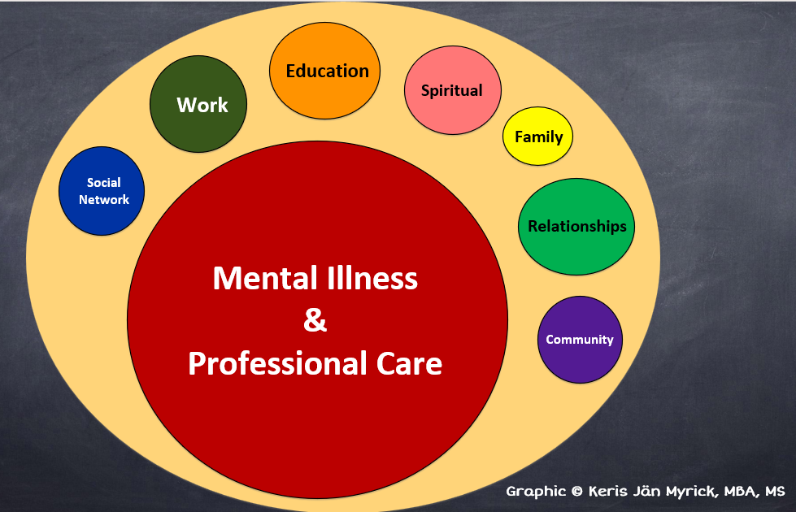
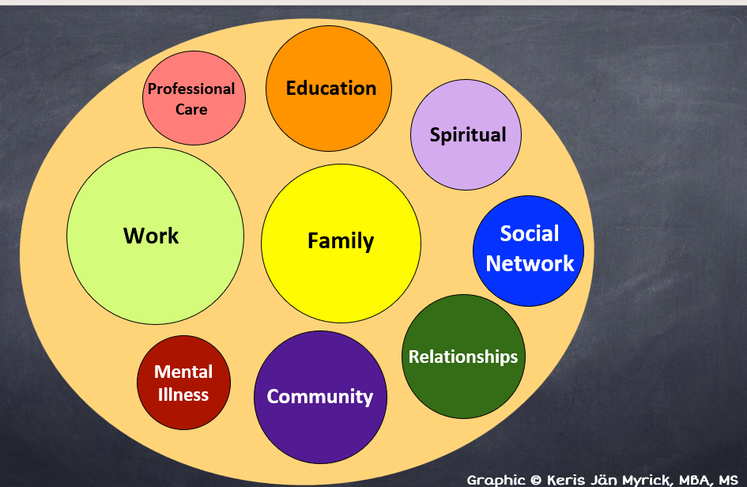
What Work Can Look Like ...
Person with living/lived experience: Perception of Care
Person with living/lived experience: Preferred Focus

Slide 37
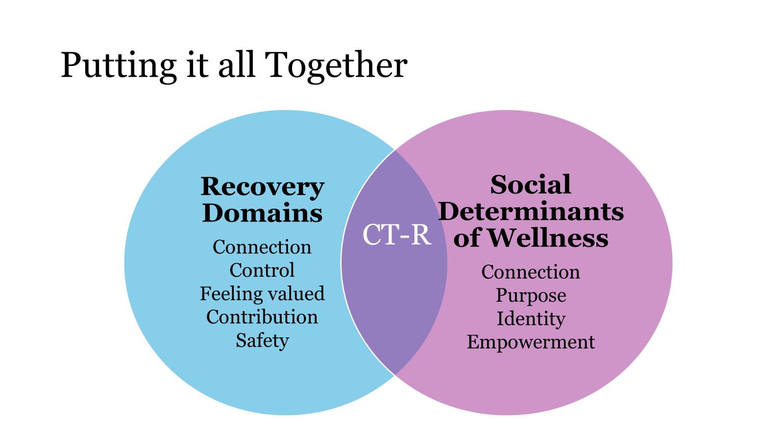
Putting it together: Recovery Oriented Cognitive Therapy

Slide 38
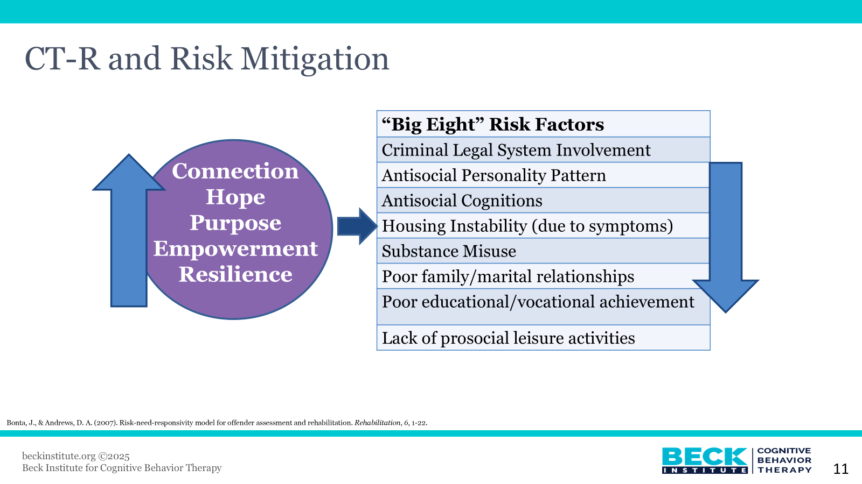
CT-R and Risk Mitigation

Slide 39
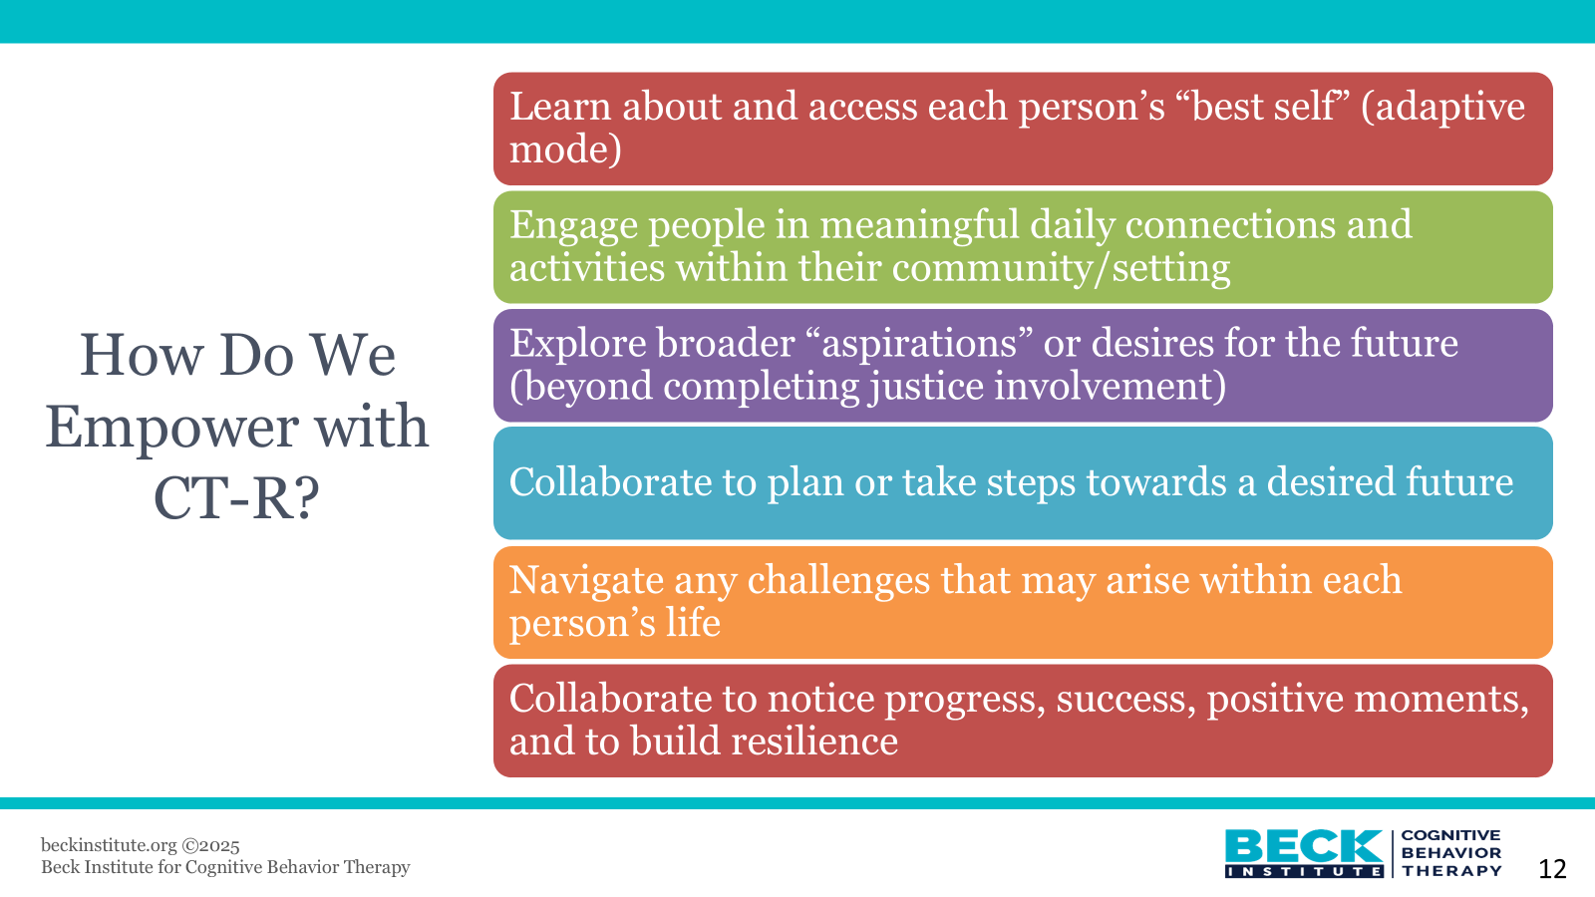
How do we Empower with CT-R?

Slide 40
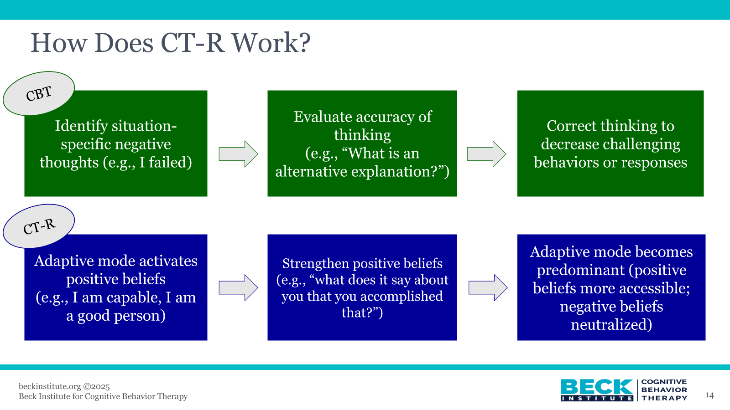
How does CT-R Work?

Slide 41
Assertive Community Treatment

Slide 42
Assertive Community Treatment (ACT)
Community-based, team-based service that includes multidisciplinary mobile teams that provide wraparound services
  Typically includes psychiatrist, nurse, case managers, peers, and other mental health professionals
  Provides services on day-to-day basis and 24/7 crisis intervention
  Look up if your county covers ACT
Additional Practices
  Housing First – connection to permanent supportive housing
  Volunteer peer support

Slide 43
Supported Decision Making

Slide 44
What is Supported Decision Making?
Individualized arrangement in which an adult with a disability chooses one or more people they trust as supporters to help them understand, make, communicate, implement, and act on their own choices
An alternative to conservatorship or guardianship
Can strengthen the capacity of a disabled person and avoid the need for conservatorship or guardianship
Can be formal or informal
Trusted, chosen supporters help the person understand, consider, or communicate choices
SDM can strengthen capacity – assess capacities with supports
California formally recognizes SDM, AB 1663 (2022); Cal. Stats. 2022 Ch. 894

Slide 45
What Role Supporters Can Play
If a client requests a supporter, supporters can
Assist client in logistics such as scheduling meetings and arranging transportation
Help client communicate – for example, supporter re-speaks the client’s words if speech is difficult to understand
Help client understand legal, medical, or other complex concepts
Enact plan from supportive decision making
But remember, the client is the client, not the supporter

Slide 46
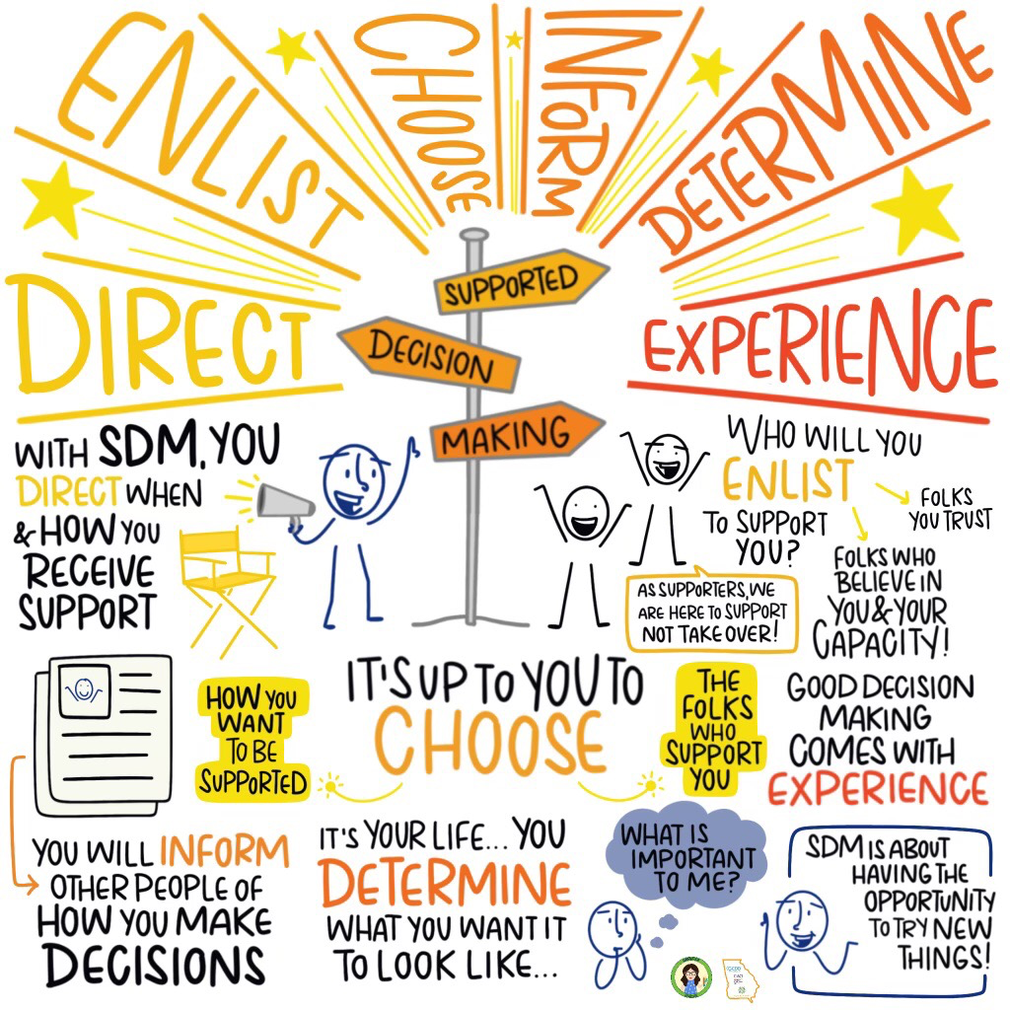
Supported Decision Making Visual

Slide 47
Peer Support
Continued

Slide 48

Family Peer Support
A parent provides experiential knowledge with a parent receiving support (Robbins, et al., 2009)
Offers hope, guidance, advocacy and camaraderie for parents and caregivers

Slide 49
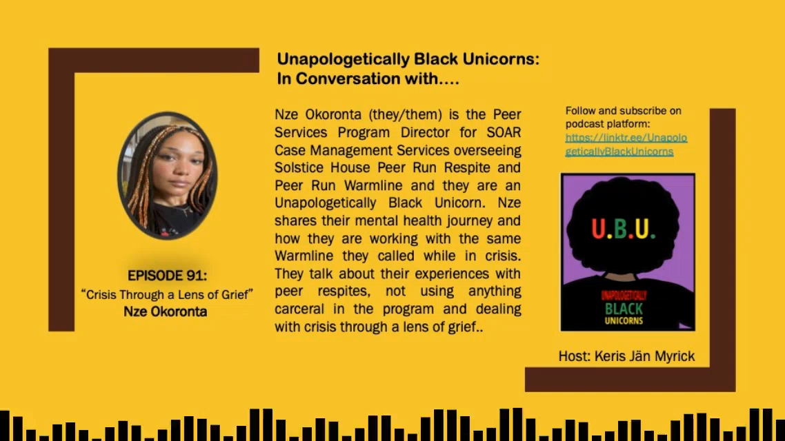
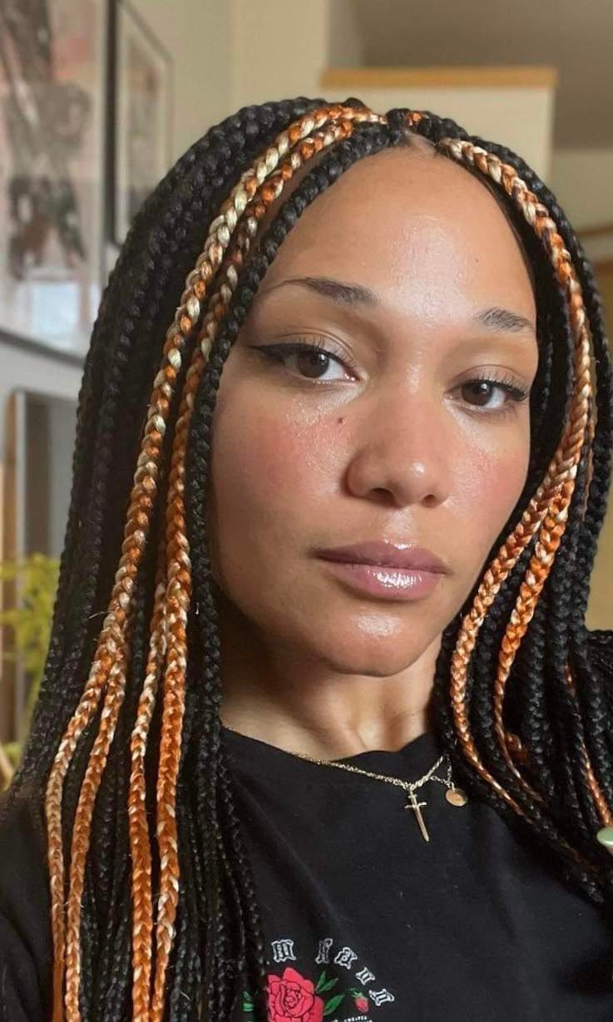
The Power of Peer Respites
Unapologetically Black Unicorns Podcast Episode 91: Nze Okoronta
https://podcasts.apple.com/us/podcast/unapologetically-black-unicorns/id1568804071?i=1000600968430

Slide 50
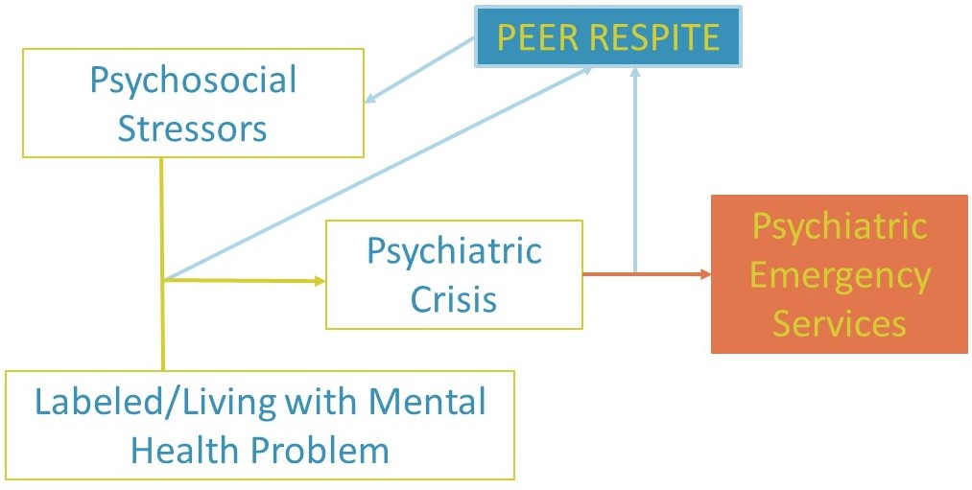
Peer Respite
A peer respite is a voluntary, short-term, overnight program that provides community-based, non-clinical crisis support to help people find new understanding and ways to move forward.
It operates 24 hours per day in a homelike environment.
Peer respites are staffed and operated by people with psychiatric histories or who have experienced trauma
peerrespite.com

Slide 51
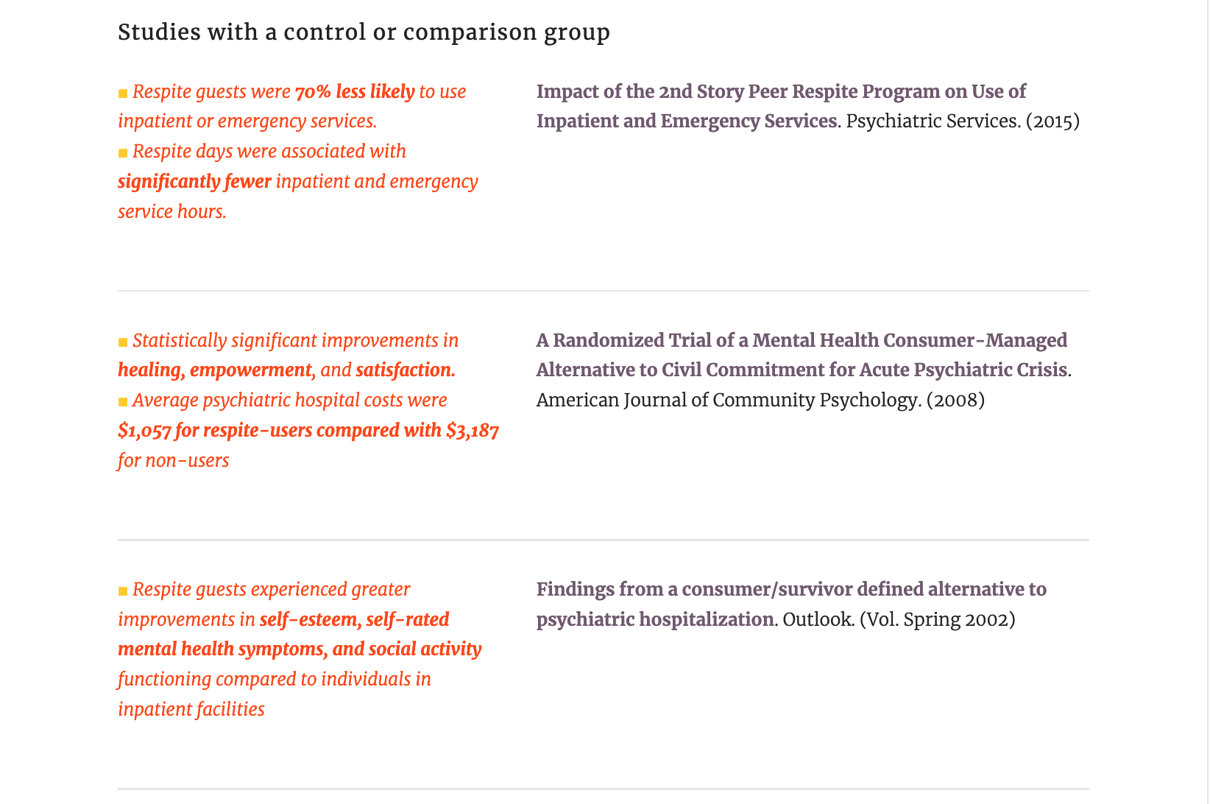
Peer Respite - Outcomes
https://www.peerrespite.com/

Slide 52

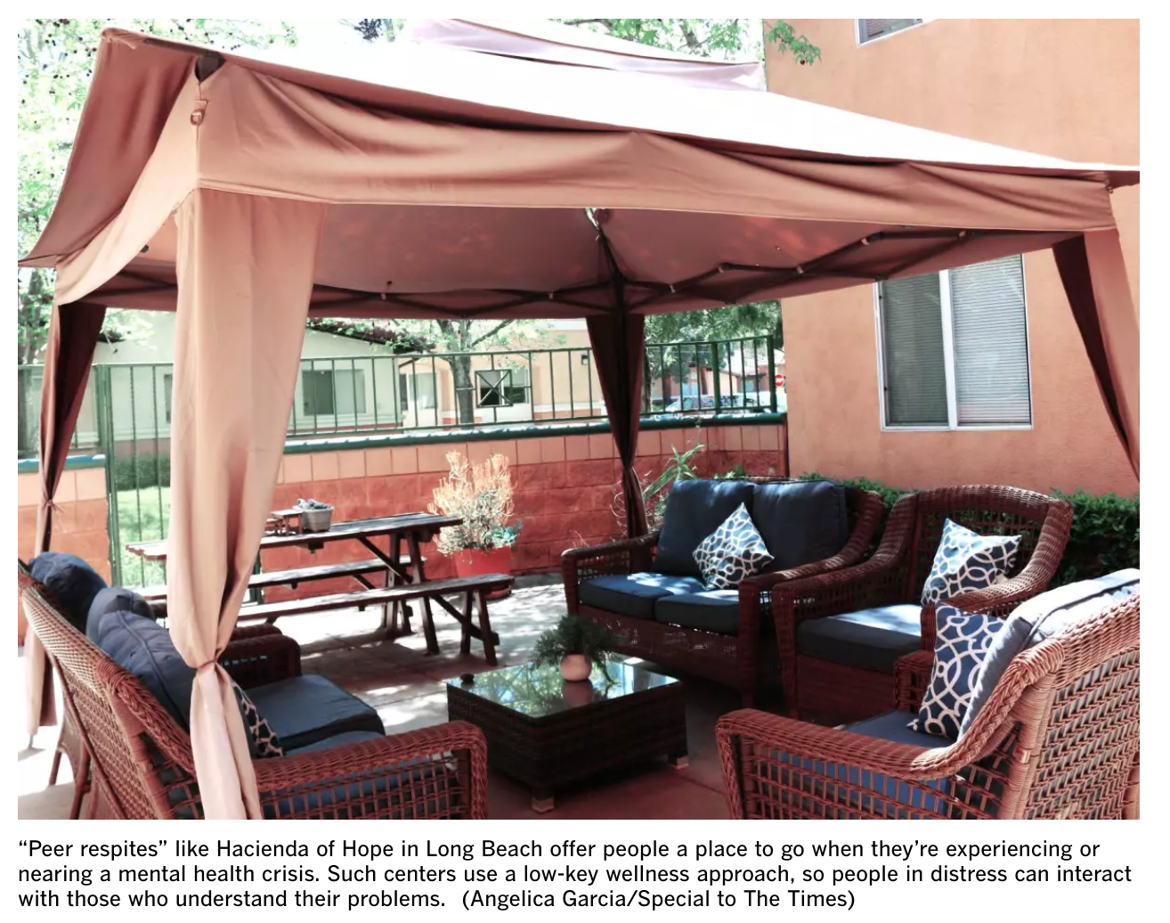
California Peer Run Respites:
2nd STORY PEER RESPITE HOUSE
  Website: https://www.encompasscs.org/second_story
  Location: Santa Cruz, CA
BLACKBIRD HOUSE PEER RESPITE
  Website: http://www.fcservices.org/blackbird-house-respite/
  Location: Santa Clara County, CA
CEDAR HOME
  Location: Weaverville, CA
HACIENDA OF HOPE
  Website: https://prpsn.org/services-peer-support-network.html?id=171
  Location: 2241 W. Williams Street, Long Beach, CA 90810
SHARE! RECOVERY RETREAT
  Website: www.shareselfhelp.org
  Location: Monterey Park, CA and North Hollywood, CA
SALLY’S PLACE
  Website: www.livelafamilia.org
  Location: Alameda County, CA
https://www.latimes.com/california/story/2021-01-11/peer-respites-people-facing-mental-health-crises-pandemic
https://power2u.org/directory-of-peer-respites/

Slide 53
Bridge Housing
CARE Court respondents have priority for the Behavioral Health Bridge Housing program. Program funds interim housing projects (from @ 60 days to @ 2 years)
https://bridgehousing.buildingcalhhs.com/
https://bridgehousing.buildingcalhhs.com/county-behavioral-health-agencies#CBHAR3Awards
https://bridgehousing.buildingcalhhs.com/county-behavioral-health-agencies#CBHAR1Awards
Citation: Cal. Welf. & Inst. Code § 5982

Slide 54
CARE Court Reports
California DHCS, Early Implementation Report (Nov. 2024)
KFF, California’s ‘Care Courts’ Are Falling Short (Dec. 2024)

Slide 55
Request from Disability Rights California
Disability Rights California is monitoring the implementation of CARE Court and would like to hear directly from respondents about their experiences. We are hoping to better understand how CARE Court is being implemented in different counties and its impact on people with disabilities.
If you know CARE Court respondents who may be willing to share their experiences, please refer them to:
Samuel.Jain@disabilityrightsca.org, (916) 504-5929.

Slide 56
Questions and Answers

