Slide 1


What is Section 503 of the Rehabilitation Act?
And How Can We Defend it?
August 19, 2025

Slide 2

Today’s Presenters
Jennifer Mathis (she, her)
Deputy Director, Bazelon Center for Mental Health Law
Claudia Center (she, her)
Legal Director, Disability Rights Education and Defense Fund
Also available for Q&A:
Taryn Mackenzie Williams (she, her), Former Assistant Secretary for Disability Employment Policy at US Department of Labor (tentative)

Slide 3
What is Section 503 of the Rehabilitation Act?
And How Can We Defend It?
Agenda
Section 503 and the 2013 Section 503 regulations – Jennifer
Proposed rescissions – Claudia
Importance of data collection and action requirements – Jennifer, Claudia
How to oppose the rescissions – Claudia
  Template Comment
  Submitting on Regulations.gov
Questions and Answers – Jennifer, Claudia, Taryn

Slide 4

Section 503 and the 2013 Regulations

Slide 5
Section 503 of the Rehabilitation Act of 1973
29 U.S.C. § 793
Any party with a contract in excess of $10,000 [now adjusted to $15,000] with any federal department or agency “shall take affirmative action to employ and advance in employment qualified individuals with disabilities.” 29 U.S.C. § 793(a).
Individuals with disabilities may file a complaint with the Department of Labor. “The Department shall promptly investigate such complaint and shall take such action thereon as the facts and circumstances warrant, consistent with the terms of such contract and the laws and regulations applicable thereto.” 29 U.S.C. § 793(b).
Note: the agency in the Department of Labor (DOL) that oversees requirements for federal contractors is the Office of Federal Contract Compliance Programs (OFCCP)

Slide 6
Goal of Section 503
The federal government has choices in the entities with which it does business. Having a contract with the federal government is not a right but a privilege. Congress has ordered DOL to require that contractors selected “shall take affirmative action to employ and advance in employment qualified individuals with disabilities.”
Data collection about applicants and employees, with a goal to measure progress, is a direct and obvious way to implement Congress’s directive.

Slide 7
History and Basis of 2013 Regulations
Extensive rulemaking process by OFCCP
2010 Advanced Notice of Proposed Rulemaking
2011 NPRM, reviewing 127 comments
  60-day comment period extended 14 days
2013 Final Rule, reviewing over 400 comments
2011 NPRM cited the U.S. Department of Labor's Bureau of Labor Statistics (BLS):
21.8% of people with disabilities aged 16+ in labor force in 2010, compared with 70.1% of individuals without disabilities aged 16+
  BLS 2025 data: 24.5% (disabled) compared to 68.1% (nondisabled)
unemployment rate for people with disabilities aged 16+ was 14.8%, compared with an unemployment rate of 9.4% individuals without disabilities aged 16+
  BLS 2025 data: 7.5% (disabled) compared to 3.8% (nondisabled) in 2024

Slide 8
2013 Regulations Implementing Section 503
41 C.F.R. Part 60–741
Contractors with 50+ employees & $50,000+ contract
Employment goal of 7% people with disabilities, 41 C.F.R. § 60-741.45(a)
Goal is benchmark that should be reached if contractor adopts affirmative action policies, 41 C.F.R. § 60-741.45(b)
OFCCP must periodically review and update goal, 41 C.F.R. § 60-741.45(c)
Periodic invitations to voluntarily self-identify as a person with a disability
Applicants, 41 C.F.R. §§ 60-741.23(c), 60-741.42(a)
After a job offer (before employment), 41 C.F.R. § 60-741.42(b)
During employment – year one and every five years after, 41 C.F.R. § 60-741.42(c)

Slide 9
2013 Regulations Implementing Section 503 (Continued)
41 C.F.R. Part 60–741
Contractors with 50+ employees & $50,000+ contract
Annual evaluation with action steps
Compare data collected to 7% goal, 41 C.F.R. § 60-741.45(d)(3)
  Larger contractors (> 100 employees) in each job group
  Smaller contractors across entire workforce
Identify problem areas where 7% goal is not reached, 41 C.F.R. § 60-741.45(e)
Implement “action-oriented programs” designed to correct problem areas, 41 C.F.R. § 60-741.45(f) such as modified personnel processes and alternative or additional outreach and recruitment efforts

Slide 10
2013 Regulations Implementing Section 503 (part 3)
41 C.F.R. Part 60–741
Contractors with 50+ employees & $50,000+ contract
Required elements of Section 503 affirmative action program:
Equal opportunity statement in accessible places and formats, 41 C.F.R. § 60-741.44(a)
Review of personnel processes to avoid stereotype, ensure access (including in technology), provide reasonable accommodation, avoid unnecessary “screen out,” prevent harassment, etc., 41 C.F.R. § 60-741.44(b), (c), (d), (e)
“Appropriate outreach and positive recruitment activities” such as to disability-related entities, students with disabilities, etc., 41 C.F.R. § 60-741.44(f)
NEW IN 2013: Annual analysis of data about applicants and employees – # of applicants with disabilities; # of job openings & jobs filled; total # of applicants; # of applicants with disabilities hired; total # of applicants hired, 41 C.F.R. § 60-741.44(k)

Slide 11
Why does workforce data and analysis matter?
“When you can measure what you are speaking about, and express it in numbers, you know something about it,”
Lord Kelvin, British physicist (1889)
“What gets measured gets done,”
Pat A. Shiu, Director of OFCCP, in Ability Magazine

Slide 12

Impact of 2013 Section 503 Regulations

Slide 13
Impact of 2013 Regulations
Most contractors surveyed (57.1%) changed their affirmative action goals in response to the 2013 regulations (“to a great extent” or “somewhat”)
Large majorities of contractors reported they are using or plan to use the disability self-identification data to:
assess progress toward the 7% utilization goal (90%)
gauge success in outreach and recruitment (87%)
assess progress in hiring (86%)
assess progress in retention (66%)
review progress in advancement (61%)
Most contractors initiated or increased recruitment efforts and improved employment policies for people with disabilities
Source: Enayati and von Schrader (2020)

Slide 14
Impact of 2013 Regulations (part 2)
Between 2015 and 2020, contractors subject to OFCCP jurisdiction reported 10,103 hires of people with disabilities, about 2,000 hires per year
Between October 2018 to June 2020, the number of federal contractors reporting to OFCCP that they had met the 7% goal increased substantially, from 85 to 356
Note: Federal contractors – more than 200,000 nationwide – do not routinely report their data to OFCCP, but do so in the specific situations such as periodic compliance reviews
Source: National Council on Disability, 2020 Progress Report on National Disability Policy, Increasing Disability Employment

Slide 15
Impact of 2013 Regulations (part 3)
See also federal government employment, affirmative action required by 29 U.S.C. § 791(b)
more years of employment goals for people with disabilities and more transparent data
October 2003: Management Directive 715 (EEOC)
January 2017: 12% goal for persons with disabilities and 2% goal persons with targeted disabilities (EEOC)
reported outcomes:
  from 2011 to 2015, 143,600 persons with disabilities were hired, exceeding goal of 100,000 (GAO)
  from 2016 to 2018, the 12% federal sector hiring goal for persons with disabilities was exceeded in 2014 and 2015 and the 2% hiring goal was reached in 2018 (Congressional Research Service)

Slide 16

Proposed Rescissions to Section 503 Regulations

Slide 17
Proposed Rescissions
Docket No. OFCCP-2025-0003
All references to 7% goal for employment of people with disabilities
All references to invitations to self identify as a person with a disability
All references to data collection related to people with disabilities
All references to analysis of data collected about people with disabilities to identify problem areas – and responsive actions to remedy problem areas
Read the proposal published in the Federal Register here.
NOTE: The 2025 proposal also adds procedural regulations. These would replace the procedures which DOL proposes to delete due to the Administration’s rescission of the President Johnson’s 1964-era EO 11246 (regarding contractor affirmative action related to race and sex).

Slide 18
How to oppose the proposed rescissions to the Section 503 regulations

Slide 19
How to Oppose Gutting Section 503
First, check the deadline and make sure you have a plan:
Here the deadline is Tuesday, September 2, 2025 at 11:59 PM EDT (8:59 pm Pacific Time)
Second, write your comment to the OFCCP about the Section 503 rules.
Tell OFCCP why you care about affirmative action in employment for people with disabilities.
Say why they should not get rid of the rules about looking at the data and making a plan to reach the 7% goal.
You can download a template from DREDF and edit it to make it your own.
The most important parts of the comment are:
Telling OFCCP more about yourself and/or your organization
Saying why you care about the employment of people with disabilities

Slide 20
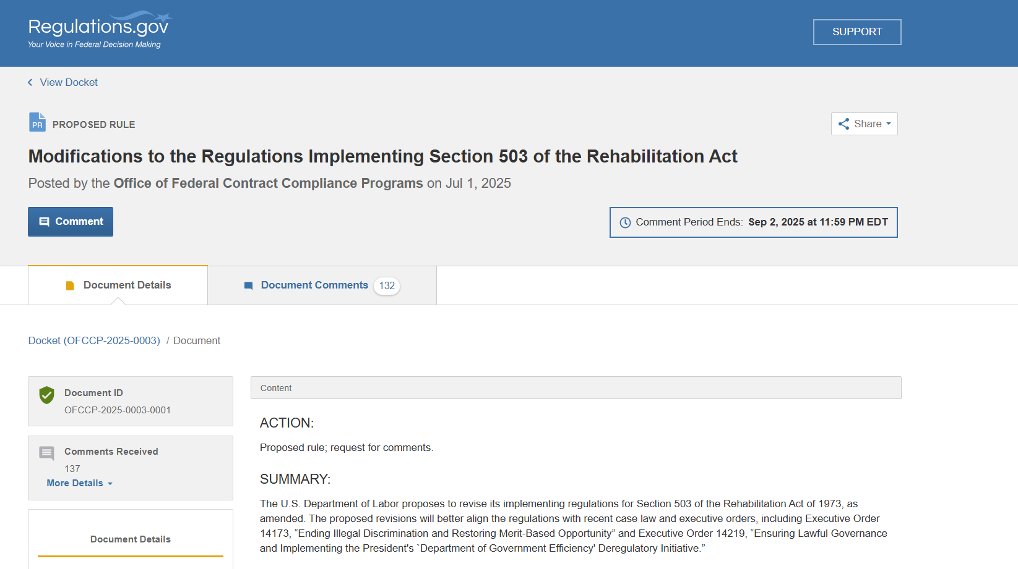
How to Oppose Gutting Section 503 (part 2)
Third, file your comment online
Go to this link, called Modifications to the Regulations Implementing Section 503 of the Rehabilitation Act, https://www.regulations.gov/document/OFCCP-2025-0003-0001
Select the blue Comment button

Slide 21
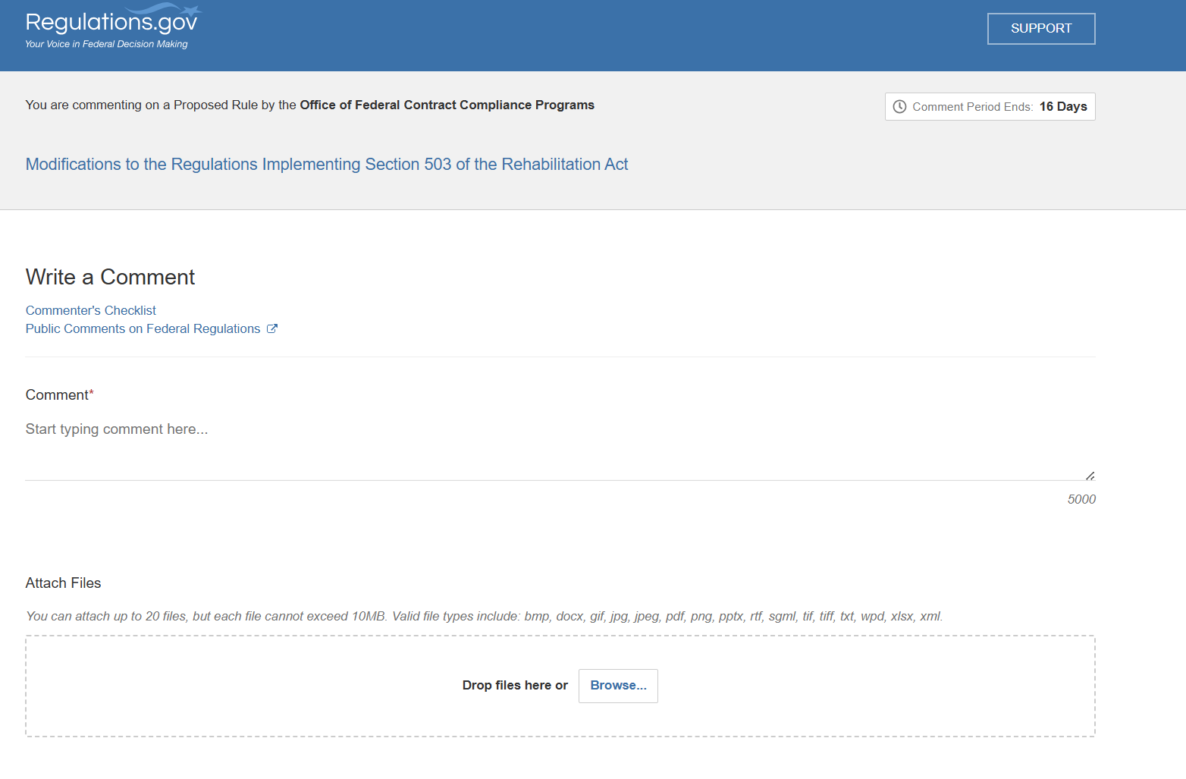
How to Oppose Gutting Section 503 (part 3)
The next screen will look like this, it will say at the beginning, “You are commenting on a Rule by the Office of Federal Contract Compliance Program”.
You can write your comment right in the Comment box if it fits. To fit, your comment must be less than 5,000 characters.

Slide 22
How to Oppose Gutting Section 503 (part 4)
You can also write your comments in a document like a Word or PDF file. The document can be longer than 5,000 characters.
Then, you can attach the file with your comments. Write a cover note in the Comment box such as “See attached letter.” The comment box is a required field.

Slide 23
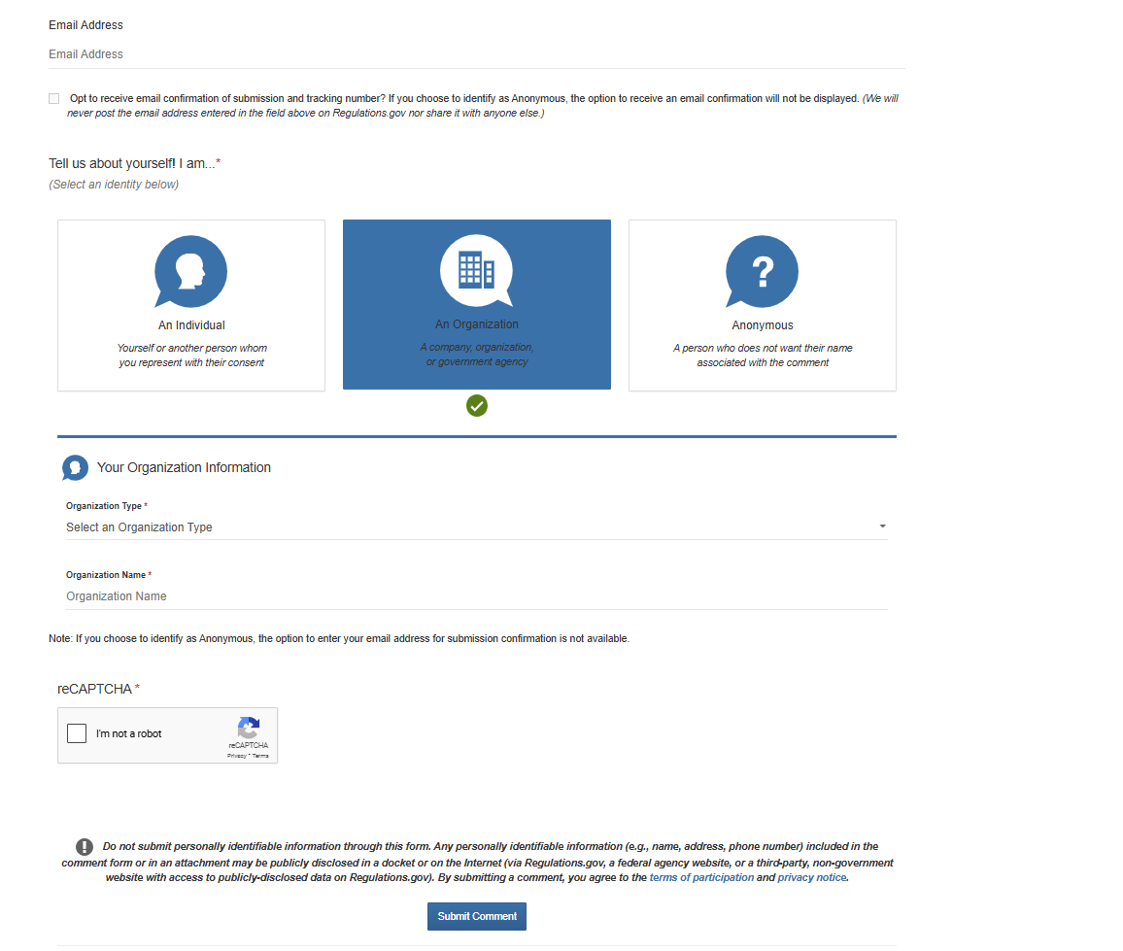
How to Oppose Gutting Section 503 (part 5)
Then you must fill out the rest of the fields:
Email address (optional)
Whether you are an individual, organization, or anonymous
If Organization, fill in:
Organization Type (drop-down menu)
Organization Name

Slide 24
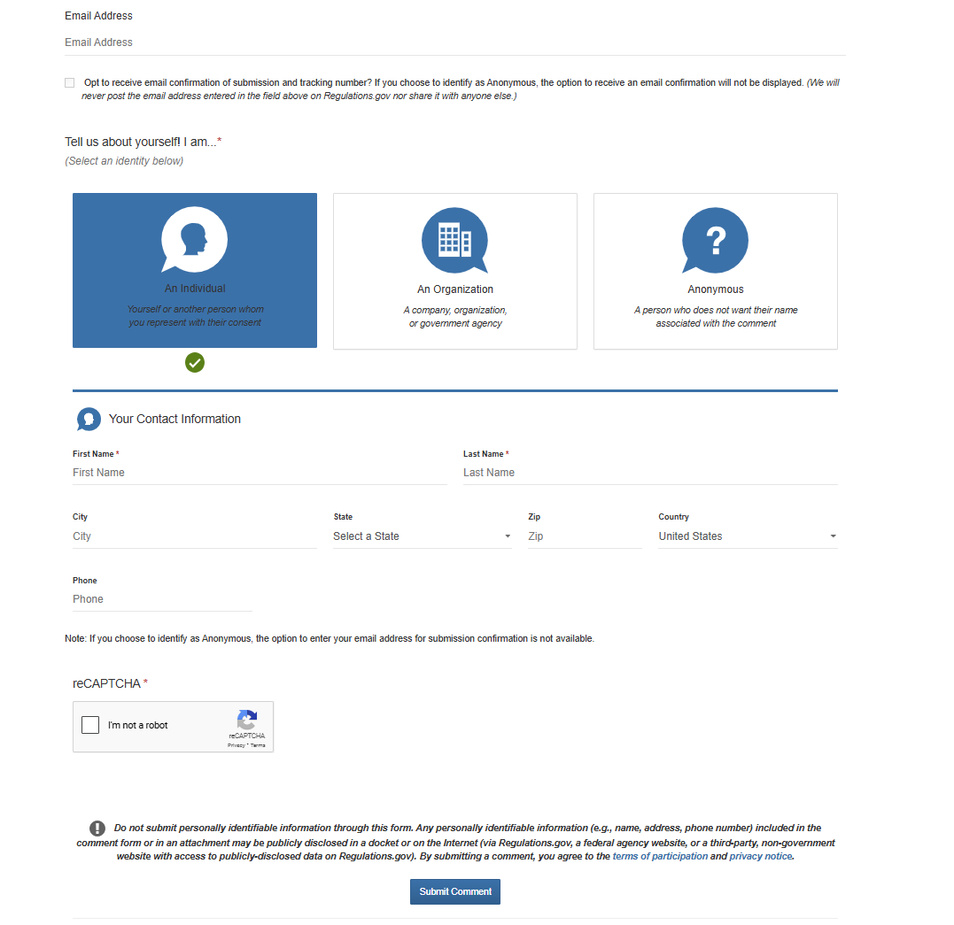
How to Oppose Gutting Section 503 (part 6)
If Individual, fill in:
First and Last Name
City, State, Zip, Country, Phone (all optional)

Slide 25
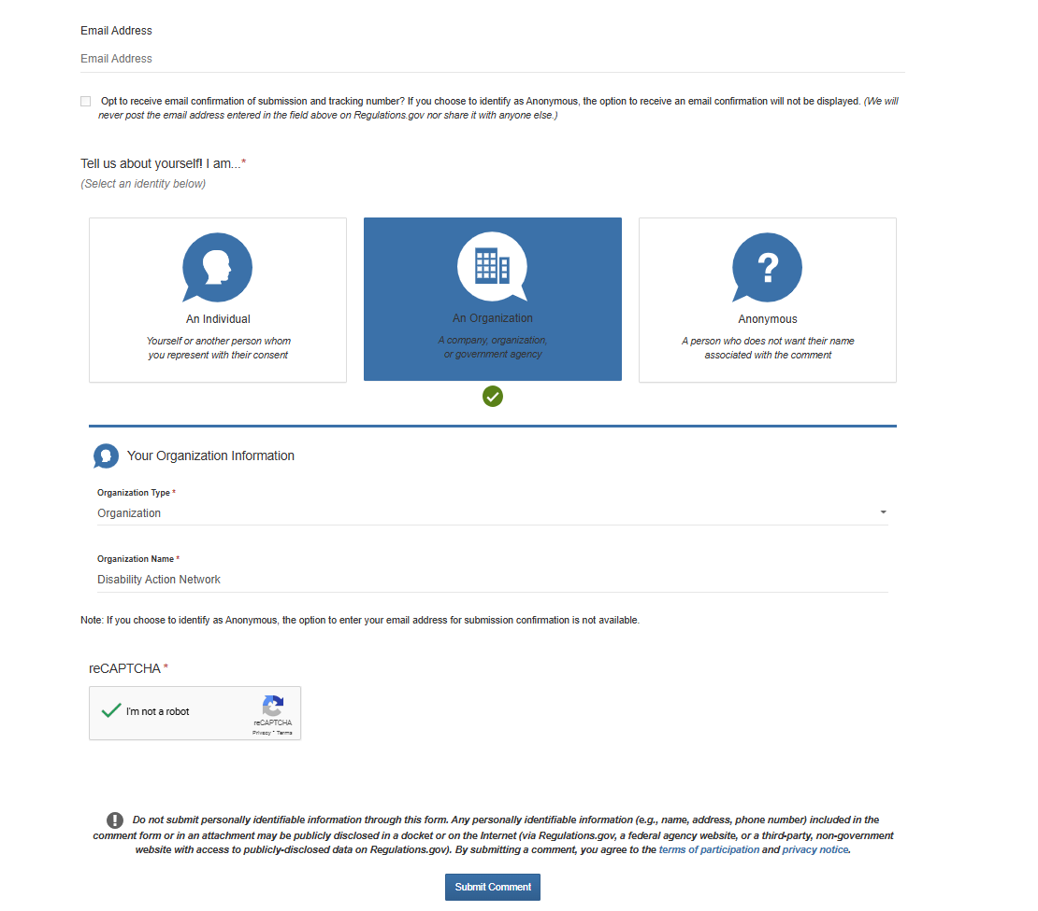
How to Oppose Gutting Section 503 (part 7)
Finally, complete the reCAPTCHA (required) and click on the blue Submit Comment button

Slide 26
We Still Have Rights!
The OFCCP cannot change statutes enacted by Congress or by our state Legislatures
We can still:
Watch out for and call out disability discrimination by federal contractors
Ask for accommodations at work
File discrimination complaints with federal agencies, including the Equal Employment Opportunities Commission
File discrimination complaints with state agencies
File a case in state or federal court
Consult an attorney to assist with any of the above

Slide 27
Make Our Voices Heard!
File comments opposing OFCCP’s proposals
  By Tuesday, September 2, before midnight Eastern Time / before 9 pm Pacific Time

Slide 28

Nothing about us without us
Photo by Disabled and Here

Slide 29
Questions and Answers

