Slide 1
by Linda D. Kilb
Federal Law
How It’s Made, Where to Find it,
How to Understand it & How to Cite it
June 24, 2025
© 2025 Disability Rights Education & Defense Fund
Notes:
Biographical Information: https://dredf.org/person/linda-kilb/
Re: DREDF Webinar - Tues June 24, 2025 at 11 a.m. - Federal Law: How It's Made, Where to Find it, How to Understand It & How to Cite It

Slide 2
What You Will Learn About
How the structure of the U.S. government impacts function
How each branch creates legal authority
No paywall places to find legal authority
How to decode citations to legal authority
What common words & phrases mean
What common numbers mean
We will click on some links in the slides to illustrate
More links in the notes

Slide 3
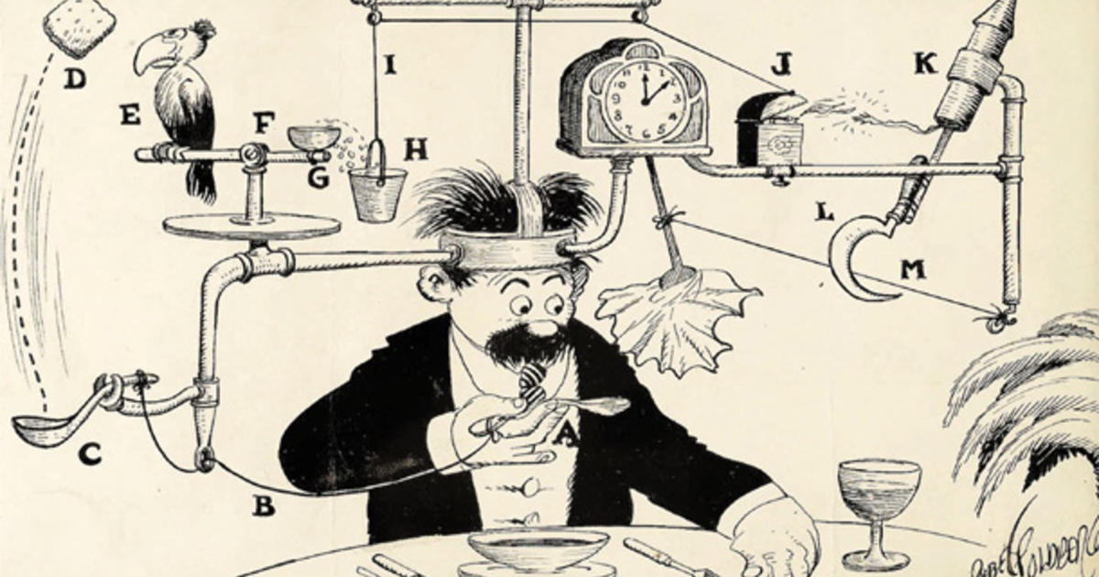
United States of America The Ultimate Rube Goldberg Machine …
Rube Goldberg’s Self-Operating Napkin
–Collier’s Magazine (Sept. 26, 1931)
… By Design

Slide 4
Structure of the U.S. Government A Constitutional Republic of Three Branches *
Legislative Branch (Article I)
Congress designs the laws
Executive Branch (Article II of the U.S. Constitution)
President & federal agencies implement the laws
Judicial Branch (Article III of the U.S. Constitution)
Courts interpret the laws
* “A republic, if you can keep it” –Ben Franklin (1706-1790)
Answering the question “What have we got?” on the last day of the Constitutional Convention (Sept. 18, 1787)
Notes:
https://blogs.loc.gov/manuscripts/2022/01/a-republic-if-you-can-keep-it-elizabeth-willing-powel-benjamin-franklin-and-the-james-mchenry-journal/#
https://www.nps.gov/articles/000/constitutionalconvention-september17.htm
https://www.archives.gov/founding-docs/constitution-transcript

Slide 5
“Legal Authority” or “The Law”
Together, the three branches create The Law of the United States
Legal authority means different things for different branches of government
Each branch can create legal authority
Each branch is supposed to stay in its lane
Most constitutional legal controversies involve debates about whether one branch was encroaching on the others
"Ambition must be made to counteract ambition"
- James Madison (1751-1836)
- Federalist 51 (1788)
“I'm not interested in inventing gadgets for the sake of inventing gadgets. I'm interested in creating solutions.”
- Rube Goldberg (1883-1970)
Notes:
https://guides.loc.gov/federalist-papers/full-text
https://guides.loc.gov/federalist-papers/text-51-60
https://www.montpelier.org/learn/the-life-of-james-madison/
https://www.bookey.app/quote-author/rube-Goldberg
https://www.rubegoldberg.org/

Slide 6

What’s in a Name?
Each branch of government has
different forms of legal citations.
“Citations” include
Words & phrases
Numbers
How to decode legal citations

Slide 7

What’s on the Internet? (No Paywalls!)
Wikipedia – https://en.wikipedia.org/wiki/Main_Page
Trust but verify!
A place to start - don’t end there!
Keyword search Wikipedia using nicknames or titles
Wikipedia often has formal legal citations
Use Wikipedia legal citations to conduct other searches
Avalon Project – Documents in Law, History & Diplomacy
https://avalon.law.yale.edu/default.asp

Slide 8
What’s on the Internet? (Slide 2)
National Archives - https://www.archives.gov/
Searchable by keyword
Searchable by legal citation
Searchable by time period
https://www.archives.gov/milestone-documents/list
Searchable by presidential libraries
https://www.archives.gov/presidential-libraries
Library of Congress - https://www.loc.gov/search/
Most useful if you want background or context information

Slide 9
What’s on the Internet? (Slide 3)
Legislative & Executive Documents – The American Presidency Project
Chronology of U.S. history with primary documents
Arranged by President (1789 to the present)
Includes links to treaties, statues, executive orders & other materials
Not fully indexed until a few years after a president leaves office
https://www.presidency.ucsb.edu/presidents
Judicial Documents – Google Scholar
Case Law
Articles
https://scholar.google.com

Slide 10
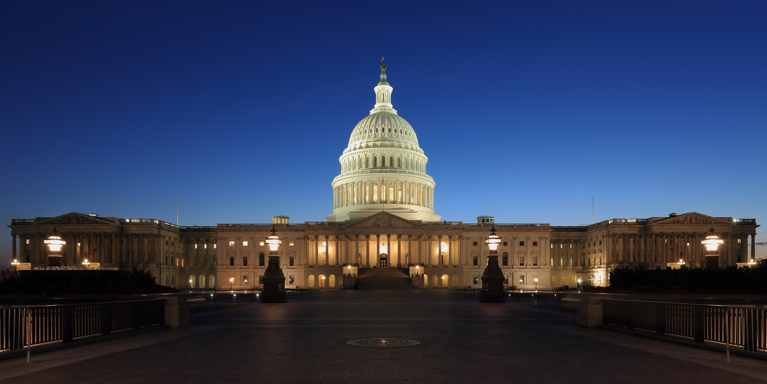
Legislative Branch
This Photo by Unknown Author is licensed under CC BY-SA

Slide 11
Key Information About Congress
There is a new Congress every two years
The first year of each Congress is the first session
The second year of each Congress is the second session
Each Congress is numbered chronologically
The 1st Congress sat from 1789-1791
The 119th Congress is sitting from 2025-2027
Wikipedia (trust but verify!)
Wikipedia includes a chronological list of every U.S. Congress since 1789
https://en.wikipedia.org/wiki/List_of_United_States_Congresses

Slide 12

Key Information About Statutes (Process)
Congress’s main way of creating legal authority is via statutes
A bill is a proposed statute
A statute is a successful bill
Proactive bills & statutes
Congress initiates the legislative process
Notes:
https://www.archives.gov/files/legislative/resources/education/veto/background.pdf

Slide 13
Key Information About Statutes (Process – Slide 2)
Legislative overrides
Congress responds to a presidential veto
Congress responds to a judicial decision
Primarily relevant to statutory authority
Recission requests
President asks Congress to cancel a prior appropriation
Notes:
Presidential Vetos
https://www.archives.gov/files/legislative/resources/education/veto/background.pdf
Recissions Explained
https://taxpolicycenter.org/briefing-book/what-are-rescissions
https://bipartisanpolicy.org/explainer/rescissions-101/
https://www.brookings.edu/articles/trump-wants-congress-to-vote-for-his-rescissions-are-republicans-willing-to-own-the-cuts/#
Congressional Budget and Impoundment Control Act of 1974
Pub. L. 93-344, 88 Stat. 297 (July 12, 1974)
https://www.govinfo.gov/content/pkg/STATUTE-88/pdf/STATUTE-88-Pg297.pdf
https://www.gao.gov/products/b-330828

Slide 14
Two Ways for A Bill To Succeed
First path to success
Both House & Senate pass a bill by simple majority
The president signs the bill
Second path to success
Both House & Senate pass a bill by simple majority
The president vetoes the bill
Congress overrides the veto with a two-thirds vote
Notes:
https://www.archives.gov/files/legislative/resources/education/veto/background.pdf

Slide 15
Key Information About Statutes (Words & Phrases)
Legislative citation (time & category information)
Categories: “Pub. L. or “Pvt. L.”
Tells you when the statute happened
Statutes at large (time information)
“Stat.” citation
Tells you when the statute happened
Notes:
https://www.archives.gov/federal-register/laws/past

Slide 16
Key Information About Statutes (Words & Phrases – Part 2)
“Pub. L” - Public Laws
Apply generally to the entire body politic
“Pvt. Law” – Private Laws
Apply to specified individuals
Ceremonial
Provide for damages
Adjust immigration status
Notes:
https://www.archives.gov/federal-register/laws/past

Slide 17
Key Information About Statutes (Words & Phrases – Part 3)
Volume of Public Laws
118th Cong. (2023-2024) – 274 passed
101st Cong. (1989-1990) – 650 passed
Volume of Private Laws
118th Cong. (2023-2024) – Zero passed
101st Cong. (1989-1990) – 16 passed
Notes:
https://www.archives.gov/federal-register/laws/past
118th Congress (2023-2024)
https://www.congress.gov/public-laws/118th-congress
https://www.congress.gov/browse/118th-congress#:~:text=Laws%20*%20Public%20Laws%20%5B650%5D%20*%20Private%20Laws%20%5B16%5D
2023-2024: 274 Public Laws passed
2023-2024: Zero Private Laws passed
101st Congress (1989-1990)
https://www.congress.gov/browse/101st-congress#
https://www.congress.gov/browse/101st-congress#:~:text=Laws%20*%20Public%20Laws%20%5B650%5D%20*%20Private%20Laws%20%5B16%5D
1989-1990: 650 Public Laws passed
1989-1990: 16 Private laws passed

Slide 18
Key Information About Statutes (Words & Phrases – Part 4)
United States Code (subject matter information)
“U.S.C.” citation
Tells you what the statute is about
Means that the statute has been “codified”

Slide 19
Key Information About Statutes (Numbers)
A bill number is very important, until the bill is successful
H.R. – introduced into the U.S. House of Representatives
S. – introduced into the U.S. Senate
Once a bill is successful, statutory numbers are more important
Pub. L. or Pvt. L. citations have two numbers
Which Congress passed the statute
When it was passed relative to other statutes of that same Congress
Stat. citations have two numbers
Volume number
Page number
U.S.C. citations have two numbers
-Volume number
-Page number
Notes:
https://www.archives.gov/files/legislative/resources/education/veto/background.pdf

Slide 20
Americans with Disabilities Act (ADA) of 1990 Pub. L. 101-336, 104 Stat. 327, 42 U.S.C § 12101 et seq. (Jul. 26, 1990)
Pub. L. 101-336
101th Congress
336th piece of legislation
104 Stat. 327
104th volume of Statutes at Large
Beginning at page 327
42 U.S.C. §§ 12101 et seq.
“Codified” in Title 42 (public health, social welfare & civil rights)
Beginning at section 12101
“Et sequential” – “and the following” (has more than one section)
Jul. 26, 1990
date signed into law by President H.W. Bush
Bill numbers during the passage process
H.R. 2273 (1989-1990)
S. 933 (1989-1990)

Slide 21
What’s on the Internet? (No Paywalls for Legislation!)
American Presidency Project
https://www.presidency.ucsb.edu/presidents
Click on the relevant U.S. President
Click on “Event Timeline”
Scroll to the relevant date
Portal to PDFs of U.S. Legislation
Searchable by Legal Citations for U.S. Public Laws & Statutes at Large
https://uslaw.link/citation/us-law

Slide 22
Legislation Search Example
Search Wikipedia for “Americans with Disabilities Act”
https://en.wikipedia.org/wiki/Americans_with_Disabilities_Act_of_1990
Date signed (July 26, 1990)
Relevant president (George H. W. Bush)
Pub. Law & Stat. citations (Pub. L. 101-336, 104 Stat. 327)
Search American Presidency Project
https://www.presidency.ucsb.edu/people/president/george-bush
https://www.presidency.ucsb.edu/documents/george-bush-event-timeline
https://www.presidency.ucsb.edu/documents/statement-signing-the-americans-with-disabilities-act-1990
Use Portal to PDFs of U.S. Legislation
https://uslaw.link/citation/us-law/public/101/336
https://uslaw.link/citation/stat/104/327
https://www.govinfo.gov/content/pkg/STATUTE-104/pdf/STATUTE-104-Pg327.pdf#page=1

Slide 23
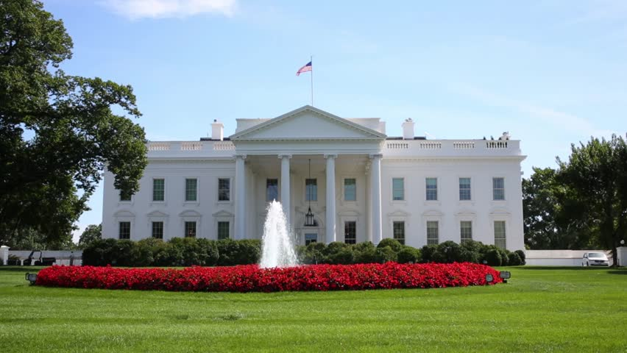
Executive Branch
Notes:
Wikipedia – Links
https://en.wikipedia.org/wiki/List_of_United_States_Congresses
https://en.wikipedia.org/wiki/List_of_presidents_of_the_United_States
https://en.wikipedia.org/wiki/List_of_courts_of_the_United_States

Slide 24

Key Information About the Executive Branch
Executive branch’s main ways of creating legal authority
U.S. president
Signs or vetoes legislation
Recission requests
Signing statements or remarks
Various presidential documents
Federal agencies
Regulations
Guidance
Dear Colleague Letters
This Photo by Unknown Author is licensed under CC BY-SA
Notes:
https://guides.loc.gov/executive-orders/order-proclamation-memorandum
https://www.regulations.gov/learn
Wikipedia – Links
https://en.wikipedia.org/wiki/List_of_United_States_Congresses
https://en.wikipedia.org/wiki/List_of_presidents_of_the_United_States
https://en.wikipedia.org/wiki/List_of_courts_of_the_United_States

Slide 25
Key Information President & Federal Agencies (Types of Documents)
Presidential Signing or Veto Statement
Presidential Proclamation
No force of law
Involves private individuals
Often ceremonial
Presidential Executive Action or Memorandum
May not have force of law
Fewer requirements than EOs
Presidential Executive Order (EO)
Has force of law
Can’t be overturned if within the president’s legal authority
Agency Regulations
Issued by federal agencies
Implement statutes
Notes:
https://guides.loc.gov/executive-orders/order-proclamation-memorandum
https://www.regulations.gov/learn

Slide 26
Signing & Veto Statements (Process)
Signing Statements
https://guides.loc.gov/legislative-history/presidential-communications/signing-statements
Part of legislative history
No force of law
Veto Statements
https://en.wikipedia.org/wiki/List_of_United_States_presidential_vetoes
Part of legislative history
Has force of law unless Congress overrides or legislative session expires
Congress can override with two-thirds vote

Slide 27
Examples of Signing Statements
Americans with Disabilities Act Signing Statement
Pub. L. 101-336, 104 Stat. 347 (Jul. 26, 1990) (H.W. Bush)
https://www.presidency.ucsb.edu/documents/statement-signing-the-americans-with-disabilities-act-1990
Remarks on Signing the Patient Protection and Affordable Care Act
Pub. L. 11-148, 124 Stat. 119 (Mar. 23, 2010) (Obama)
https://www.govinfo.gov/content/pkg/DCPD-201000196/pdf/DCPD-201000196.pdf

Slide 28
Examples of Veto Statements
Nixon Vetoes Rehabilitation Act of 1972
Due to “fiscal irresponsibility,” and
Creates “organizational rigidities” in vocational rehabilitation program
Pocket veto (time runs out on legislative session) (not enacted)
Nixon Vetoes Rehabilitation Act of 1972
“Fiscally irresponsible” and “badly constructed”
Veto sustained (not enacted)
Nixon Signs Rehabilitation Act of 1973
Three’s a charm!
Notes:
Nixon Vetoes Rehabilitation Act of 1972, H.R. 8395, 92nd Cong., 2nd Sess. (Oct. 22, 1972)
https://www.presidency.ucsb.edu/documents/memorandum-disapproval-nine-bills
“Fiscal irresponsibility”
Would create “organizational rigidities” in vocational rehabilitation program
Pocket veto (time runs out on legislative session)
Nixon Vetoes Rehabilitation Act of 1972
H.R. 8395, 92nd Cong., 2nd Sess. (Oct. 22, 1972)
Nixon Vetoes Rehabilitation Act of 1972
S. 7, 93rd Cong., 1st Sess., (Mar. 27, 1973)
https://www.senate.gov/legislative/vetoes/messages/NixonR/S7-Sdoc-93-10.pdf
https://www.presidency.ucsb.edu/documents/veto-the-vocational-rehabilitation-bill
“Fiscally irresponsible” & “badly constructed”
Veto sustained (not enacted)
Nixon Signs Rehabilitation Act of 1973
Pub. L. 93-112, 87 Stat. 355 (Sept. 26, 1973)
https://www.presidency.ucsb.edu/documents/statement-signing-the-rehabilitation-act-1973
Three’s a charm!

Slide 29
Key Information About Presidential Activities (Process)
Executive Orders (EOs)
https://www.federalregister.gov/presidential-documents/executive-orders/
In writing
Within legal authority given to executive branch
Signed
“Published” in the Federal Register (Fed. Reg.)
Executive Actions or Memoranda
https://www.whitehouse.gov/presidential-actions/
Don’t need to cite legal authority
Don’t need to be published
Don’t require OMB “Budgetary Impact Statement”
Generally used when executive branch wants to avoid EO requirements
Notes:
https://guides.loc.gov/executive-orders/order-proclamation-memorandum
https://www.ecfr.gov/current/title-1/chapter-I/subchapter-E/part-19/section-19.1
https://www.fjc.gov/history/administration/judicial-review-executive-orders#
https://www.americanbar.org/groups/public_education/publications/teaching-legal-docs/what-is-an-executive-order-/

Slide 30
Examples of Executive Orders
Creating the U.S. Peace Corps
Legal authority: Mutual Security Act of 1954
Exec. Order No. 10924 (Mar. 1, 1961) (Kennedy)
Published at 26 Fed. Reg. 1789 (Mar. 2, 1961)
Banning the Hording of Gold
Legal Authority: Emergency Banking Act of 1933
Exec. Order No. 6102 (Apr. 5, 1933) (F. Roosevelt)
Predated the Federal Register Act of 1935 (effective 1936)
Notes:
Creation of the U.S. Peace Corps
https://www.presidency.ucsb.edu/documents/executive-order-10924-establishment-and-administration-the-peace-corps-the-department
Legal authority: Mutual Security Act of 1954, 22 U.S.C. §§ 1750 et seq.
Exec. Order No. 10924 (Mar. 1, 1961) (Kennedy)
Published at 26 Fed. Reg. 1789 (Mar. 2, 1961)
Banning the Hording of Gold
https://www.presidency.ucsb.edu/documents/executive-order-6102-forbidding-the-hoarding-gold-coin-gold-bullion-and-gold-certificates
Legal authority: Emergency Banking Act of 1933, 12 U.S.C. §§ 95 et seq.
Exec. Order No. 6102 (Apr. 5, 1933) (F. Roosevelt)
Predated the 1936 requirement for publication
Federal Register Act of 1935
Pub. L. 74-417, 49 Stat. 500 (July 26, 1935) (F. Roosevelt)
https://govtrackus.s3.amazonaws.com/legislink/pdf/stat/49/STATUTE-49-Pg500.pdf

Slide 31
Examples of Executive Orders (Continued)
Review of Designations Under the Antiquities Act
Legal authority: Antiquities Act of 1906
Exec. Order No. 13792 (Apr. 26, 2017) (Trump 45)
Protecting Public Health and the Environment and Restoring Science to Tackle the Climate Crisis
Legal authority: Antiquities Act of 1906
Exec. Order No. 13990 (Jan. 20, 2021) (Biden)
Rescinding Exec. Order No. 13792 (Trump)
Unleashing American Energy
Legal authority: Various, but no cite to Antiquities Act of 1906
Exec. Order No. 14154 (Jan. 20, 2025) (Trump 47)
Notes:
Antiquities Act of 1906
54 U.S.C. §§ 320301 et seq.
https://www.law.cornell.edu/uscode/text/54/320301
Review of Designations Under the Antiquities Act
Exec. Order No. 13792 (Apr. 26, 2017) (Trump 45)
https://www.govinfo.gov/content/pkg/FR-2017-05-01/pdf/2017-08908.pdf
Addressing Climate Impacts & Restoring National Monuments
Exec. Order No. 13990 (Jan. 20, 2021) (Biden)
Protecting Public Health and the Environment and Restoring Science to Tackle the Climate Crisis
Legal authority: Antiquities Act of 1906, 54 U.S.C. §§ 320301 et seq.
Exec. Order No. 13990 (Jan. 20, 2021) (Biden)
Rescinding Exec. Order No. 13792 (Trump)
Unleashing American Energy
Legal authority: various, but not including the Antiquities Act of 1906
Exec. Order No. 14154 (Jan. 20, 2025) (Trump 47)
https://www.govinfo.gov/content/pkg/FR-2025-01-29/pdf/2025-01956.pdf
https://www.law.cornell.edu/uscode/text/54/320301

Slide 32
Contrast in Executive Actions (Federalizing the National Guard)
Desegregating Little Rock High School
Legal authority:
Implements Brown v. Board of Education
Statutory authority to remove an obstruction of justice: 10 U.S.C. §§ 332-334
Limited to Arkansas
Exec. Order No. 10730 (Sept. 24, 1957) (Eisenhower)
Published at 22 Fed. Reg. 7628 (Sept. 25, 1957)
Addressing “Violence and Disorder” in Response to Immigration Enforcement
Legal authority: Power during “rebellion” or “invasion” 10 U.S.C. §12406
No geographic limit
Presidential Memorandum (June 7, 2025) (Trump 47)
Publication not required
Notes:
Desegregating of Little Rock High School
Exec. Order. No. 10730 (Sept. 24, 1957) (Eisenhower)
https://www.eisenhowerlibrary.gov/sites/default/files/research/online-documents/civil-rights-little-rock/press-release-eo-10730.pdf
https://www.presidency.ucsb.edu/documents/executive-order-10730-providing-assistance-for-the-removal-obstruction-justice-within-the
https://www.eisenhowerlibrary.gov/research/online-documents/civil-rights-little-rock-school-integration-crisis
https://www.law.cornell.edu/uscode/text/54/320301
Addressing “Violence and Disorder” in Response to Immigration Enforcement
Presidential Memorandum (June 7, 2025) (Trump 47)
https://www.whitehouse.gov/presidential-actions/2025/06/department-of-defense-security-for-the-protection-of-department-of-homeland-security-functions/
https://www.law.cornell.edu/uscode/text/10/12406

Slide 33
Key Information About Federal Agency Activities (Process)
Pursuant to Statutory Authority
A delegation of authority from Congress & President via statute
Focus on implementing a statute
Fills in details addressed or left unclear in statute
Specific Process
Activities must be “published”
Advanced Notice of Proposed Rulemaking (ANPRM)
Agency asking for input about whether a regulation is needed
Notice of Proposed Rulemaking (NPRM)
Public comment period
Notice of Final Rule
Direct Final Rule
Notes:
https://www.regulations.gov/learn
https://uploads.federalregister.gov/uploads/2013/09/The-Rulemaking-Process.pdf
Interim Final Rule (explanation) When an agency finds that it has good cause to issue a final rule without first publishing a proposed rule, it often characterizes the rule as an “interim final rule,” or “interim rule.” This type of rule becomes effective immediately upon publication. In most cases, the agency stipulates that it will alter the interim rule if warranted by public comments. If the agency decides not to make changes to the interim rule, it generally will publish a brief final rule in the Federal Register confirming that decision.
Direct Final Rule (explanation): When an agency decides that a proposed rule is unnecessary because it would only relate to routine or uncontroversial matters, it may publish a direct final rule in the Federal Register. In a direct final rule, the agency states that the rule will go into effect on a certain date, unless it gets substantive adverse comments during the comment period. An agency may finalize this process by publishing in the Federal Register a confirmation that it received no adverse comments. If adverse comments are submitted, the agency is required to withdraw the direct final rule before the effective date. The agency may re-start the process by publishing a conventional proposed rule or decide to end the rulemaking process entirely.
Example of Direct Final Rule Attempt
https://www.energy.gov/sites/prod/files/2015/12/f27/CUAC-CUHP%20CWAF%20Direct%20Final%20Rule.pdf
https://docs.google.com/document/d/1kGDZKpFpbfEpj-CpJnbuVfHO7G8yR-6Gk6oV8c5Q1OI/edit?tab=t.0

Slide 34
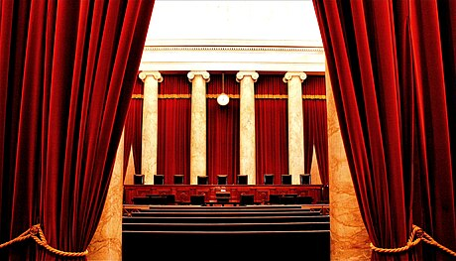
Judicial Branch
This Photo by Unknown Author is licensed under CC BY-SA

Slide 35
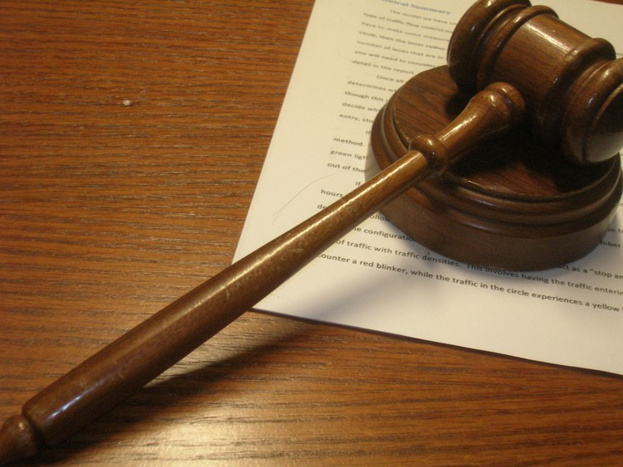
Key Information About Court Cases (Process)
Courts’ main way of creating authority is via case law
Judicial decisions issued in litigation (lawsuits)
Published (citable precedent)
Unpublished (not citable in other future cases)
There are three main levels of federal court cases
District Court cases
Circuit Court cases
U.S. Supreme Court cases
Stages of Litigation
Cases start in district courts
Most cases settle without creating case law
Many district court decisions never go to circuit courts
Even fewer cases go to the Supreme Court

Slide 36

What’s Your Style?
A litigation case name is called a “style”
Elements of style
Party name v. party name
Court name
Case number
Party names can change if a party drops out
General Rule: First party named is the party that filed the lawsuit
Exception: U.S. Supreme Court
The first name is whoever asks for high court review
You can only ask for review if you lost in the circuit court
The first name is the party who lost below

Slide 37

Slip Opinions
Issued when case is decided
Formal citation not yet available
May indicate “published” or “unpublished”
Historic rules for “unpublished” decisions
Only binding in that one lawsuit
Not citable in other cases
New rule for decisions on or after January 1, 2007
Fed. R. App. P. 32.1 – Citing Judicial Dispositions
Cal. Rules of Court
Rule 8.1105 – Publication of appellate opinions
Rule 8.1120 – Requesting publication of unpublished opinions
Notes:
Publication Rules for Federal Court Opinions
https://sdlawlibrary.libguides.com/c.php?g=1290789&p=9477549
https://www.law.cornell.edu/rules/frap/rule_32.1
Publication Rules for California State Court Opinions
Cal. Rules of Court, rule 8.1105 – Publication of appellate opinions
https://courts.ca.gov/cms/rules/index/eight/rule8_1105
Cal. Rules of Court, rule 8.1120 –
https://courts.ca.gov/cms/rules/index/eight/rule8_1120

Slide 38
Key Information About Court Cases (Party Pleadings)
There are five main types of federal cases
Appellate cases (specified by numbers)
Bankruptcy cases (BK)
Criminal cases (CR)
Civil cases (CV)
Multidistrict litigation (MDL)
Important numbers
Year case was filed
Case number
Initials for Judges & Magistrates

Slide 39
Decoding Party Pleadings (Example)
Blake v. City of Grants Pass
1:18-cv-01823-CL (D. Or.)
CL is assigned code for federal Magistrate Judge Mark D. Clarke
Johnson v. City of Grants Pass
Nos. 20-35752 & 20-35881 (9th Cir.)
Grants Pass v. Johnson
23-175 (U.S.)
Notes:
https://ord.uscourts.gov/index.php?option=com_content&view=article&id=337&Itemid=491
https://libguides.uakron.edu/bluebook/federalabbreviations

Slide 40
Key Information About Court Cases (Judicial Decisions)
Federal court case law is collected in chronological reporter series
District Court decisions (D.)
Collected in Federal Supplement series (F. Supp.)
Circuit Courts (Cir. )
Collected in Federal Reporter series (F.)
Supreme Court decisions collected in parallel series
Official United States Reports series (U.S.)
Unofficial Supreme Court Reports series (S. Ct.)
Unofficial Lawyers Edition (L. Ed.)

Slide 41
What’s on the Internet?
Judicial Documents – Google Scholar
https://scholar.google.com
Case Law
Articles
Just Security – Specific to Second Trump Administration
https://www.justsecurity.org/107087/tracker-litigation-legal-challenges-trump-administration/
Websites for Party Counsel Organizations
Websites for Media
Basic Browser Searches

Slide 42
What’s on the Internet? (Continued)
Resources for Circuit Decisions That Go to the Supreme Court
SCOTUSblog links to circuit court slip opinion below
Style may be reversed, depending on who lost
Resources for U.S. Supreme Court Decisions
Supreme Court Official Website https://www.supremecourt.gov/docket/docket.aspx
Easy to find “Questions Presented”
SCOTUSblog
https://www.scotusblog.com/

Slide 43
Decoding Lower Court Decisions (Example)
District Court – Blake v. City of Grants Pass (via Google search)
No Federal Reporter Citation
Paywall: 2020 U.S. Dist. Lexis 129494 (D. Or. July 22, 2020)
Paywall: 2020 WL 4209227 (D. Or. July 22, 2020)
Free: https://clearinghouse.net/case/43966/
Free: https://clearinghouse.net/doc/136123/
Circuit Court – Johnson v. City of Grants Pass
https://scholar.google.com/scholar_case?case=390983368744510393&q
50 F. 4th 787 (9th Cir. Sept. 28, 2022)
Notes:
https://ord.uscourts.gov/index.php?option=com_content&view=article&id=337&Itemid=491
https://libguides.uakron.edu/bluebook/federalabbreviations

Slide 44
Decoding Supreme Court Decisions (Example)
City of Grants Pass v. Johnson – Slip Opinion
https://www.supremecourt.gov/opinions/23pdf/23-175_19m2.pdf
Available via Supreme Court website https://www.supremecourt.gov/docket/docket.aspx
Available via SCOTUSblog: https://www.scotusblog.com/
City of Grants Pass v. Johnson – Formal Legal Citation
https://scholar.google.com/
603 U.S. __, 144 S. Ct. 2202, 219 L. Ed. 2d 941 (June 28, 2024)
U.S. reporter citations no longer use page numbers
Notes:
https://ord.uscourts.gov/index.php?option=com_content&view=article&id=337&Itemid=491
https://libguides.uakron.edu/bluebook/federalabbreviations

Slide 45
Thank you!
© 2025 Disability Rights Education & Defense Fund

