Slide 1


HHS’s Anti-Trans Proposal to Limit Section 504
Informational Briefing
January 12, 2026

Slide 2
Presenters
Claudia Center (she/her) Legal Director Disability Rights Education & Defense Fund
Ma'ayan Anafi (they/them) Senior Counsel for Health Equity and Justice National Women's Law Center
2

Slide 3
Topics
What Happened on December 18, 2025?
Background Information re: Proposed Rule
Summary of Proposed Rule
Why the Proposed Rule is Harmful and Wrong
How to Oppose the Proposed Section Rule
Next Steps
Questions and Answers
3

Slide 4
December 18, 2025: HHS Proposes Three Anti-Trans Rules
Weakening disability rights: Claims to allow recipients of HHS funding to discriminate against people with gender dysphoria on the basis of disability, 90 Fed.Reg 59478 – comments due January 20, 2026
Medicaid / CHIP restrictions: Would prevent the use of federal funds to pay for essential health care for trans youth covered by Medicaid or CHIP, 90 Fed.Reg. 59441 – comments due February 17, 2026
4
Notes:
https://www.federalregister.gov/documents/2025/12/19/2025-23484/nondiscrimination-on-the-basis-of-disability-in-programs-or-activities-receiving-federal-financial
https://www.federalregister.gov/documents/2025/12/19/2025-23464/medicaid-program-prohibition-on-federal-medicaid-and-childrens-health-insurance-program-funding-for

Slide 5
December 18, 2025: HHS Proposes Three Anti-Trans Rules [continued]
Restrictions on hospitals: Would bar trans youth from receiving needed care from hospitals that receive Medicaid or Medicare dollars – essentially all U.S. hospitals, 90 Fed.Reg. 59463 – comments due February 17, 2026
Context: 77 anti-LGBTQ actions by Administration since January 2025 including at least 8 anti-trans Executive Orders and EO rescissions
5
Notes:
https://www.federalregister.gov/documents/2025/12/19/2025-23465/medicare-and-medicaid-programs-hospital-condition-of-participation-prohibiting-sex-rejecting
https://glaad.org/trump-accountability-tracker/

Slide 6
Disclosure and content note about forthcoming language
6

Slide 7
December 18, 2025 [continued]
HHS Secretary RFK, Jr.
The Biden era amendments that designated gender dysphoria as a disability … betrayed the original intention of those laws[.] … [T]he misuse of these statutes for these purposes injures the statutes themselves and injures other people who are entitled to that protection and who Americans want to see protected.”
7
Notes:
Link to video: https://www.youtube.com/live/aY1XfN6Tt0Q?si=1WSsJefelE5UKaez
Link to transcript: https://docs.google.com/document/d/1Wpt09UTqKF2RkGDukd6Gi8BMvynDaF8C4pHuNGMzQ_8/edit?usp=sharing

Slide 8
December 18, 2025 [continued]
HHS Deputy Secretary Jim O’Neill:
The denial of fundamental truths can destroy nations from within. At the root of the evils we face, such as the blurring of the lines between sexes and radical social agendas, is a hatred for nature as God designed it[.] … As part of the Biden administration's war on nature, this department perverted the Rehabilitation Act of 1973.
Additional adverse actions, including a declaration that care for trans youth is dangerous and not supported by evidence
8
Notes:
Link to video: https://www.youtube.com/live/aY1XfN6Tt0Q?si=1WSsJefelE5UKaez
Link to transcript: https://docs.google.com/document/d/1Wpt09UTqKF2RkGDukd6Gi8BMvynDaF8C4pHuNGMzQ_8/edit?usp=sharing

Slide 9
Background Information Re: Proposed Rule
Court decisions over the past decade, including Williams v. Kincaid (4th Cir. 2022)
2023-24 HHS Section 504 Rulemaking
9

Slide 10
Court Decisions re Gender Dysphoria
Large majority of court decisions (84%): gender dysphoria is not categorically excluded from federal disability rights protections (Kevin Barry)
Williams v. Kincaid (4th Cir. 2022): only appellate court ruling, gender dysphoria is not categorically excluded
Every court decision after Williams: gender dysphoria is not categorically excluded
10

Slide 11
Williams v. Kincaid (4th Cir. 2022)
Facts: trans woman with gender dysphoria incarcerated in men’s housing unit of county jail, harassed and denied medical care, brought case under ADA and U.S. Constitution
Appellate court analyzed ADA language that excluded “gender identity disorders not resulting from physical impairments”
Ruling: the phrase “gender identity disorders” included in the ADA in 1990 did not include gender dysphoria
Result: a person with a disability based on gender dysphoria can be protected from discrimination under the ADA and Section 504
11

Slide 12
Analysis in Williams v. Kincaid
“Gender dysphoria” differs dramatically from now-rejected diagnosis of “gender identity disorder”
GID focuses exclusively on a person’s gender identity and treats that identity itself as a “disorder”
Gender dysphoria, unlike GID, concerns itself primarily with clinically significant distress and other disabling symptoms, rather than simply being transgender
2008 law: Congress expressly directed that courts construe disability broadly, to “maximum extent permitted” by the law
Constitutional avoidance: original GID exclusion in 1990 motivated by discriminatory animus toward transgender people
12

Slide 13
2023-24 HHS Section 504 Rulemaking
HHS Section 504 Final Rule (May 9, 2024)
Discussion of gender dysphoria and Williams at 89 Fed.Reg 40068-69 (preamble to Final Rule)
Gender dysphoria may be a disability under Section 504 depending on the facts
13
Notes:
https://www.federalregister.gov/documents/2023/09/14/2023-19149/discrimination-on-the-basis-of-disability-in-health-and-human-service-programs-or-activities
https://www.federalregister.gov/documents/2024/05/09/2024-09237/nondiscrimination-on-the-basis-of-disability-in-programs-or-activities-receiving-federal-financial

Slide 14
Summary of Proposed Section 504 Rule
The proposed rule seeks to categorically exclude gender dysphoria from disability nondiscrimination protections.
It could lead recipients of HHS federal funds to discriminate against people with gender dysphoria, in violation of Section 504’s requirements.
14

Slide 15
Summary of Proposed Section 504 Rule [continued]
The rule would change the definition of “disability” found in 45 C.F.R. § 84.4 by amending subsection (g) to include:
The term “disability” does not include the conditions set forth at 29 U.S.C. 705(20)(F), including “transvestism, transsexualism, … [or] gender identity disorders not resulting from physical impairments …” … [T]he term “gender identity disorders not resulting from physical impairments” includes gender dysphoria not resulting from physical impairments.
15

Slide 16
Why the Proposed Rule is Harmful and Wrong
The Proposed Rule would harm people with gender dysphoria
People with gender dysphoria could be turned away from basic health and human services or face mistreatment when accessing these programs
People with gender dysphoria already face barriers – this rule would make them worse
16

Slide 17
Why the Proposed Rule is Harmful and Wrong [continued]
The Proposed Rule is motivated by anti-trans bias
From day 1, coordinated attack on transgender community as a whole
Press conference statements reinforce anti-trans bias and ableism
Anti-trans bias and ableism are not legitimate bases for rulemaking
17

Slide 18
Why the Proposed Rule is Harmful and Wrong [continued]
Congress said that the ADA & Section 504 definition of disability should be construed as broadly as possible, ADA Amendments Act of 2008. But the proposed rule narrows the definition of disability.
18

Slide 19
Why the Proposed Rule is Harmful and Wrong [continued]
Secretary Kennedy is wrong: Including people with disabilities based on gender dysphoria in the protections of Section 504 does not harm people with other disabilities. People with all different kinds of disabilities are stronger when we work together and resist efforts to divide us or weaken civil rights
19

Slide 20
Why the Proposed Rule is Harmful and Wrong [continued]
Congress did not exclude people with gender dysphoria from federal laws prohibiting disability discrimination. For years, courts have held that gender dysphoria is not categorically excluded. This includes Williams v. Kincaid, where the Fourth Circuit considered the question carefully and ruled that people with gender dysphoria can be covered. This is the only appellate court ruling on the issue.
20

Slide 21
Why the Proposed Rule is Harmful and Wrong [continued]
Section 504 should be interpreted in a way that is fair and constitutional. The original exclusion of “gender identity disorder” was motivated by discriminatory animus. Bias and prejudice are not legitimate reasons for excluding people with disabilities from civil rights protections.
21

Slide 22
How to Oppose the Proposed Section 504 Rule
Step 1: Write your comment
Step 2: Submit your comment via the Federal Register web portal or by Mail
Comments must be postmarked or electronically submitted by January 20, 2026
22

Slide 23
What to Include in Your Comment
Introduce yourself
State your connection to disability rights and Section 504
You can include things like your profession or personal experiences – but consider your safety and privacy
State your opposition
State that you oppose the proposed rule and do not want people who have a disability based on gender dysphoria to be excluded from Section 504’s protections
Explain why you oppose the rule
You can use our materials to come up with ideas for what to say
Please use your own words – unique comments are important
23

Slide 24
What to Include in Your Comment [continued]
Ask that the comment period be extended
30 days is too short – the other rules have 60 days (standard)
The 30 days overlapped with the holiday and end of year break
The rulemaking portal was incorrectly closed for several days
The comment period should be extended for another 30 days
Conclude by restating your opposition to the proposed rules
24

Slide 25
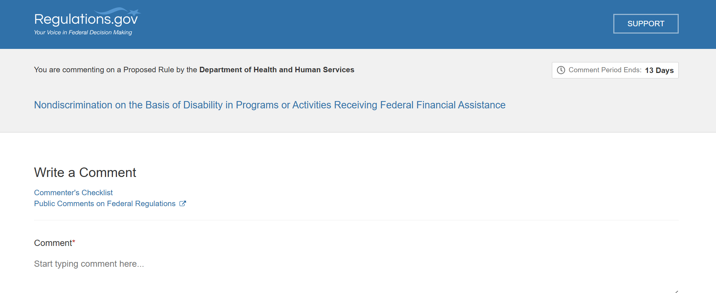
How to File Your Comment Via Regulations.gov [continued]
Go to this link to enter your comment – https://www.regulations.gov/commenton/HHS-OCR-2026-0034-0001
25

Slide 26
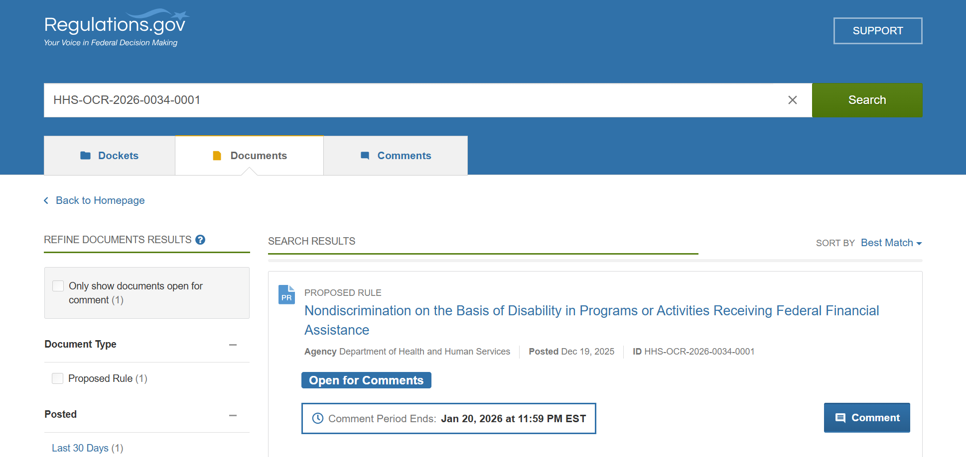
How to File Your Comment Via Regulations.gov [continued]
Alternative route: go to Regulations.gov and type this in the search bar:
HHS-OCR-2026-0034-0001
26

Slide 27
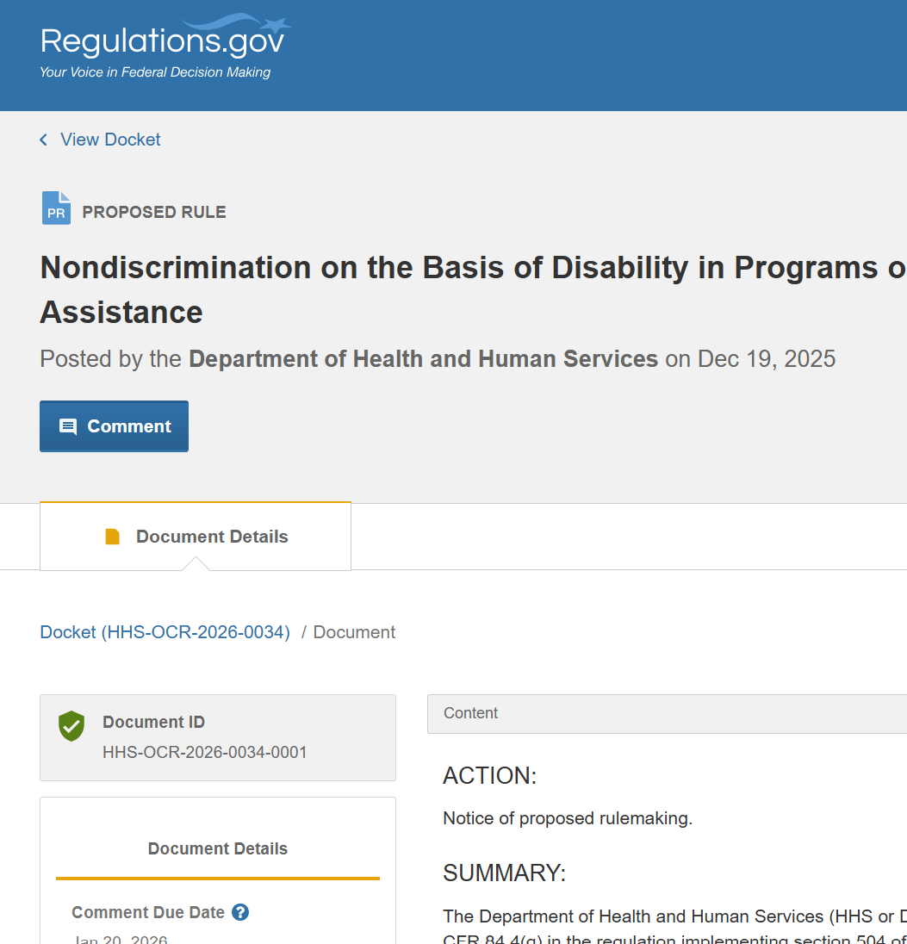
How to File Your Comment Via Regulations.gov [continued]
Select the blue Comment button
27

Slide 28
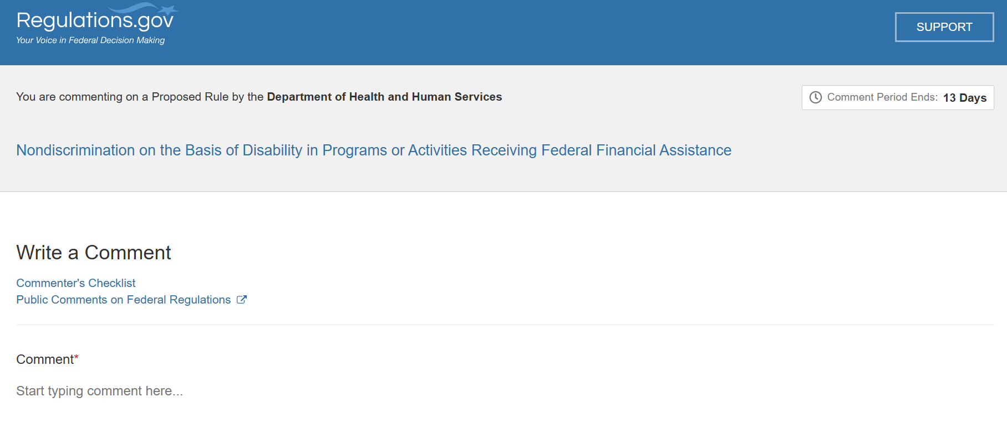
How to File Your Comment Via Regulations.gov [continued]
Type or paste your comment in the comment field if it fits. To fit, your comment must be less than 5,000 characters (about 800 to 1000 words).
28

Slide 29
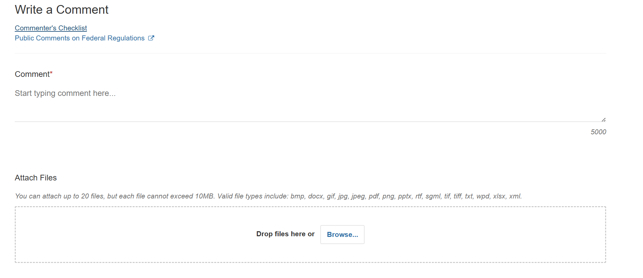
How to File Your Comment Via Regulations.gov [continued]
You can also attach your comment to a document, like a Word or PDF file. The PDF file must be readable (not a scanned document).
29

Slide 30
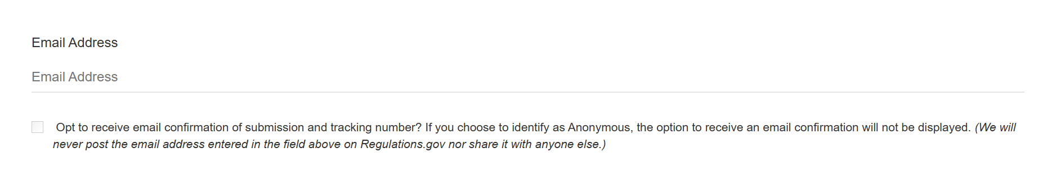
How to File Your Comment Via Regulations.gov [continued]
Enter your email address if you choose to provide it. You can leave it out if you want to remain anonymous. You can also select the checkbox to opt to receive email confirmation of your submission and a tracking number, but it is not required.
30

Slide 31
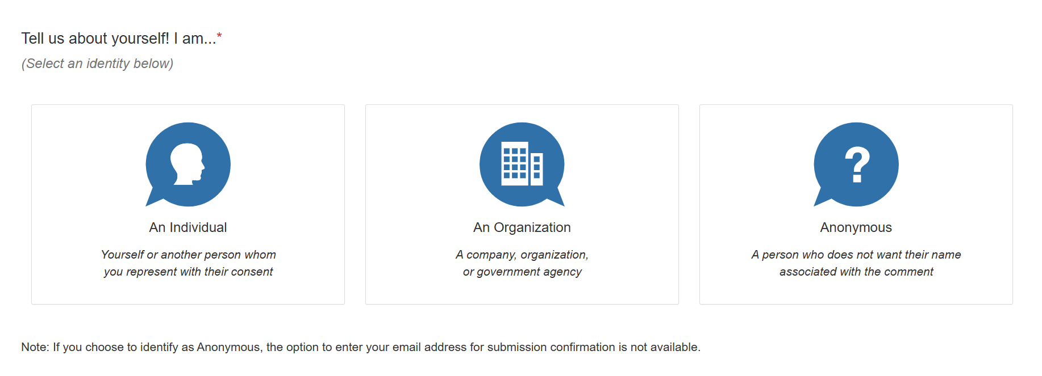
How to File Your Comment Via Regulations.gov [continued]
Select whether you are an Individual or an Organization, or whether you want to be anonymous. Note that all comments are made available to the public, even if you select “Anonymous.”
31

Slide 32
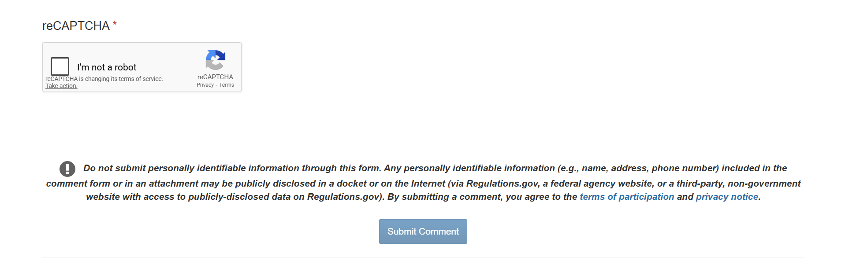
How to File Your Comment Via Regulations.gov [continued]
Select the box that says, “I’m not a robot”
Review your comment and click on the blue Submit Comment button
32

Slide 33
How to File Your Comment – By Mail
Your comment must be postmarked by January 20, 2026, and addressed to:
U.S. Department of Health and Human Services
Office for Civil Rights
Attention: Disability NPRM, RIN 0945-AA27
Hubert H. Humphrey Building, Room 509F
200 Independence Avenue SW
Washington, DC 20201
Note: A new rule by USPS explains that postmarks are added at processing centers, and may not be added on the same day as mail is collected by a letter carrier or dropped off at a post office. To be sure, you can mail your comment before January 20 or ask for a manual postmark at the counter.
33
Notes:
Link:
https://www.federalregister.gov/documents/2025/11/24/2025-20740/postmarks-and-postal-possession

Slide 34
Next Steps
Make sure you file your comments to oppose the Section 504 rule by January 20, 2026
Make sure you file comments in the other two rulemakings by February 17, 2026 at 5pm ET.
The Center for American Progress has a toolkit. Follow the instructions on how to submit comments and what you might want to include in your comments.
You can also submit comments using this portal, provided by the Human Rights Campaign.
If you don’t have time to submit a comment of your own, you can sign this petition by the ACLU to oppose the rules.
34
Notes:
Links:
https://www.americanprogress.org/article/how-to-submit-public-comments-to-oppose-proposed-rules-restricting-transgender-health-care-access/
https://act.hrc.org/page/183931/petition/1?ea.tracking.id=or_gnr_hrc_NPRMcomments
https://act.aclu.org/a/tell-hhs-hands-our-care

Slide 35
Questions and Answers
35

Slide 36




Connect With Us
Phone: 510.644.2555
Toll Free: 800.348.4232
BlueSky: dredf
Email: info@dredf.org
Facebook: dredf.org
Website: www.dredf.org
Instagram: dredf1979
Linktree: dredf
LinkedIn: disability-rights-education
-and-defense-fund
YouTube: DredfOrg
TikTok: disabilityrights
36

