Slide 1



Federal Retreat, California Resolve
Emotional Support Animals After HUD's Policy Reversal

Slide 2
Housekeeping
This is a Zoom Webinar
All attendees are muted, and cameras are turned off.
If there is enough time, we will take questions at the end.
Live Captioning is Available
Select “Show Captions” in the Zoom meeting control bar to enable captions, and to view the full transcript. There is a drop down menu to choose English or Spanish language.
Or, to get the captions in a web browser, go this link bit.ly/DREDF-CART, which will also be dropped in the Chat.
Please use the Q&A or reach out to Ally Cline, by email at acline@dredf.org with any questions and/or comments.

Slide 3
Presenters
Michelle Uzeta, Esq.
Executive Director
Disability Rights Education & Defense Fund
muzeta@dredf.org
Kara Brodfuehrer, Esq.
Attorney III
California Civil Rights Department

Slide 4

DREDF is a national cross-disability law and policy center founded in 1979 as a unique alliance of disabled adults and parents of children with disabilities who were leaders in the disability rights and independent living movements.
DREDF's mission is to advance and defend the civil and human rights of people with disabilities through legal advocacy, training, education, and public policy.
DREDF focuses its work on issues in which disability, poverty, race, ethnicity, gender, immigration status, and LGBTQI+ status intersect, and operates in a manner consistent with core principles of equality of opportunity, disability accommodation, accessibility, and inclusion.

Slide 5

Mission
Protect the people of California from unlawful discrimination in employment, housing, and public accommodations, and from hate violence and human trafficking.

Slide 6
Civil Rights Department (CRD) disclaimer
This guidance is for informational purposes only, does not establish substantive policy or rights, and does not constitute legal advice.
This information is based on the most recent guidance as of the date of this training. It is the responsibility of the attendee to be aware of changing guidance and laws.
The opinions expressed by the other presenters do not necessarily reflect the opinions of CRD.
Notes:
Note: If you are co-presenting with a representative from another entity, consider adding the following language if appropriate: The opinions expressed by the presenters do not necessarily reflect the opinions of CRD.

Slide 7

Topics & Learning Outcomes
Level set: service animals v. ESAs.
Explain HUD’s May 22, 2026 and its impact.
Identify the remedies that still remain for assistance animal users.

Slide 8
Level Set

Slide 9
Obligations Under the Fair Housing Act
The Fair Housing Act (FHA) makes it unlawful for a housing provider to refuse to make changes to policies, practices or procedures that a person with a disability may need to have equal opportunity to enjoy and use a dwelling. “Reasonable Accommodation.”
One common request housing providers receive is for a reasonable accommodation to providers’ pet or no animal policies so that individuals with disabilities are permitted to use assistance animals in housing, including public and common use areas.
42 U.S.C. § 3604(f)(3)(B); 24 C.F.R. § 100.204

Slide 10

What is an Assistance Animal under FHA?
Prior to HUD’s May 22, 2026, Memo, an animal that
Works, provides assistance, or performs tasks for the benefit of a person with a disability (service animal).
That provides emotional support that alleviates one or more identified effects of a person’s disability (emotional support animal or ESA).
Not limited to dogs.

Slide 11

Important Note!
The definitions have lived entirely in sub-regulatory guidance.
Prior operative documents were the 2013 notice (FHEO-2013-01) and the January 28, 2020 notice (FHEO-2020-01) (Both were rescinded in September 2025)

Slide 12
Obligations Under the ADA
Since March 15, 2011, the DOJ regulations recognize only dogs as service animals under Titles II and III of the ADA — defined as a dog individually trained to do work or perform tasks for a person with a disability (28 C.F.R. §§ 35.104, 36.104).
One carve out – for miniature horses.
ESAs are not recognized. No access rights attach.

Slide 13


What Did HUD Do?

Slide 14
May 22, 2026 Enforcement Guidance Memo
Announced HUD’s enforcement shift away from housing discrimination cases concerning ESAs.
Announced intent to pursue only cases “involving animals trained to provide disability-related assistance.”
Makes permanent the September 2025 recission of HUD’s prior guidance from 2013 and 2020 that discuss assistance animals, including ESAs, as reasonable accommodations under FHA.

Slide 15
Specific Changes
Adopts the ADA’s trained-service-animal standard.
Removes the presumption favoring untrained ESAs.
Freezes all open ESA cases for individual review.
Signals future rulemaking — but gives no timeline.

Slide 16
Change 1: It Adopts the ADA Standard
HUD will only recognize animals “individually trained to do work or perform tasks for the benefit of an individual with a disability, including a physical, sensory, psychiatric, intellectual, or other mental disability.”
Comfort or companionship alone does not equal “work” or “task.”
Non-dog species can still count – but only if individually trained.
Eliminates the whole concept of an ESA from federal enforcement.

Slide 17
Changes 2 & 3: Presumption Gone; Cases Frozen
The presumption favoring untrained ESAs is gone.
Open ESA complaints will be sent for individual review under the new standard.
Cases near a discrimination finding will likely close without one.

Slide 18
Changes 4: Memo Signals Future Rulemaking
HUD says it will update its 1989 regulations to match the ADA.
That means public notice, a comment period, and a final rule.
No timeline is given, and the process invites legal challenge.
Until a final rule issues, current regulations stand.

Slide 19

What It Means
in Practice

Slide 20
What Changed for You as a Tenant
A HUD complaint is no longer meaningful for an untrained ESA - only trained animals will get federal enforcement.
HUD will close ESA cases without finding a violation.
A major deterrent against ESA denials and pet fees has been removed.

Slide 21
What “Individually Trained” Means
Must be trained to do a task directly related to your disability.
General comfort and companionship do not count.
No certified trainer required; owner-training can be enough.

Slide 22
Pet Fees and the Henderson Case
Old FHEO guidance: generally no pet fees for assistance animals.
HUD attached Henderson v. Five Properties LLC to the memo.
That case: refusing to waive a pet fee wasn’t automatically illegal.
Federal consequences for charging ESA fees are now less likely.
Legality still depends on your facts and your state’s law.

Slide 23
Your ESA Letter & Existing Approvals
A treating provider’s letter is still meaningful evidence of need for accommodation.
HUD just won’t use it to pursue an untrained-ESA complaint.
Courts and state agencies still weigh that documentation.
Already approved at your home? That approval should stands.
Bigger risk: moving, a new request, or an emboldened landlord.

Slide 24


What Remains: Rights & Remedies

Slide 25
What Did NOT Change
The FHA is still law — its text never required training.
Your right to sue: two years, in federal or state court.
Section 504 of the Rehabilitation Act is unaffected.
State and local fair housing laws are unaffected.
Fair housing organizations can still investigate and sue (but whether they can use federal funding to do so is an unanswered question).

Slide 26
If Your Landlord Says No
Don’t panic — HUD was never your only path.
Put everything in writing and keep copies.
Contact a fair housing or disability rights organization (often free).
In California: file with the CRD or consult a disability rights organization, fair housing organization, or attorney.
Don’t sign away rights or agree to fees under pressure.

Slide 27




Contact Us
Phone: 510.644.2555
Toll Free: 800.348.4232
BlueSky: dredf.bsky.social
Email: info@dredf.org
Facebook: dredf.org
Website: dredf.org
Instagram: dredf1979
Linktree: dredf
LinkedIn: disability-rights-education
-and-defense-fund
YouTube: DredfOrg
TikTok: disabilityrights
27

Slide 28

I live in California, how will HUD’s new guidance impact me?
California has always had stronger housing discrimination protections, and this has not changed.
  FEHA, Unruh Civil Rights Act, GC 11135
Refusing to allow a reasonable accommodation for an untrained service animal is still a violation of California law.
CRD will continue taking and enforcing complaints involving untrained ESAs.

Slide 29

Local law can add protections in addition to federal and state law. For example, Los Angeles protects against discrimination based on employment status, which is not recognized by federal or state law.
State law can include protections in addition to the federal “floor”. For example, California protects against discrimination based on criminal history, which is not recognized by federal law.
Federal law sets the “floor” of legal protections. When states have no applicable state law, federal law applies. States with applicable laws may have protections in addition to federal law, but cannot provide less protections than federal law. For example, disability discrimination is protected by federal law, so California must minimally protect against disability discrimination.
Notes:
Los Angeles example: https://civilandhumanrights.lacity.gov/our-enforcement-areas-protected-classes

Slide 30

Housing Protected characteristics (Federal)
(California)
Religion
Sexual Orientation
Disability
Immigration Status
National Origin
Ancestry
Familial Status
Age
Color
Gender
Gender Identity
Race
Medical Condition
Genetic Information
Primary Language
Ethnicity
Marital Status
Military/Veteran Status
Gender Expression
Citizenship
Source of Income (ex. Section 8)
Can be actual, perceived, or associated with a person with protected characteristics
Art by Disabled and Here

Slide 31

California law is clear that housing providers must allow untrained ESAs if there is a disability-related need for one.
Housing providers are allowed to have rules regarding pets, including prohibiting pets; prohibiting certain types of pets, such as large or wild animals; or prohibiting nuisance activity caused by pets, such as constant barking
However, if a tenant or resident has a disability-related need for an ESA, the housing provider must allow the person to have the animal as a reasonable accommodation, unless the housing provider can show that an exception applies

Slide 32

Can a housing provider ask me for proof of my need for an untrained ESA?
Yes
But only enough info to document the disability related need. No diagnosis or medical records are necessary.
No documentation required if a disability is obvious.

Slide 33

Does documentation of the need for an ESA have to come from a licensed medical professional?
No
Documentation can come from any reliable third party who is in a position to know about the individual’s disability or the disability-related need for the ESA, such as a:
Therapist
Social worker
Non-medical service provider
Member of a peer support group
Parent, child, or other relative
A person’s own credible statement

Slide 34

Poll: Can a housing provider charge a fee or rent to have an ESA?
No
Housing providers may not charge someone with an ESA a “pet deposit,” “pet rent,” or any other fee or rent because of the ESA.
  This is true even if they charge other tenants such additional fees, deposits, or rent
In addition, a housing provider may not require someone with an ESA to obtain liability insurance covering the animal
But still liable for damage done by ESA that is more than normal wear and tear

Slide 35

Must an ESA be registered to qualify for a reasonable accommodation?
No
There is no legal requirement that an animal must be “registered” or “certified” for it to serve as an ESA.
Businesses that claim to register or certify ESAs are charging for a service that is unnecessary to establish the necessity of a reasonable accommodation.

Slide 36
When may a housing provider deny a request for an ESA that helps someone manage their disability?
After a tenant or resident has shown that they have a disability-related need for an ESA, the housing provider may deny the request only in the following, limited circumstances:
  An undue financial burden
  A fundamental alteration to the housing provider’s business, or
  When the animal constitutes a direct threat to the health or safety of others or would cause substantial physical damage to the property of others, and that harm cannot be sufficiently reduced or eliminated by a reasonable accommodation

Slide 37

Can someone have more than one ESA?
Yes
Housing providers can ask for documentation of why each animal is necessary.
Housing provider may consider whether the total impact of multiple animals in the same housing unit amounts to an undue burden or fundamental alteration of the housing program

Slide 38

May a housing provider limit the breed, size, or weight of ESAs?
No
A determination of a direct threat must be analyzed on a case-by-case basis.
Can’t be based on stereotypes.
Insurance companies must also allow Ras for ESAs even if they exclude certain breeds in homeowners insurance policies.

Slide 39
Did Assembly Bill 468 change California fair housing law regarding ESAs?
NO
In 2021, California enacted Assembly Bill 468, which, among other things, places some conditions on health care practitioners providing documentation relating to an individual's need for an emotional support dog, but this does not impact fair housing law and does not affect the rights and responsibilities we are discussing today.
Therefore, housing providers must allow reasonable accommodations for ESAs under the rules described in this presentation and DFEH ESA guidance, including the existing rules regarding what type of documentation establishes someone’s disability-related need for a reasonable accommodation to have an ESA

Slide 40
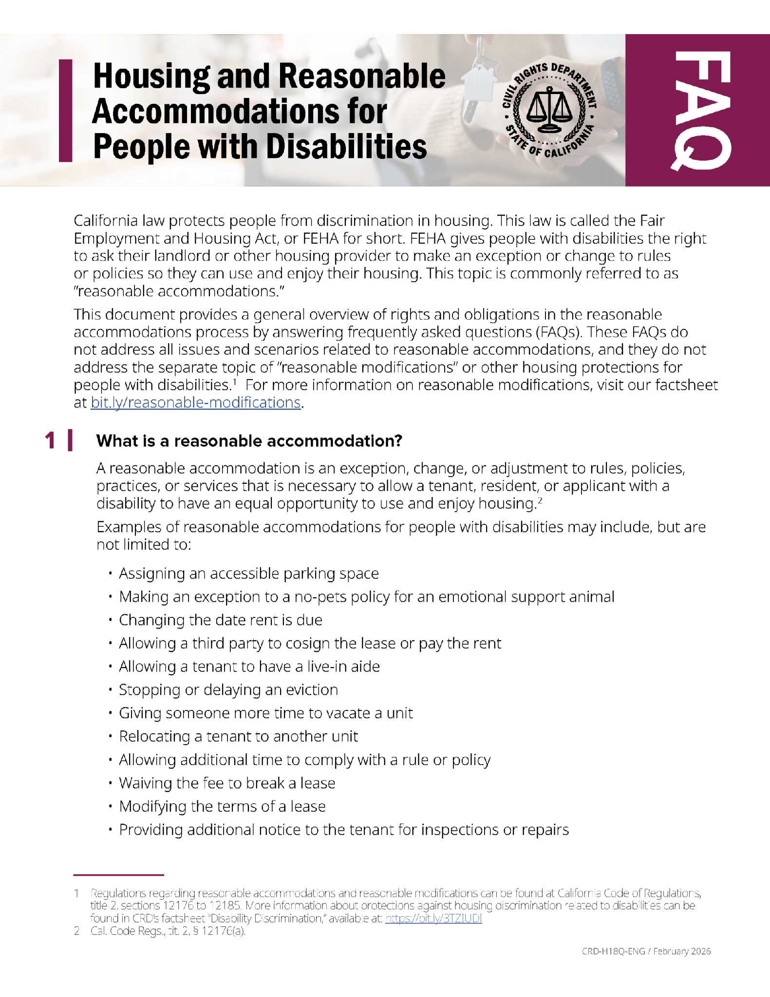
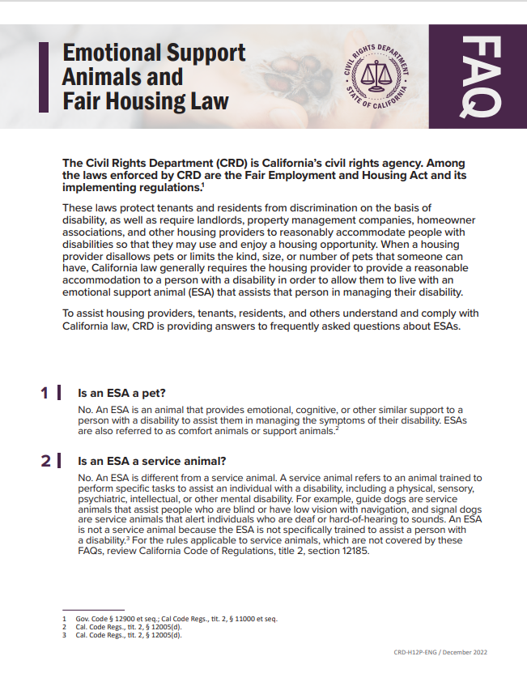
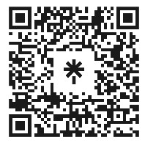
Resources
Access at: https://calcivilrights.ca.gov/Posters/

Slide 41

CRD is now doing webinars three times a month!
Visit CRD’s website to sign up for webinars!
https://calcivilrights.ca.gov/events/category/crd-webinar-series/

Slide 42


Free on-demand trainings
You can find recordings of many of CRD’s housing and housing related trainings on CRD’s YouTube channel:
www.youtube.com/@calcivilrights

Slide 43

Thank you!
For more information or to file a complaint please contact CRD:
Website: www.calcivilrights.ca.gov
Phone: Contact Center: 800-884-1684 (voice)
California's Relay Service at 711
Email: contact.center@calcivilrights.ca.gov

